Slide 2
Case Presentation: pineal pilocytic astrocytoma
Dr.zavar Hematology resident
Mofid pediatric hospital
92/07/11

Slide 3
A 12 yr-old boy suffering from nausea and fine tremour of upper extermities.

Slide 4
Microscopy (91/12/08):
An infiltrative vascular glial tumor with areas of mild to moderate cellularity and mild atypia.
Cystic changes as well as honey cumb cells resembling oligodendroglioma.
Tumor vessels show areas with extensive hyalinization and focal calcification.
Vast areas of infarct-like necrosis is seen. scattered mitotic figures are noted.
Ki67 proliferation index is about 4-5% in most cellular areas.

Slide 5
Diagnosis:
Infiltrative glial tumor with infarction and endothelial prolifration compatible with anaplastic astrocytoma.

Slide 6
MRI (92/03/01):
Mass in the cavity of 3th ventricular outlet has been near totally vanished just small abnormal enhancement is present in the R.thalamus measuring under 12mm in diameter.
The pattern of enhancement is mostly infavor of small residue for differentiation from post radiation necrosis MRS whould be complementary.
However, associated hydrocephalus has been reduced which is remarkable finding.

Slide 7
Chemotherapy starts (92/03/13):
CCNU * VCR * PRD
Procarbazin * Temozolamide

Slide 8
♣ CT (92/06/30):
▪ Bilateral pleural effusion particular on R.side
▪ Mild pericardial effusion and pericardial thickening
▪ Vascular congestion is noted with central septal thickening in favor of edema.

Slide 9
مشاوره پاتولوژی از فرانسه:
یک تومور هتروژن با کامپوننت اولیگودندروسیتی و به اضافه ناحیه آستروسیتیک پیلوسیتیک و بدون شواهدی از بدخیمی دیده می شود. ناحیه نکروز به نظر میرسد که بیشتر ایسکمیک باشد. میتوز تا حدود 1 عدد در
10/hpf
دیده میشود و یافته ای به نفع گانگلیوگلیوم ندارد. وجود نکروز شک به پیلوسیتیک آتیپیک را مطرح میکند هرچند عدم وجود نکروز و عدم وجود آتیپی سلولی شدید و عدم وجود ناحیه با سلولاریته بالا و عدم وجود فاکتور پرولیفراسیون
MIB-1 and Ki67
بیشتر در نواحی که واسکولاریته زیاد است دیده می شود ˛ به نظر می رسد هیپوتز پیلوسیتیک آستروسیتوم کلاسیک بیشتر مطرح است.

Slide 10
Pleural eff. :
Glu:122
WBC:130
P=80
L=20
Pr:1142
RBC:170
Culture (bactec): ▬
Fungal smear: ▬
TB-PCR: ▬

Slide 11
Primary tumors of the CNS are the second most common neoplasms of childhood.
2.5% or less of childhood brain tumors and most commonly arise during the first decade of life, especially in infancy.
Usually cause compression of the third ventricle with resultant hydrocephalus, vomiting, headaches, and sornnolence.
pizzo 2011, p:791

Slide 15
Astrocytomas grading (WHO):
Grades I or II >>> are nonmalignant and may be referred to as low-grade (JPA).
Grades III and IV >>> are malignant and may be referred to as high-grade astrocytomas.
Anaplastic astrocytomas are grade III astrocytomas. Grade IV astrocytomas are known as glioblastoma multiforme.

Slide 16
Age: Younger children (age <5 years) showed higher rates of tumor progression but there was no significant age effect for OS in multivariate analysis.
Tumor location: Cerebellar and cerebral tumors showed higher PFS at 8 years compared with patients with midline and chiasmatic tumors.
medscape

Slide 17
Prognosis: Low-grade astrocytomasLow-grade astrocytomas (grade I [pilocytic] and grade II) have a relatively favorable prognosis, particularly for circumscribed, grade I lesions where complete excision may be possible. Tumor spread, when it occurs, is usually by contiguous extension; dissemination to other CNS sites is uncommon, but does occur.
Although metastasis is uncommon, tumors may be of multifocal origin, especially when associated with NF1.
Unfavorable prognostic features include young age, fibrillary histology, and inability to obtain a complete resection. Elevated MIB-1 labeling index, a marker of cellular proliferative activity, is associated with shortened PFS in patients with pilocytic astrocytoma. A BRAF-KIAA fusion, found in pilocytic tumors, confers a better clinical outcome.
National Cancer Institute 2012

Slide 19
MRI is the optimum modality although CT scanning is more specific about the presence of calcification. Furthermore CT scanning is usually the first radiological investigation performed in the acute or emergency setting, and therefore is very frequently performed prior to MRI.
British Neuro-Oncology Society/NCAT Rare Tumour Guidelines (June 2011)

Slide 20
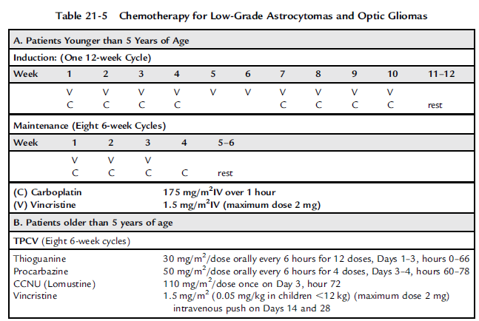

Slide 21
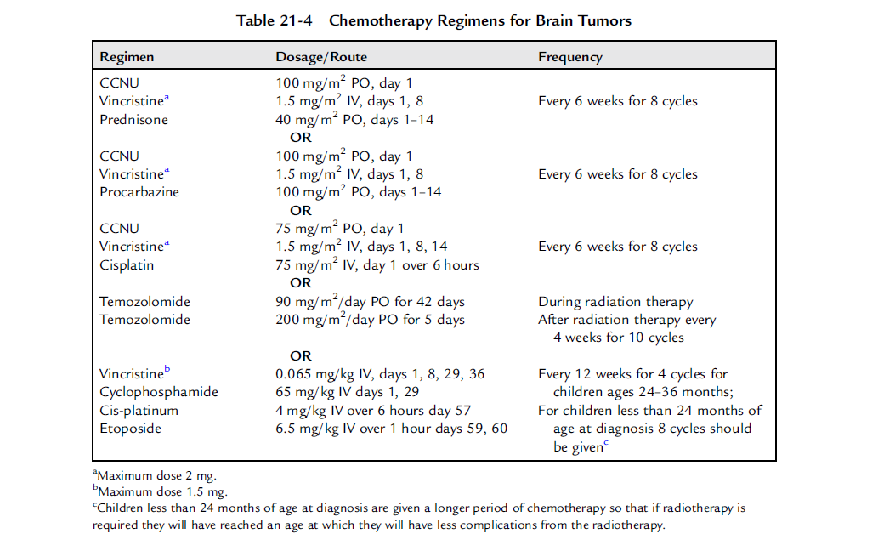

Slide 22
Etoposide (100 mg/m2, days 1, 2, 3) over one to four hours prior to cisplatin and ifosfamide.
Cisplatin (20 mg/m2, days 1, 2, 3, 4, 5) over one hour, and must be accompanied by an adequate diuresis.
Ifosfamide (1500 mg/m2, days 1, 2, 3, 4, 5) after cisplatin, over 3 hours by continuous infusion with hydration and mesna (uromexitan).
Mesna should be given at a dose of 1800mg/m2/day (120% of the daily Ifosfamide dose) and continued for at least 12 hours following completion of the last dose of ifosfamide.

Slide 23
Hydration fluid: at least three hours before ifosfamide and continue throughout the infusions of cisplatin and ifosfamide, at a total rate of at least 125ml/m2/hour (3L/m2/day) and continue until 24 hours from the end of the cisplatin infusion. 2.5% dextrose 0.45% saline should be used with potassium, magnesium and calcium additives:
20mmol KCl per litre
10mmol MgSO4 per litre
0.6mmol Ca Gluconate per litre
British Neuro-Oncology Society/NCAT Rare Tumour Guidelines (June 2011)

Slide 24
Surgery is often the treatment of choice. Total resection is often possible.
After total resection the 10-year survival rate is 90%. After incomplete resection, the 10-year survival rate is as high as 45%. Morbidity is determined by the location (and accessibility) of the tumor and with the associated complications for a tumor resection.
Wikipedia.org

