Slide 1
In The Name Of GOD

Slide 2
Pediatric acute lymphoblastic leukemia: where are we going and how do we get there?
bloodjournal.hematologylibrary.org by guest on August 10, 2012.
Ching-Hon Pui,1-3 Charles G. Mullighan,2 William E. Evans,3,4 and Mary V. Relling3,4
Departments of 1Oncology and 2Pathology, St Jude Children’s Research Hospital, Memphis, TN; 3University of Tennessee Health Science Center, Memphis, TN;
and 4Department of Pharmaceutical Science, St Jude Children’s Research Hospital, Memphis, TN

Slide 3
Precise risk stratification
increase in cure rate can be expected with the development of novel targeted treatment through high-throughput genomics

Slide 4
We discuss:
current treatment and to improve the cure rate and quality of life of the patients.

Slide 5
gene expression, DNA copy number alterations, and more recently, next-generation wholegenome and transcriptome sequencing have provided potential targets for therapy
monoclonal antibodies, small molecule inhibitors, chemotherapeutics, and cell-based treatment strategies.

Slide 6
Emerging leukemia subtypes
Traditionally, ALL has been classified into precursor T (or T-cell), precursor B, and B-cell (Burkitt) phenotypes
Recent studies have identified a novel high-risk immature T-cell subtype, termed “early T-cell precursor” ALL, which is characterized by immunologic markers and a gene expression profile reminiscent of double-negative 1 thymocytes that retain the ability to differentiate into both T-cell and myeloid, but not B-cell, lineages.

Slide 7
Mutational spectrum of this subtype shares characteristics of acute myeloid leukemia, and the transcriptional profile of the blasts is similar to that of normal hematopoietic stem cells and granulocytemacrophage precursors, suggesting that this subtype of leukemia is a stem cell disease

Slide 8
The mutations frequently involve genes regulating hematopoietic development (GATA3, ETV6, RUNX1, IKZF1, and EP300), cytokine receptor and RAS signaling (NRAS, KRAS, FLT3, IL7R, JAK3, JAK1, SH2B3, and BRAF), and histone modification (EZH2, EED, SUZ12, SETD2, and EP300).

Slide 9
findings suggests that patients with early T-cell precursor ALL may benefit from new therapies that exploit the myeloid or stem cell features of this leukemia, such as high-dose cytarabine or epigenetic therapy,14 a hypothesis that remains to be proven.

Slide 10
there is no consensus on the specific genotypes used for treatment stratification. Thus, different favorable (hyperdiploidy 50; trisomies 4, 10, and 17; ETV6-RUNX1) and unfavorable (hypodiploidy 44; intrachromosomal amplification of chromosome 21; BCR-ABL1) genotypes have been used by various study groups to direct therapy

Slide 11
Pre-B ALL with the t(1;19) (q23;p13) and expression of the TCF3-PBX1 fusion, once considered a high-risk entity, is not even prospectively identified by some study groups
We assert that this genotype should still be identified for intensification of intrathecal therapy because of its associated risk of CNS relapse in the context of clinical trials with improved systemic contro

Slide 12
We hypothesized that improved hematologic control might have increased the risk of CNS relapse in these patients because bone marrow relapse and CNS relapse can be competing events

Slide 13
this hypothesis could also explain the seemingly paradoxical findings in a randomized study of the Children’s Oncology Group (COG), showing improved CNS control but inferior survival of patients treated with triple intrathecal therapy compared with those treated with intrathecal methotrexate therapy.

Slide 14
Primary genetic abnormalities can be identified in 75% to 80%
but in virtually all cases with the addition of genome-wide analyses
Of several newly discovered subtypes, one is characterized by increased CRLF2 and commonly with a concomitant JAK1/2 sequence mutation
5% to 7% of children with precursor B-cell ALL and, remarkably, in approximately 50% of the cases with Down syndrome.

Slide 15
non-Down syndrome patients with this genotype probably require more intensive therapy because they generally have a poor outcome
The prognostic impact with Down syndrome remains to be determined.

Slide 16
Another novel high-risk subtype, termed “BCR-ABL1–like” ALL, also has a precursor B-cell phenotype, exhibits a gene expression profile similar to that of BCR-ABL1–positive ALL with an IZKF1
10% of children with ALL
half of the BCR-ABL1–like cases have a CRLF2 rearrangement, with concomitant JAK mutations in one-third of the CRLF2-rearranged cases.

Slide 17
This genotype is associated with a high risk of relapse
we would test patients with refractory or relapsed leukemia for these subtypes, as they may benefit from targeted therapy
Table 2

Slide 18
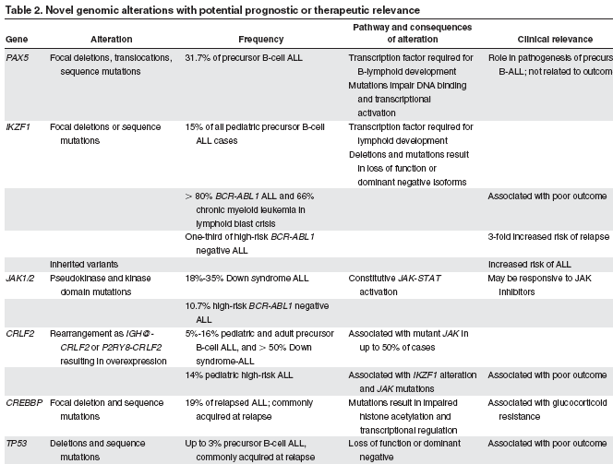

Slide 19
Potential therapeutic targets: the search fo personalized medicine
The remarkable improvement of early treatment outcome in children with BCR-ABL1–positive ALL with the addition of an ABL1 tyrosine kinase inhibitor (imatinib) to an intensive treatment regimen of the COG

Slide 20
An international study has been initiated to test whether the intensity of chemotherapy can be reduced and cranial irradiation limited to only patients with overt CNS leukemia at diagnosis by substitution of imatinib with a more potent second-generation inhibitor (dasatinib) that penetrates readily to the CNS.

Slide 21
The identification of activating mutations of the Janus kinases (primarily JAK2, but also JAK1 and JAK3) in high-risk ALL has led to a COG phase 1 clinical trial of JAK inhibitor (ruxolitinib) for relapsed and refractory malignancy

Slide 22
Among genetic abnormalities identified in BCR-ABL1–like cases, EBF1-PDGFRB or NUP214-ABL1 fusion responded to ABL1 tyrosine kinase inhibitors (which also inhibit PDGFRB), and BCR-JAK2 or mutated IL7R responded to JAK2 inhibitor in preclinical studies.

Slide 23
gene sequencing study:
suggesting RAS/MAPK signaling as a potentia target for therapy
association of high expression of FLT3 with a poor outcome in infant ALL cases without MLL rearrangement suggests clinical trials testing an FLT3 inhibitor
It may also be of interest to test the multikinase inhibitors sorafenib and crenolanib, which have significant activity in acute myeloid leukemia with mutated FLT3, in infant cases.

Slide 24
The findings of aberrant DNA methylation in the majority of MLL-rearranged infant ALL cases and mutations of CREBBP encoding histone acetyltransferase CREB-binding protein in relapsed ALL cases raise the possibility of using epigenetic treatment (eg, DNAmethyltransferase inhibitor and histone deacetylase inhibitor) in these patients.

Slide 25
it would seem reasonable to search for them in refractory or relapsed cases so that the affected patients could benefit from targeted therapy.

Slide 26
Toward more precise risk stratification
Precise assessment of the risk of relapse in individual patients is essential to ensuring that intensive treatment is limited primarily to high-risk cases, thus sparing low-risk cases from undue toxicities.

Slide 27
This point is well illustrated by recent experience in our Total Therapy XV study, where treatment with intensive asparaginase and perhaps also high-dose methotrexate might have contributed to the outstanding outcome of patients with ETV6-RUNX1 fusion, especially those with poor early treatment response.
Table 3

Slide 28
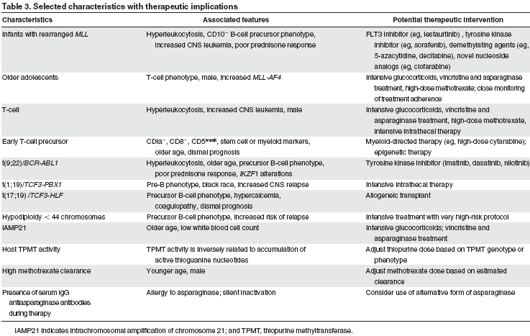

Slide 29
the response to remission induction therapy as determined by MRD level is the most important prognostic indicator
If so, why did the level of MRD at the end of remission induction lack prognostic significance in a recent COG study for Philadelphia chromosome-positive ALL,18 and remission induction failure did not predict a dire outcome of precursor B-cell ALL without other adverse features in an international cooperative group study?57

Slide 30
A possible explanation is that the ABL1 tyrosine kinase inhibitor was not used during remission induction in the COG study, and antimetabolites (including high-dose methotrexate), which are effective treatment components for precursor B-cell ALL (especially those with hyperdiploidy), tend to be used only after remission induction.

Slide 31
In this regard, the St Jude Total Therapy XV study used MRD level at day 46 of remission induction (after treatment with prednisone, vincristine, daunorubicin, asparaginase, cyclophosphamide, cytarabine, and mercaptopurine) for final risk assessment.7 Likewise, in the AIEOP-BFM-ALL 2000 study, MRD at the second time point on day 78 (after treatment with the same 7 drugs) was found to be the most important predictor of treatment outcome, superseding the MRD result at the first time point on day 33 (after treatment with the first 4 drugs).58

Slide 32
Optimizing remission induction therapy
it should be emphasized that neither molecular nor immunologic remission after induction therapy is required for cure.
early studies showed that intensive induction therapy may not be necessary for standard-risk patients, provided that they receive adequate postremission intensification therapy.59,60

Slide 33
In our Total Therapy XV study, patients with an MRD level of 0.01% to 0.99% at the end of induction received intensified postremission therapy and achieved a 5-year survival of 90.9% plus or minus 5.4%, a rate similar to that (94.5% 1.9%) for patients who had negative MRD at the end of induction therapy.7

Slide 34
remission induction should be moderate in intensity for standard-risk patients,and Down syndrome who are more susceptible to fatal infectious complications.
myelosuppressive therapy should be temporarily delayed in the presence of infection during induction, even in high-risk patients.

Slide 35
Based on the finding of sensitivity of normal bone marrow lymphoid progenitors (CD19, CD10, and/or CD34) to corticosteroids and other antileukemic drugs, a simple and inexpensive assay for MRD detection has been developed to identify such patients during remission induction therapy

Slide 36
Two recent studies showed that dexamethasone, given at 10 mg/m2 per day during remission induction, improved outcome in patients with T-cell ALL and a good response to 7 days of upfront prednisone treatment, and in children under 10 years of age with precursor B-cell ALL, compared with prednisone administered at 60 mg/m2 per day.66,67

Slide 37
it should be noted that the efficacy of prednisone and dexamethasone is dose dependent; and when the dose ratio of prednisone to dexamethasone is greater than 7, event-free survival (EFS) estimates are comparable with the 2 drugs, although dexamethasone still appears to yield improved CNS control.65 These findings notwithstanding, an excellent outcome can also be achieved with a relatively low dose of prednisone (40 mg/m2 per day) during remission induction, provided that postremission treatment is adequate and includes dexamethasone, as shown in our Total Therapy XV study.

Slide 38
Dexamethasone at a dose of 10 mg/m2 is not recommended for remission induction in children 10 years of age or older with precursor B-cell ALL because of the high rates of toxicity and toxic death associated with the treatment,66 a finding partly related to the slower clearance of dexamethasone in this age group

Slide 39
Selecting effective consolidation/intensification reinduction therapy
This phase of therapy is essential for all patients with ALL
Intensification of methotrexate treatment clearly improves outcome in patients with intermediate-risk or high-risk ALL, but its utility in low-risk (or so-called standard-risk) patients is still disputed.

Slide 40
Although the addition of escalating intravenous methotrexate (initial dose 100 mg/m2, increasing by 50 mg/m2 every 10 days for 4 doses) without leucovorin rescue has been shown to improve the outcome of standard-risk ALL,71 it was not as effective or less toxic than high-dose methotrexate with leucovorin rescue in a recent COG study for high-risk(!!) ALL.

Slide 41
we recommend the infusion of high dose ( 5 g/m2) over 24 hours for T-cell cases and those with TCF3-PBX1 fusion.69,73
For patients who receive such high dose, we would also individualize the dosage to achieve the desired steady-state plasma concentration (65M) not only to optimize antileukemic effects but also to reduce toxicity

Slide 42
In COG studies, intensification treatment for 6 months is as effective as 10 months of such therapy for standard-risk patients and high-risk patients with a rapid early response.74
Whether high-risk slow early responders would benefit from prolonged intensification therapy remains uncertain.

Slide 43
altered dosing of dexamethasone during delayed intensification, by giving it on days 1 to 7 and days 15 to 21 for 2 courses rather than on days 1 to 21 for 1 course, significantly reduced the incidence of osteonecrosis in a COG study.

Slide 44
10% to 60% of the patients would develop hypersensitivity
One-third of the patients without clinical hypersensitivity reactions may also develop IgG antibodies that can inactivate asparaginase, leading to suboptimal asparagine depletion(!!desensitisation)

Slide 45
IgG antibodies, with or without clinical hypersensitivity, can lead not only to decreased exposure to asparaginase but also to high clearance of dexamethasone when given concomitantly

Slide 46
Routine antibody monitoring is not being implemented
testing could be useful in some clinical conditions
measurement of antibodies is an excellent tool for diagnosing

Slide 47
PEG-asparaginase treatment can still yield a therapeutic level of asparaginase in patients with low to intermediate antibody(!!) levels against E coli
some patients may have antibodies to the nonprotein PEG moiety resulting in rapid clearance of PEG-asparaginase,79 but they can still respond to native E coli asparaginase.

Slide 48
In the absence of a monitoring tool, the serum albumin level may serve as a biomarker of asparaginase activity.64
Pancreatitis and thrombosis
Most frequent dose-limiting asparaginase-related toxicities, occurring more often in patients 10 years of age or older

Slide 49
Concomitant administration of other drugs may potentiate or contribute to the risk and severity of pancreatitis (eg, glucocorticoid, mercaptopurine, trimethoprim sulfamethoxazole) and thrombosis (glucocorticoid).

Slide 50
With low-molecular-weight heparin prophylaxis and close monitoring, most patients with thrombotic complications can complete the scheduled asparaginase treatment
In one study, patients with mild pancreatitis were rechallenged after resolution of symptoms and normalization of pancreatic enzymes, with two-thirds having a second episode of pancreatitis after receiving an average of 7 or or 8 additional doses of asparaginase.

Slide 51
Pharmacogenomics-guided continuation
(maintenance) treatment: gaining a therapeutic edge
The combination of weekly low-dose methotrexate and daily mercaptopurine, with or without pulses of dexamethasone and vincristine, constitutes the standard “backbone” of ALL continuation regimens
Tailoring the dosages of methotrexate and mercaptopurine to the limits of tolerance has been associated with a better outcome.

Slide 52
In most clinical trials, both drugs are increased or decreased in parallel without ascertaining the genetic polymorphism status of thiopurine methyltransferase
patients with an inherited deficiency of this enzyme are at increased risk of mercaptopurine-induced toxicities

Slide 53
among patients with poor tolerance to continuation treatment, mercaptopurine dosage can be selectively reduced, whereas methotrexate can still be given at full dosage in those with a deficiency of the enzyme. This approach has reduced the likelihood of acute myelosuppression without compromising disease control

Slide 54
patients with thiopurine methyltransferase deficiency are at greater risk for the development of mercaptopurine-induced myeloid malignancy, particularly if they receive high-dose mercaptopurine (eg, 75 mg/m2 per day).

Slide 55
Thioguanine is more potent than mercaptopurine, but its prolonged use at a dose more than 40 mg/m2 has been associated with profound thrombocytopenia, an increased risk of death, and an unacceptable rate of hepatic veno-occlusive disease ( 20%).86,87

Slide 56
Hence, thioguanine is no longer used for continuation treatment; however, whether its short-term use can improve outcome, especially in terms of CNS control, without causing undue toxicity remains to be determined. Notably, thiopurine methyltransferase also has a significant impact on the pharmacokinetics of thioguanine, and patients with the enzyme deficiency are at an increased risk of developing hepatic veno-occlusive disease.88

Slide 57
We recommend implementation of the guidelines for thiopurine therapy (updates at http://www.pharmgkb.org), based on the association between clinical effects and genotype/phenotype of the enzyme, as recently developed by the Clinical Pharmacogenetics Implementation Consortium.83

Slide 58
In many clinical trials, weekly methotrexate is given orally for convenience and cost savings. We prefer to give it intravenously
adherence rate of less than 95% was associated with an increased risk of relapse in a recent COG study.89(!!weekly dose or total)

Slide 59
The case for complete omission of prophylactic cranial irradiation
Two studies have shown that prophylactic cranial irradiation can be successfully omitted from virtually all patients, regardless of their presenting features, in the context of effective systemic therapy (including high-dose intravenous methotrexate) and intrathecal therapy.4,7

Slide 60
Both studies used triple intrathecal therapy: 13 doses for the non–highrisk patients and 15 to 17 doses for the high-risk patients in the Dutch Childhood Oncology Group protocol ALL-9,4 and 13 to 18 doses in low-risk cases and 16 to 25 doses in standard- or high-risk cases in the St Jude Total Therapy XV study.7

Slide 61
Despite these results, many leukemia therapists still prefer intrathecal methotrexate and are reluctant to omit cranial irradiation from protocols for high-risk patients.
COG study (CCG 1952):triple intrathecal therapy resulted in a significantly lower incidence of isolated CNS relapse than did treatment with intrathecal methotrexate (6-year cumulative risk: 3.4% 1.0% vs 5.9% 1.2%). The impact was even more pronounced in patients with a CNS2 status (6-year cumulative risk: 7.7% 5.3% vs 23.0% 9.5%)

Slide 62
significantly more hematologic and testicular relapses occurred among patients treated with triple intrathecal therapy than among those receiving intrathecal methotrexate, resulting in a significantly inferior survival for the former group (90.3% 1.5% vs 94.4% 1.1%).

Slide 63
we would argue that triple intrathecal therapy used together with effective systemic chemotherapy, at least in patients at high risk of relapse, would allow cranial irradiation to be omitted in this subgroup.

Slide 64
adding intravenous methotrexate for patients treated with triple intrathecal therapy improves outcome by reducing both CNS and non-CNS relapses, whereas adding it for those treated with intrathecal methotrexate yields little benefit.

