Slide 1
ALPS

Slide 2
1390/6
A 5-yr-old girl presented with fever, malaise and onycholysis of 10 days duration.
CBC : Mild anemia, ESR :40
Physical exam: bilateral cervical LAP, enlarged tonsils, splenomegaly (7-8cm BCM), falling nails and toes.
Chest CT scan: patchy nodular and alveolar infiltration in both lung fields, triangular pleural based nodule in Lt lung and multiple nodules in Rt lung. Hilar, mediastinal and axillary LAP.
Abdomen CT scan :Hepatosplenomegaly and para-aortic LAP
Sinus CT scan: opacification of Lt maxillary sinus + opacification of left mastoid(mastoiditis)

Slide 3
HIV- ELISA: neg,
Leishmania: neg, PPD :neg,
ACE: 63( mildly increased)[R/O; sarcoidosis]
Collagen vascular: neg, Coombs test: neg
BMA & biopsy: Nl
Flowcytometry: Nl
Doppler ultrasound of portal vein,splenic and hepatic veins: Nl
Echocardiography: Nl
Bone survey: Nl, decreased density
Ophthalmoscopy: Nl

Slide 4
1390/9
Chest CT scan: Bihilar, Rt paratracheal , subcarinal and azygoesophageal recess adenopathy
Mediastinoscopy and biopsy: Atypical lymphoid hyperplasia
Thoracotomy: Reactive hyperplasia

Slide 5
The patient got afebrile, weight gain, regrowth of nails spontaneously without any tratment,
Chest & Abdomen CT : normal(1390/10)
========================================== She lost follow-up and returned 91/12:
Fever, cough and facial swelling of 1 month duration
Bilateral cervical and inguinal LAP and huge spleen
Mild anemia & thrombocytopenia(140-150,000)
Hypergammaglobulinemia, Increased Ig M
Positive Coomb’s test, Autocontrol: +, Agglutination on crossmatch (Hb dropped to 6.5 , Plt to <50,000 )

Slide 6
1391/12
CXR : bilateral round lesions
CT of chest & abdomen: Multiple variable sized, ill defined lung nodules with surrounding halo, LAP in mediastinal and axillary region with enhancement+ cervical & supraclavicular LAP

Slide 7
New admission on 92/1
Worsening of anemia and thrombocytopenia
+ positive Coomb’s
hypergammaglobulinemia in setting of chronic lymphadenopathy and solenomegaly
EBV-PCR +, viral load:750 copy/ml
AUTOIMMUNE LYMPHOPROLIFERATIVE SYNDROME

Slide 8
Autoimmune lymphoproliferative syndrome (ALPS)
Failure of apoptotic pathways of lymphocytes, causes
accumulation of lymphoid mass and persistence of autoreactive T
cells that manifests in childhood with chronic non malignant LAP,
hepatosplenomegaly, and recurring cytopenias.
Cytopenias in these patients can be the result of splenic
sequestration or autoimmune complications manifesting as
autoimmune hemolytic anemia, thrombocytopenia, and
neutropenia.
More than 300 families with hereditary ALPS have now been
described; nearly 500 patients

Slide 9
The first clinical manifestation of ALPS is chronic LAP and/or splenomegaly in an otherwise healthy child
Multilineage cytopenias that are chronic and refractory are typically most severe in early Childhood and tend to improve in adolescents and young adults.
A large proportion of ALPS patients may present initially with episodes of pallor, and icterus associated with hemolytic anemia, spontaneous bruises, and mucocutaneous hemorrhages because of thrombocytopenia or bacterial infections associated with Neutropenia.
They have potential for developing multiple autoimmune as well as infiltrative lymphoproliferative disorders involving different organ systems.

Slide 10
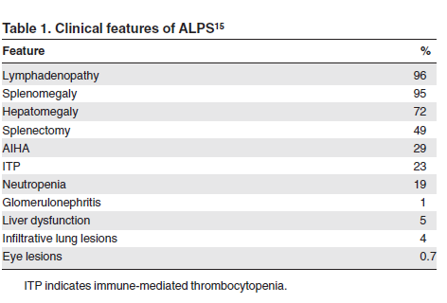

Slide 11
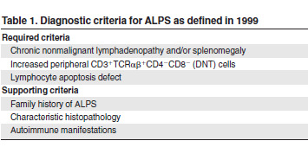

Slide 12
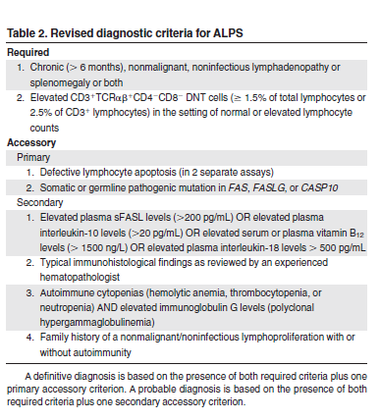

Slide 13
For a definitive ALPS diagnosis a patient has to meet both required criteria and one of the primary accessory criteria (NIH-2009).
A probable ALPS diagnosis can be entertained by the presence of the required criteria and any one of the secondary accessory criteria.
patients with probable ALPS should be treated and monitored in the same way as patients with a definitive diagnosis, but physicians are advised to pursue a genetic or apoptosis assay–based diagnostic workup.
In many cases associated hepatomegaly may also be present, but in isolation it is not a diagnostic criterion
The lymphadenopathy in ALPS typically fluctuates and involves the cervical, axillary, and inguinal chains, although mesenteric, retroperitoneal, pelvic, and mediastinal lymph nodes.

Slide 14
TCR-DNT levels between 1.0- 1.5% of total lymphocytes may be observed in healthy persons or as a reactive phenomenon; hence, their presence as an isolated finding should not prompt screening for ALPS.
The percentage of TCR-DNT cells required for a diagnosis has been revised to be = or >1.5% of total lymphocytes (or 2.5% of T lymphocytes), in the setting of normal or elevated lymphocyte counts and is hallmark of ALPS.
The presence of “lymphopenia” invalidates this criterion.
TCR-DNT cells > 3% of the total lymphocytes or > 5% of T-lymphocyte are essentially pathognomonic for ALPS.

Slide 15
The presence of apoptotic defect in patients who fulfill required criteria is enough for a diagnosis of ALPS.
This test is no longer considered essential for the diagnosis of ALPS, because patients with somatic FAS mutations and germline FASLG mutations typically are found to have normal FAS-induced apoptosis assays.
The demonstration of germline or somatic mutations in FAS, FASLG, or CASP10 is now considered a diagnostic criterion.
Patients with germline CASP8 and somatic NRAS mutations
are now classified separately.

Slide 16
The presence of elevated TCR- DNT cells coupled to high serum or plasma levels of IL-10, IL-18, sFASL or vitamin B12 can accurately predict the presence of germline or somatic FAS Mutations.
Their use greatly facilitates the diagnosis in settings without access to genetic analysis or apoptosis testing.
Two common presenting features of ALPS: autoimmune cytopenias and hypergammaglobulinemia, are now incorporated as diagnostic criteria + lymphoproliferation and elevated TCR-DNTcells indicates a high likelihood of ALPS, these patients should referred for further testing

Slide 17
Lymph node pathologic findings
paracortical expansion due to infiltration of polyclonal TCRDNT
Cells accompanied by follicular hyperplasia and polyclonal plasmacytosis.(reactive hyperplasia)
Marked TCR-DNT cell infiltration in some cases can lead to
architectural effacement of lymph nodes with infiltration of bone marrow and spleen, leading to an erroneous diagnosis of peripheral T-cell lymphoma.
Progressive transforming germinal center (LPD)

Slide 18
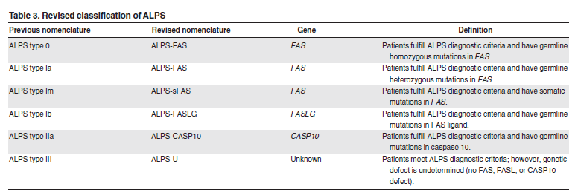
Patients who fulfill diagnostic criteria for ALPS but in whom no genetic diagnosis can be determined should now be classified as ALPS-U (undetermined), instead of ALPS type III.

Slide 19
Classification of ALPS-related disorders
Caspase 8 deficiency state(CEDS)
Patients with mutations in the gene encoding for caspase-8 (CASP8) present with a syndrome of lymphadenopathy, splenomegaly, marginal elevation of DNTs, and defective FAS-induced lymphocyte apoptosis and were previously classified as ALPS type IIb.
These patients also show defective T, B, and NK-cell activation, with consequent recurrent bacterial and viral infections.

Slide 20
RAS-associated autoimmune leukoproliferative disease : RALD
Autoimmune phenomena, LAP/splenomegaly, somatic mutations in NRAS, Nl or elevated TCR-DNT cells
May present with atypical features such as elevations in cells of myeloid origin (monocytosis and granulocytosis) and showed partial overlap with JMML as well as lymph node histopathology not typical of ALPS

Slide 21
Dianzani autoimmune lymphoproliferative disease
Autoimmunity, lymphadenopathy and/or splenomegaly, and
defective in vitro Fas-mediated apoptosis, without elevation
in TCR-DNT cells.
The genetic defect is not known, but an inherited component is
suggested on the basis of the defective FAS function displayed by
relatives of these patients.
Patients may display a wide range of autoimmune
manifestations, and an increased risk of cancer has been reported

Slide 22
X-linked lymphoproliferative disease (XLP1)
Immunodeficiency caused by mutations Or deletions in the SH2D1A gene, and can be included in the spectrum of ALPS-like disorders.
Patients present with fulminant Epstein-Barr virus infection,hypogammaglobulinemia, or lymphoma.

Slide 23
