Slide 1
How I treat relapsed childhood acute lymphoblastic leukemia
Franco Locatelli, Martin Schrappe, Maria Ester Bernardo and Sergio Rutella
Blood.August 15, 2012

Slide 2
Relapsed ALL
80-85% of ALL: cure- prognostic factors -risk-oriented treatment protocols.
Rrelapse:15-20%
Relapsed ALL is the 4’th most common childhood malignancy similar to the number, of children with newly diagnosed AML or Rhabdomyosarcoma.
Intensive combination chemotherapy &
A-HSCT:30-50% relapsed ALL ,cure.

Slide 3
Relapsed -ALL
Novel salvage regimens are needed.

Slide 4
ALL-Relapse
Site of relapse
Time from diagnosis to relapse
Immune- phenotype
-documenting a prognostic significance of this stratification

Slide 5
Relapsed-ALL
Time
Berlin-Frankfurt-Münster (BFM) stratification:
Very early relapses : <18 months from diagnosis
Early relapses: between 18 months and 30 months from remission
Late relapses : 30 months or more from remission
BFM :children with T-cell ALL BM relapses have a much worse prognosis than B-cell precursor (BCP)-ALL
irrespective of the time between diagnosis and recurrence.
Children’s Oncology Group (COG) stratification
Early BM relapse :< 3 years( 36 Mo) from diagnosis
Late BM relapse : > 3(36 Mo) years after diagnosis

Slide 6
Relapse ALL:MRD
Persistence of MRD,( Molecular techniques or flow-cytometry,) after induction/consolidation therapy (i.e., after 5 and 12-13 weeks from the beginning of treatment for relapse:
MRD :0.01% level in most patients with either method
Children with MRD levels below 1x10-3 or 1x10- 4 have been shown to carry a lower risk of recurrence than patients with higher levels of MRD
MRD -HSCT , childhood relapsed ALL :Molecular persistence of leukemia before the allograft heralded a high chance of disease recurrence.

Slide 7
What we do for the treatment of relapsed ALL
Standard salvage regimens for relapsed ALL are still mostly based on different combinations of the same agents used in frontline therapy
remission can be achieved in more than 70% of early relapses & 96% of late BM relapses.
Response rates cluster around 40% in second and subsequent relapse varying doses and schedules

Slide 8
Relapse-ALL
Treatment
A POG study in children with BCP-ALL showed:
higher reinduction rates with weekly rather than biweekly pegylated asparaginase.
A correlation between increased asparaginase levels and improved CR rate was shown.
The BFM group randomized dose and duration of infusion af MTX in reinduction, demonstrating similar outcomes between intermediate-dose (1 g/m2 over 36 hours) and high-dose (5 g/m2 over 24 hours) infusions and have adopted the former for future trials.

Slide 9
Relapse-ALL
Treatment
UK Children's Cancer Group enrolled :239 children with first ALL relapse, HR, IR, SR groups : duration of first CR, site of relapse, and immunophenotype :
Idarubicin or mitoxantrone during induction.
After three blocks of therapy, HR and IR patients with a MRD ≥10-4 cells received allogeneic HSCT,
SR and IR patients with a MRD <10-4 continued chemotherapy.
Progression-free survival (PFS) and OS were significantly higher in the mitoxantrone group, and the differences in PFS were mainly related to a decrease in disease events (progression, second relapse, disease-related deaths).
The 3-year OS was 69% in the mitoxantrone group
,45% in the idarubicin,

Slide 10
Relapse-ALL
Treatment
Italian Pediatric Hematology Oncology Association (AIEOP) has shown efficacy of high-dose
Idarubicin (40 mg/m2) combined with high-dose cytarabine in patients with HR relapsed ALL
Idarubicin was not found to be superior to daunorubicin when used at lower dosage (10-
12.5 mg/m2/week for 3 administrations) in first BM relapse, as suggested by a CCG study

Slide 11
Relapse-ALL
Given the paucity of randomised clinical trials, it remains unclear whether any reinduction
combination in use today is significantly superior to any other.
In our view,:
children with first BM relapse of ALL should be treated with chemotherapy protocols proved to be effective in reinducing & consolidating a second morphological CR

Slide 12
CNS relapse
Radiotherapy together with systemic chemotherapy
POG study, BM relapse in patients with isolated CNS relapse has also been shown to be prevented by administering intensive chemotherapy before
delayed craniospinal radiation.
83 patients – ALL: received systemic and intrathecal chemotherapy for 6 months, followed by craniospinal radiation (24 Gy cranial/15 Gy spinal) and by maintenance treatment.
The 4-year EFS for patients with CR1 lasting >18 or < than 18 months
before CNS relapse was 83% and 46%, respectively.

Slide 13
CNS-Relapse
With the use of contemporary systemic therapy there is no clear evidence of the superiority of craniospinal irradiation over cranial radiotherapy
we use for all patients with CNS involvement a radiation dose of 18 Gy, which is reduced to 15 Gy in case of prior cranial irradiation

Slide 14
Testicular relapse
Either orchiectomy or irradiation have been used as local treatment for children with recurrence of ALL in the testes.
There are no data supporting one approach over the other, although, in principle, orchiectomy may provide a greater chance for definitive eradication of testicular disease.
We use orchiectomy in case of monolateral testicular involvement
; we perform biopsy of the controlateral testis for demonstrating the absence of leukemia localization before administering prophylactic radiotherapy (15 Gy)
.

Slide 15
Testicular relapse
. In case of bilateral testicular localization, we consider either orchiectomy or radiotherapy (24 Gy) as appropriate
If there is no doubt that orchiectomy leads to infertility and abrogates sex hormone production, it has to be underlined that also local radiotherapy at the dosage used for bilateral testicular recurrence is expected to induce infertility and significantly impair hormone production

Slide 16
To whom and when we offer allogeneic HSCT in relapsed ALL
Allogeneic HSCT is frequently used for pediatric patients with ALL in CR2 after marrow Relapse.
Several studies have documented that allogeneic HSCT from matched family donors (MFD) offers high chances of rescuing these patients, and the EFS has been reported to be superior to that achieved with second-line chemotherapy treatment

Slide 17
ALL-Relapds
A-HSCT
BFM ALL-REZ-87 :EFS was better after transplantation than after chemotherapy group only in patients with HR or IR ALL relapse.
Eapen et al: demonstrated an advantage of A-HSCT only in children relapsing within 36 MO from diagnosis when they receive a (TBI)-based conditioning regimen.
COG study CCG-1941 failed to demonstrate an advantage for patients given HSCT over those treated with chemotherapy Only.

Slide 18
ALL-Relaps
A-HSCT
More than 70% of children: lack an HLA identical family donor.
UD selected through high-resolution typing of HLA loci offers minimal or possibly no significant disadvantage compared with employing an HLA-identical Sibling.
BFM :UD-HSCT with chemotherapy for children with ALL in CR2 documented that the probability of EFS was significantly higher for HR (44% vs. 0%), but not IR (39% vs 49%) patients given the allograft.

Slide 19
ALL-Relaps
A-HSCT
Cord blood :opportunity ,to patients lacking an HLA-matched donor.
outcome of umbilical cord blood transplantation (UCBT) and UD-BMT in children with hematological malignancies:
The Eurocord group published a study comparing the outcome of matched unrelated BMT (HLA 6/6 matched), either unmanipulated or T-cell-depleted, with HLA-mismatched UCBT
Incidence of relapse &EFS: the same in the 3 groups.

Slide 20
ALL-Relaps
A-HSCT
Eapen et al: compared results observed in 503 children given UCBT with those of 282 UD-BMT recipients [116 were HLA allele-matched ,HLA-A, -B,-C and DRB1, thus 8 /8) and 166 mismatched.
Of the UCBT recipients, only 35 were matched at the HLA A, B (antigen level) and DRB1 (allele-level).
children ,allele-matched UD-BMT, patients transplanted with 1 or 2 HLA-disparate, high-cell content UCB units ,: similar 5 year EFS,
while an even better outcome was evident for the 35 children given HLA-matched UCBT.

Slide 21
ALL-Relaps
A-HSCT
Ruggeri et al. 170 children with ALL in CR;
77 transplanted in CR2, the 4-year EFS was 44% and high levels of MRD before the allograft predicted an increased relapse risk.

Slide 22
ALL-Relaps
A-HSCT
Tcell-depleted HSCT from an HLA-haploidentical relative (haplo-HSCT) with leukemia relapse risk
Adult patients with AML transplanted in CR, a GvL effect could be mediated by Natural Killer (NK) cells when an HLA-disparate, NK alloreactive relative was employed as donor.

Slide 23
ALL-Relaps
A-HSCT
NK-mediated GvL effect has also been
documented in children with ALL.
European Blood and Marrow Transplant (EBMT) registry :
outcomes of 127 children with ALL /haplo-HSCT.
While the EFS of children transplanted not in remission was 0%
Children with CR2 and CR3 was 34% and 22%, respectively.

Slide 24
ALL-Relaps
A-HSCT
An unmanipulated HLA-haploidentical HSCT can be considered for Those few patients who are unable to locate an HLA-compatible donor, a suitable UCB unit or a NK-alloreactive relative.

Slide 25
ALL-Relaps
A-HSCT
HSCT to any child:
with either HR features or poor clearance of blast cells (e.g., high levels of MRD), since these patients (around two thirds of the overall population of relapsed children) have a probability of survival below 30% without

Slide 26
ALL-Relaps
A-HSCT
HLA-matched siblings as preferred donors; for children
lacking an HLA-compatible family donor, either UD, or UCB units or haploidentical family donor
We use high-resolution molecular typing for HLA-A, -B, -C, -DRB1 loci for
selecting unrelated BM donors, which should not differ from the recipient for more than 1 allele.
HLA-haploidentical donors, optimally if NK-alloreactive
Whatever the type of transplant given, we perform HSCT in children achieving second CR after 2-3 courses of consolidation chemotherapy aimed at obtaining low MRD level, since this portends favorable implications for disease recurrence.
Although TBI still represents the golden standard, alternative chemotherapy based
regimens should be tested in future controlled trials.

Slide 27
Novel drugs into current regimens for relapsed
ALL
Nelarabine is an inhibitor of PNP-purine nucleoside phosphorylase
Clofarabine is a second-generation purine analogue capable of inhibiting DNA synthesis/repair and inducing cell death
Monoclonal antibodies:
Epratuzumab is a humanized monoclonal antibody targeting the CD22 antigen, highly expressed in the majority of BCP-ALL.

Slide 28
Novel drugs into current regimens for relapsed
ALL
Blinatumomab : murine, single-chain antibody construct belonging to a new class of bi-specific
T-cell engagers (BiTE) and designed to link CD19-expressing B cells and T cells.
This synapsis results in cytotoxic T-cell responses (CTL) against CD19-expressing cells
Bortezomib is a proteasome inhibitor, which renders leukemic cells more sensitive to the apoptotic effects of chemotherapy.

Slide 29
Novel drugs into current regimens for relapsed
ALL
Molecularly targeted therapy in ALL :TKI
FLT3 is frequently over- expressed in
MLL-rearranged ALL
C-kit (CD117)-positive T-cell ALL
Hyperdiploid ALL
FLT3 inhibitors display in vitro cytotoxicity in samples of BCP-ALL with MLL rearrangements and activated FLT3.
Liposomal cytarabine: serious neurotoxicity employing IT liposomal cytarabine in association with high-dose MTX

Slide 31
Precursor B-cell acute lymphoblastic leukemia presenting as obstructive jaundice:
A 44-year-old man : RUQ pain ,Jaundice, pancytopenia , hyperbilirubinemia, DB> 50%
Imaging :hepatomegaly.
liver Biopsy: pre B-cell ALL+ lymphocytic infiltration of the hepatic parenchyma leading to bile stasis.
Bone marrow biopsy:ALL
Journal of Medical Case Reports 2011, 5:269presenting .Muhammad N Siddique1

Slide 32
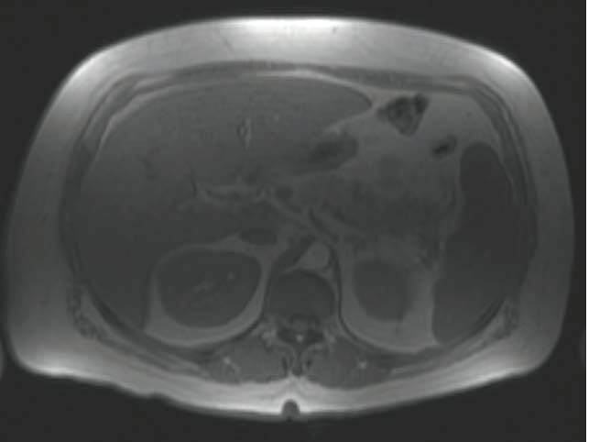
Magnetic resonance imaging scan of the liver with contrast enhancement obtained during the first week of admission showing a normal hepatobiliary tree

Slide 33
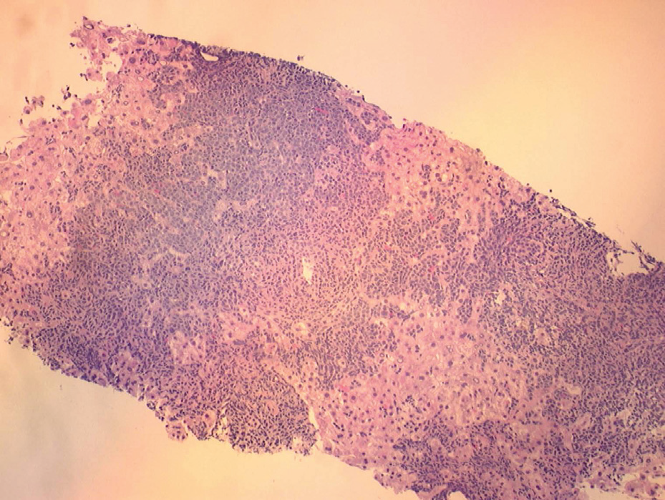
Ultrasound-guided core biopsy of the liver showing small to medium-sized lymphoblasts infiltrating the hepatic parenchyma

Slide 34
Acute Hepatitis as a Manifestation of Acute Lymphoblastic
Leukemia
7 –Y boy Jundice,dark urine and acholic stool, then lymphadenopathy , fever. . hepatomegaly
work up:
lymph node biopsy : reactive hyperplasia BMA1 : NL
Laboratory findings included:
leukocyte count= 1400/mm3, Hb= 8.69 gr/dl, platelet= 55,000, andLiver function tests showed:
Total bilirubin= 11.2 gr/dl, Direct bilirubin= 5.3 gr/dl,
ALT= 1532 u/lit, AST= 3250 u/lit normal PT and PTT
(BMA)2 :ALL
Sonography : paraaortic lymphadenopathy and hepatosplenomegaly
.
Fatemeh Farahmand Iranian Journal of Pediatric SocietyVolume 2, Number 1, January 2010: 44-46

Slide 35
Acute lymphoblastic leukemia presenting in fulminant hepatic failure.
.
A previously healthy 4-year-old boy was admitted because of acute liver failure. He was icteric, lethargic, had elevated ammonia and abnormal liver function tests. Serology was negative for viral hepatitis.
There was no history of hepatotoxic drugs.
Family history was unremarkable. The child was taken to the operating room for a living-related hepatic transplant.
Frozen section showed massive hepatic leukemic infiltration and hepatocellular necrosis.
Bone marrow aspiration confirmed the diagnosis of acute lymphoblastic leukemia (ALL).
Transplant was withheld and chemotherapy was attempted. He died the following day due to systemic leukemic infiltration, cerebral edema, and severe anoxic ischemic encephalopathy.
Litten JB, Rodríguez MM, Maniaci V. Pediatr Blood Cancer. 2006 Nov;47(6):842-5. University of Texas Southwestern, Dallas, TX, USA

Slide 36
Acute Hepatic Failure in a Case of Acute Lymphoblastic Leukemia
A 15 year-old boy :jaundice , no splenomegaly or hepatomegaly.
2500/mm3, Hb 14.1g/dl, platelet 80,000/mm3 and erythrocyte
Bilirubin 10.3 g/dl, AST 350 U/L, ALT 1140 U/L and LDH
1789 U/L.
Bone marrow:ALL
risk of inducing massive liver necrosis : No Chemo
1 week later,: improvement with supportive care
Repeat of BMA was not done.
After several days, the fever rose together with severe jaundice in the patient.
leukemic cells in the peripheral blood smear again.
Within several days, the clinical picture rapidly progressed to hepatic
failure and encephalopathy.
Finally, he died of multiorgan failure.
Salih CESUR1. Turk J Med Sci. (2004)34 279-275 .

Slide 37
Precursor B-cell acute lymphoblastic leukemia presenting as obstructive jaundice
Disscussion:
Liver involvement by hematologic malignancies is not infrequent, though it is rarely the initial presentation.
Histopathological :liver specimens – autopsy 44% of untreated patients with leukemias and lymphomas and 26% received chemotherapy /evidence of neoplastic involvement
Asymptomatic hepatic lesion , hepatomegaly to liver failure.
4 cases of fulminant hepatic failure were reported by Zafrani et al.
Rarely, obstructive jaundice is the initial presentation.

Slide 38
Precursor B-cell acute lymphoblastic leukemia presenting as obstructive jaundice
LEE etal, [3] described a case of AML with granulocytic sarcoma obstructing the biliary tract. Myeloperoxidase in these myeloid cells gives these masses a greenish coloration - chloroma
Obstructive jaundice is a very rare presentation of ALLs. Some cases of T-cell ALL , B-cell ALL
Megakaryoblastic leukemia
Only a few of these cases had no evidence of biliary obstruction on imaging.
The pathophysiology of jaundice in these cases of ALL was leukemic infiltration of hepatic sinusoids.
.

Slide 39
Acute Hepatitis as a Manifestation of Acute Lymphoblastic
Leukemia
Hepatosplenomegaly is common in leukemia (30-40%).
30% of patients with ALL clinical and biochemical abnormalities in liver function tests sometimes during their illness but frank jaundice is rare especially at the onset of disease.
Liver involvement in leukemia can be due to various factors such as infiltration of leukemic cells, viral hepatitis, drug toxicity.
Fatemeh Farahmand Iranian Journal of Pediatric SocietyVolume 2, Number 1, January 2010: 44-46

Slide 40
Precursor B-cell acute lymphoblastic leukemia presenting as obstructive jaundice
Hepatic insufficiency at presentation of malignancies may pose an important therapeutic challenge as it may reduce tolerance to intensified chemotherapy.
Some authors have suggested a short course of prednisone prior to instituting full dose chemotherapy. Once a downward trend in bilirubin level is established, one can proceed with further chemotherapy

Slide 41
Acute Hepatic Failure in a Case of Acute Lymphoblastic Leukemia
In order to avoid a rapidly fatal outcome secondary to liver failure and metabolic disorders, early recognition of these malignancies is necessary so as to assure prompt administration of appropriate chemotherapy

