Slide 2
radio-iodinated metaiodobenzylguanidine
(123I-MIBG)
DR.KAJI 1392

Slide 4
• Neuroblastoma is the most common extracranial solid tumor in children, accounting for 7% of all childhood malignancies. It accounts for 15% of childhood cancer mortality
• Neuroblastoma is the most common malignancy in infants with an annual incidence of 10 per million live births
• At diagnosis, 50% of patients are under age 2, 75% under age 4 and 90% under age 10. Peak age of incidence is 2 years

Slide 5
I123-Meta-iodobenzylguanidine (MIBG) scintigraphy is recommended for detection of bony metastases and occult soft tissue disease. MIBG is taken up by approximately 90% of neuroblastoma
Tc-diphosphonate bone scan is only recommended for evaluation of bone involvement when tumors do not take up MIBG or MIBG scan is unavailable
F-fluorodeoxyglucose positron emission tomography (FDG-PET) may be useful to visualize primary and metastatic sites of disease, especially soft tissue disease, in patients whose tumors are not MIBG avid

Slide 6
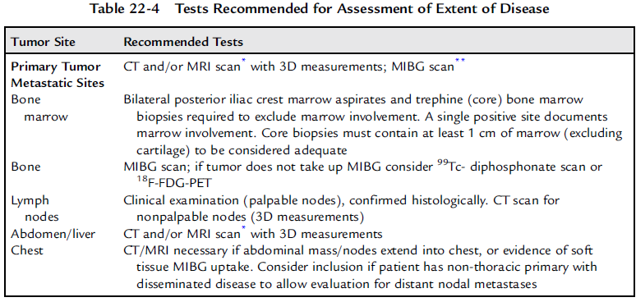

Slide 9
123I-MIBG Scintigraphy and 18F-FDG PET in Neuroblastoma
THE JOURNAL OF NUCLEAR MEDICINE • Vol. 50 • No. 8 • August 2009

Slide 10
The purpose of this study was to compare the diagnostic utility of 123I-metaiodobenzylguanidine (123I-MIBG) scintigraphy and 18F-FDG PET in neuroblastoma.
Methods: A total of 113 paired 123I-MIBG and 18F-FDG PET scans in 60 patients with neuroblastoma were retrospectively reviewed. Paired scans were acquired within 14 days of each other.

Slide 11
Conclusion: 18F-FDG is superior in depicting stage
1 and 2 neuroblastoma, although 123I-MIBG may be needed to
exclude higher-stage disease. 18F-FDG also provides important
information for patients with tumors that weakly accumulate 123IMIBG and at major decision points during therapy (i.e., before
stem cell transplantation or before surgery). 18F-FDG can also
better delineate disease extent in the chest, abdomen, and pelvis.
123I-MIBG is overall superior in the evaluation of stage 4 neuroblastoma, especially during initial chemotherapy, primarily
because of the better detection of bone or marrow metastases.

Slide 12
Comparison of Iodine-123 Metaiodobenzylguanidine (MIBG) Scan and [18F]Fluorodeoxyglucose Positron EmissionTomography to Evaluate Response After Iodine-131 MIBG Therapy for Relapsed Neuroblastoma
2009 by American Society of Clinical Oncology

Slide 13
Purpose
Children with relapsed neuroblastoma have poor survival. It is crucial to have a reliable method for evaluating functional response to new therapies. In this study, we compared two functional imaging modalities for neuroblastoma: metaiodobenzylguanidine (MIBG) scan for uptake by the
norepinephrine transporter and [18F]fluorodeoxyglucose positron emission tomography (FDG-PET) uptake for glucose metabolic activity.
Patients and Methods
Patients enrolled onto a phase I study of sequential infusion of iodine-131 (131I) MIBG (NANT-2000-01) were eligible for inclusion if they had concomitant FDG-PET and MIBG scans. 131I-MIBG therapy was administered on days 0 and 14. For each patient, we compared all lesions identified on concomitant FDG-PET and MIBG scans and gave scans a semiquantitative score.

Slide 14
Conclusion
MIBG scan is significantly more sensitive for individual lesion detection in relapsed neuroblastoma than FDG-PET, though FDG-PET can sometimes play a complementary role, particularly in soft tissue lesions. Complete response by FDG-PET metabolic evaluation did not always correlate with complete response by MIBG uptake.

Slide 16
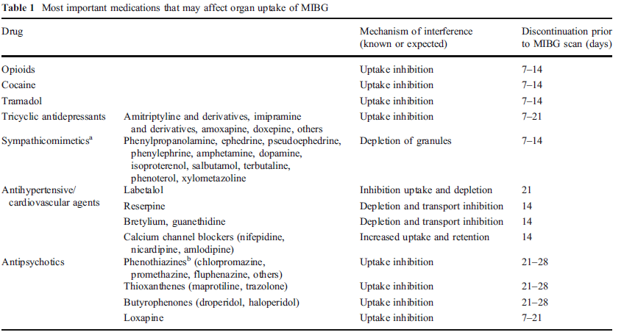

Slide 17
The organs with the highest absorbed dose per unit activity administered (mGy/MBq) are the liver, bladder,gallbladder, spleen, heart, and adrenals.
Contraindications
MIBG is contraindicated in patients with known hypersensitivity to MIBG or MIBG sulphate.
Side effects
Very rarely (<1%) adverse effects of MIBG (dizziness, rash,pruritus, flushing and injection site haemorrhage)

Slide 19
The purpose of this study was to present the characteristics and outcome of patients with proven pheochromocytoma or paraganglioma who had false-negative (123I-MIBG SPECT). Twenty-one patients with false-negative 123I-MIBG SPECT (7 males, 14 females), aged 13–55 years (mean: 41.40 years), were included.
We concluded that falsenegative 123I-MIBG SPECT is frequently related to metastatic tumors and usually due to SDHB mutations with unfavorable prognosis. We therefore recommend that patients with false-negative 123I-MIBG SPECT be tested for SDHB mutations and undergo more regular and close follow-up.

Slide 20
False-Positive MIBG Uptake in Pneumonia in a Patient With Stage IV Neuroblastoma
Clinical Nuclear Medicine • Volume 35, Number 9, September 2010

Slide 21
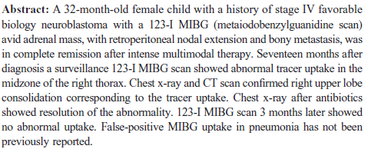

Slide 22
False-positive radio-iodinated metaiodobenzylguanidine(123I-MIBG) accumulation in a mast cell-infiltrated infantile haemangioma
The British Journal of Radiology, 83 (2010),

