Slide 1
How I treat relapsed and refractory Hodgkin lymphoma
dr.kaji 1392
blood-2010-09-288373
Prepublished online January 24, 2011;

Slide 2
Introduction
The treatment of limited-stage Hodgkin lymphoma (HL) has improved significantly with the adoption of combined modality therapy, with treatment failure occurring in approximately 10% of patients.
Although the therapy of advanced-stage HL has also improved, up to 10% of patients with advanced-stage HL will not achieve complete remission (CR), and 20%–30% of responding patients subsequently relapse after treatment.
Salvage chemotherapy followed by autologous stem cell transplantation (ASCT) is the treatment of choice in patients with relapsed HL or if the
disease is refractory to initial chemotherapy.

Slide 3
Disease Monitoring
Imaging studies for disease recurrence generally include a CT of the neck and chest and of other primary site (abdomen/pelvis). In the first 18 months, this is generally obtained every 3 months. Some protocols recommend alternating CT with chest radiographs (for chest
primary) during the first 18 months. Thereafter, CT screening generally continues every 6 months until 48 months and then annually through 5 years. After 5 years no routine imaging for disease recurrence is required. At these same time points, all patients should have a careful history and physical examination, a CBC and ESR.

Slide 4
Repeat biopsy should
be considered when the initial pathologic diagnosis is ambiguous
or unclear and is also important if the relapse is late in the disease
course (beyond 3-5 years of primary therapy) or if the clinician
believes another diagnosis may be likely.
Unfortunately, the positive predictive value of a PET scan for
detecting residual active disease is quite variable and generally
lower than the negative predictive value of PET posttherapy.
The diagnosis would appear clear, but we recommend either serial imaging if the site of disease is difficult to access or a biopsy to obtain definitive evidence of disease.

Slide 5
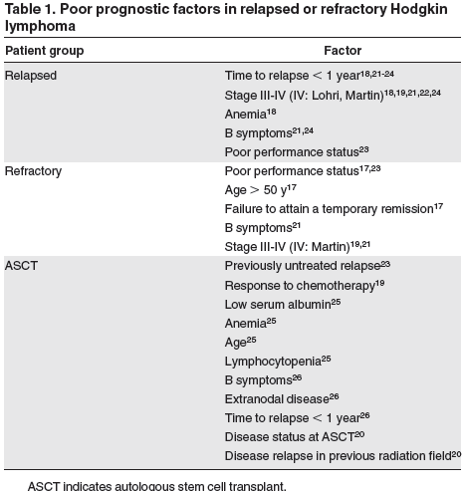

Slide 6
Treatment

Slide 7
Treatment
Salvage chemotherapy: before ASCT
Despite a multitude of published phase 2 studies reporting results
of salvage regimens for RR-HL, there are no direct comparisons
of different combinations and thus no consensus on the gold-standard second-line chemotherapy.
We recommend the use of a standard salvage therapy regimen
with which clinicians are comfortable that results in high response
rates, acceptable toxicity, that does not impair stem cell mobilization,
and ideally, that can be delivered in the outpatient setting.
Regimens such as ICE (ie, ifosfamide, carboplatin, and etoposide)
or GDP are reasonable options.
An alternate regimen (we use mini-BEAM on the basis of our experience described previously) should be used in patients with PD, larger volume disease, or lesions that remain positive by functional imaging.

Slide 8
The role of functional imaging in response assessment before ASCT;
Retrospective institutional series suggest that abnormal functional imaging (FI; either gallium or FDG-PET scan) after salvage therapy and before ASCT are predictive of poor outcome (3-year OS of 58% vs 87% if negative FI). In particular, patients who had achieved a PR with CT imaging could be discriminated by FI—in those with negative FI, outcome was similar to patients in CR (3-year OS of 90% in CR, 80% in PR with negative FI) but significantly inferior if positive (65%).

Slide 9
ASCT high-dose therapy regimens
Although there was no difference in OS, freedom from treatment failure at 3 years was significantly improved in the ASCT group (55% vs 34%, P .02).registry data address the benefit of ASCT in these patients.
The randomized trials of ASCT in RR-HL used BEAM as the
high-dose therapy regimen and thus BEAM could be considered
the standard. We would stress that ASCT programs should use a
regimen with which they have experience and report favorable
toxicity results.

Slide 11
radiotherapy
radiotherapy alone at relapse is thought to be largely palliative,
the role of combined modality therapy with the use of conventional-dose chemotherapy as part of a second-line
treatment strategy has only been studied retrospectively. This type
of strategy would be particularly appealing if patients have not
received radiotherapy with previous treatment or have relapsed
with disease in sites that have not been previously irradiated.
Salvage radiotherapy alone may be considered reasonable treatment, especially for older patients with relapsed HL who lack B symptoms, have a good performance status, and have limited stage disease at relapse.

Slide 12
We believe that some patients with very late relapse (at our center, 5 years) after primary therapy who experience localized relapse without B symptoms can be treated successfully with standard-dose chemotherapy and involved (or occasionally extended) field radiation.

Slide 13
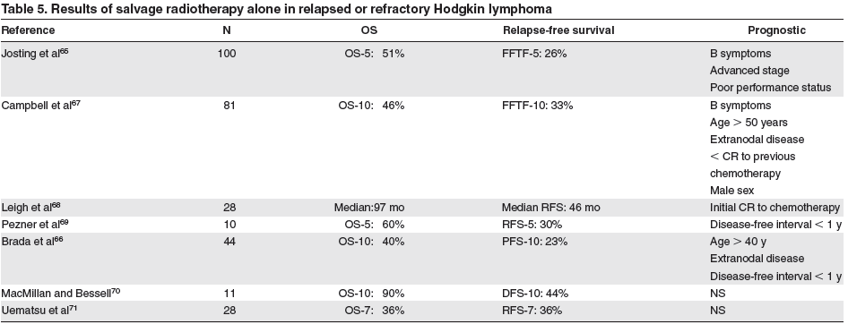

Slide 14
Intensive strategies including allografting and secondautograft;
we recommend RIC-allo for HL only in the context of prospective clinical trials because allo-SCT trials continue to report disappointing relapse rates. However, if clinicians feel strongly about proceeding with this strategy, patients with refractory disease should be excluded and opportunities to exploit the GVHL effect should be used.
The role of a second autograft remains unclear but can be considered in patients with a time to relapse of greater than 1 year (5 years at our center) after the initial transplant.

Slide 15
Noncurative treatment of RR-HL
Despite the aggressive strategies outlined in this work, up to 50%
of patients will ultimately relapse after ASCT.
A minority of these patients may be eligible for RIC-allo, but many factors may pose obstacles to this type of treatment.
In the noncurative setting, there are many conventional agents that may be used in sequence or combination to provide disease control; gemcitabine and vinblastine frequently are used.
Unfortunately, the first trials of novel agents in RR-HL were largely unsuccessful; anti-CD30 antibodies, bortezomib, and thalidomide
failed to show promising single-agent activity or favorable results when combined with standard drugs.

Slide 16
Recent
reports of novel therapeutics have described new agents with
favorable single-agent activity. A pilot study of the monoclonal
anti-CD20 antibody rituximab has shown a response rate of 22% in
classic HL and was associated with resolution of B symptoms.
Recent studies of a conjugated anti-CD30 antibody (brentuximab
vedotin or SGN-35) have shown impressive activity in heavily
pretreated patients
Emerging data suggest several classes of agents—histone deacetylase inhibitors, mammalian target of rapamycin inhibitors, and immunomodulatory agents are potentially worthy of further study in RR-HL.

