Slide 1
Antifungal Treatment
Dr. Kouros Aghazade
Shahid Beheshti Medical University

Slide 2
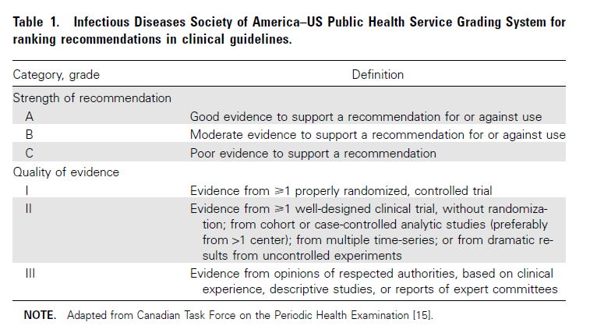

Slide 3
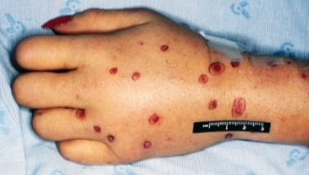
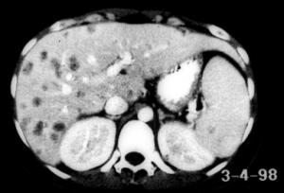
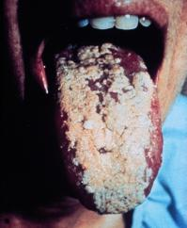
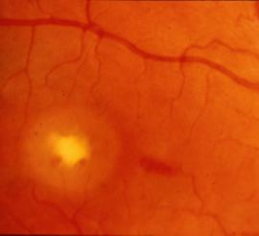
Candidiasis Spectrum of Infection
Cutaneous fungemia
Disseminated
Mucosal
Chorioretinitis
Images courtesy of Kenneth V. Rolston, MD, and John R. Wingard, MD. Walsh et al. Infect Dis Clin North Am. 1996;10:365-400.
Notes:
Candidiasis is a spectrum of infections which may be cutaneous, mucosal, or deeply invasive. Deeply invasive infections include candidemia, disseminated candidiasis, or single-organ candidiasis.
Candida species are the most frequent cause of invasive fungal infections in neutropenic patients. Although C albicans is the most common cause of candidemia, there has been a shift to non-albicans species in recent years.
This slide illustrates some of the clinical manifestations of candidiasis. Panel A shows the hand of a 47-year-old woman with refractory acute AML who developed Candida krusei fungemia and had multiple showers of cutaneous lesions such as the ones depicted.
Panel B shows a patient with AML and oral candidiasis.
Panel C is a computed tomography (CT) scan of a patient with AML who developed chronic systemic candidiasis. The lesions depicted here developed after recovery from neutropenia.
Panel D depicts Candida chorioretinitis, a finding in nonneutropenic patients with dissemination.
Walsh TJ, Hiemenz JW, Anaissie E. Recent progress and current problems in treatment of invasive fungal infections in neutropenic patients. Infect Dis Clin North Am. 1996;10:365-400.
Slide 39

Slide 5
Candida colonization, the presence of the yeast on mucocutaneous surfaces without any sign of invasion, must be distinguished from infection, where there is a clinically evident pathological process with mucosal damage and inflammation.
A culture of oropharyngeal, intestinal, or genital material that grows Candida species is clinically insignificant unless there are signs or symptoms of infection, as it is part of the normal flora.

Slide 7
Candidemia in Nonneutropenic Patients
Fluconazole (loading dose of 800 mg [12 mg/kg],then 400 mg [6 mg/kg] daily) or an echinocandin (caspofungin: loading dose of 70 mg, then 50 mg daily; micafungin: 100 mg daily; anidulafungin: loading dose of 200 mg, then 100 mg daily) is recommended as initial therapy for most adult patients (AI).

Slide 8
The Expert Panel favors an echinocandin for patients with moderately severe to severe illness or for patients who have had recent azole exposure (A-III).
Fluconazole is recommended for patients who are less critically ill and who have had no recent azole exposure (A-III).
The same therapeutic approach is advised for children, with attention to differences in dosing regimens.

Slide 9
Transition from an echinocandin to fluconazole is recommended for patients who have isolates that are likely to be susceptible to fluconazole (e.g.,Candida albicans) and who are clinically stable (A-II).

Slide 10
For infection due to Candida glabrata, an echinocandin is preferred (B-III).
Transition to fluconazole or voriconazole therapy is not recommended without confirmation of isolate susceptibility (B-III).
For patients who have initially received fluconazole or voriconazole, are clinically improved, and whose follow-up culture results are negative, continuing use of an azole to completion of therapy is reasonable (B-III).

Slide 11
For infection due to Candida parapsilosis, treatment with fluconazole is recommended (B-III).
For patients who have initially received an echinocandin, are clinically improved, and whose follow-up culture results are negative, continuing use of an echinocandin is reasonable (B-III).

Slide 12
Amphotericin B deoxycholate (AmB-d) administered at a dosage of 0.5–1.0 mg/kg daily or a lipid formulation of AmB (LFAmB) administered at a dosage of 3–5 mg/kg daily are alternatives if there is intolerance to or limited availability of other antifungals (A-I).
Transition from AmB-d or LFAmB to fluconazole is recommended for patients who have isolates that are likely to be susceptible to fluconazole (e.g., C. albicans) and who are clinically stable (A-I).

Slide 13
Voriconazole administered at a dosage of 400 mg (6 mg/kg) twice daily for 2 doses and then 200 mg (3mg/kg) twice daily thereafter is effective for candidemia (A-I), but it offers little advantage over fluconazole and is recommended as stepdown oral therapy for selected cases of candidiasis due to Candida krusei or voriconazole-susceptible C. glabrata (BIII).

Slide 14
The recommended duration of therapy for candidemia without obvious metastatic complications is for 2 weeks after documented clearance of Candida from the bloodstream and resolution of symptoms attributable to candidemia (A-III).

Slide 15
Intravenous catheter removal is strongly recommended for nonneutropenic patients with candidemia (A-II).

Slide 16
Candidemia in Neutropenic Patients
An echinocandin (caspofungin: loading dose of 70 mg, then 50 mg daily; micafungin: 100 mg daily [A-II]; anidulafungin: loading dose of 200 mg, then 100 mg daily [A-III]) or LFAmB (3–5 mg/kg daily [A-II]) is recommended for most patients.

Slide 17
For patients who are less critically ill and who have no recent azole exposure, fluconazole (loading dose of 800 mg [12 mg/ kg], then 400 mg [6 mg/kg] daily) is a reasonable alternative (B-III).
Voriconazole can be used in situations in which additional mold coverage is desired (B-III).

Slide 18
For infections due to C. glabrata, an echinocandin is preferred (B-III). LFAmB is an effective but less attractive alternative (B-III).
For patients who were already receiving voriconazole or fluconazole, are clinically improved, and whose follow-up culture results are negative, continuing use of the azole to completion of therapy is reasonable (B-III).

Slide 19
For infections due to C. parapsilosis, fluconazole or LFAmB is preferred as initial therapy (B-III). If the patient is receiving an echinocandin, is clinically stable, and follow-up culture results are negative, continuing the echinocandin until completion of therapy is reasonable.
For infections due to C. krusei, an echinocandin, LFAmB, or voriconazole is recommended (B-III).

Slide 20
Recommended duration of therapy for candidemia without persistent fungemia or metastatic complications is for 2 weeks after documented clearance of Candida from the bloodstream, resolution of symptoms attributable to candidemia, and resolution of neutropenia (A-III).

Slide 21
Intravenous catheter removal should be considered (B-III).

Slide 22
Empirical Treatment for Suspected Invasive Candidiasis in Nonneutropenic Patients

Slide 23
Empirical therapy for suspected candidiasis in nonneutropenic patients is similar to that for proven candidiasis. Fluconazole (loading dose of 800 mg [12mg/kg], then 400 mg [6 mg/kg] daily), caspofungin (loading dose of 70 mg, then 50 mg daily), anidulafungin (loading dose of 200 mg, then 100 mg daily), or micafungin (100 mg daily) is recommended as initial therapy (B-III).

Slide 24
An echinocandin is preferred for patients who have had recent azole exposure, whose illness is moderately severe or severe, or who are at high risk of infection due to C. glabrata or C. krusei (B-III).

Slide 25
AmB-d (0.5–1.0 mg/kg daily) or LFAmB (3–5 mg/kg daily) are alternatives if there is intolerance to other antifungals or limited availability of other antifungals (B-III).

Slide 26
Empirical antifungal therapy should be considered for critically ill patients with risk factors for invasive candidiasis and no other known cause of fever, and it should be based on clinical assessment of risk factors, serologic markers for invasive candidiasis, and/or culture data from nonsterile sites (B-III).

Slide 27
Empirical Treatment for Suspected Invasive Candidiasis in Neutropenic Patients

Slide 28
LFAmB (3–5 mg/kg daily), caspofungin (loading dose of 70 mg, then 50 mg daily) (A-I), or voriconazole (6 mg/kg administered intravenously twice daily for 2 doses, then 3 mg/ kg twice daily) are recommended (B-I).

Slide 29
Fluconazole (loading dose of 800 mg [12 mg/kg], then 400 mg [6 mg/kg] daily) and itraconazole (200 mg [3mg/kg] twice daily) are alternative agents (B-I).

Slide 30
AmB-d is an effective alternative, but there is a higher risk of toxicity with this formulation than with LFAmB (A-I).

Slide 31
Azoles should not be used for empirical therapy in patients who have received an azole for prophylaxis (B-II).

Slide 32
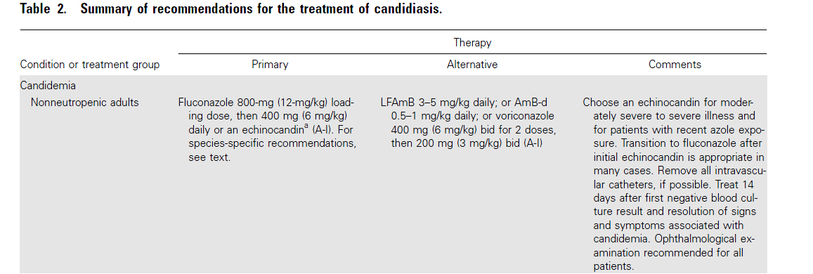

Slide 33
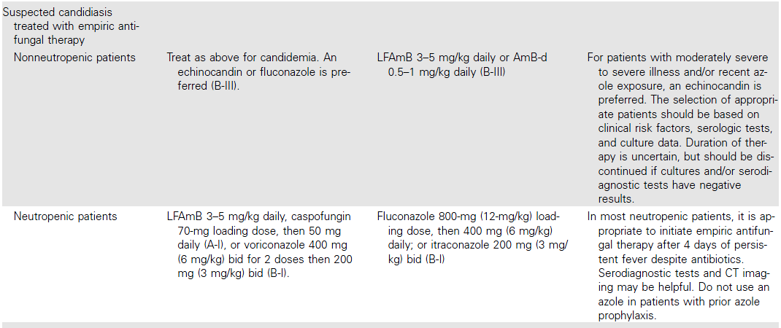

Slide 34
Pediatric Dosing
The pharmacokinetics of antifungal agents vary between adult and pediatric patients, but the data on dosing for antifungal agents in pediatric patients are limited.

Slide 35
AmB-d kinetics are similar in neonates and adults . There are few data describing the use of LFAmB in neonates and children. A phase I/II study of ABLC (2–5 mg/kg per day) in the treatment of hepatosplenic candidiasis in children found that the area under the curve and the maximal concentration of drug were similar to those in adults . There are anecdotal data reporting successful use of L-AmB in neonates

Slide 36
Flucytosine clearance is directly proportional to glomerular filtration rate, and infants with a very low birth weight may accumulate high plasma concentrations because of poor renal function due to immaturity . Thus, the use of flucytosine without careful monitoring of serum drug levels is discouraged in this group of patients.

Slide 37
The pharmacokinetics of fluconazole vary significantly with age . Fluconazole is rapidly cleared in children (plasma half-life, ∼14 h). To achieve comparable drug exposure, the daily fluconazole dose needs to be doubled, from 6 to 12 mg/ kg daily, for children of all ages and neonates .

Slide 38
In comparison with the volume of distribution (0.7 L/kg) and halflife (30 h) seen in adults, neonates may have a higher volume of distribution and longer half-life ; it has been recently reported that the volume of distribution in young infants and neonates is 1 L/kg and that the half-life is 30–50 h .

Slide 39
These data indicate that once-daily dosing of 12 mg/kg in premature and term neonates will provide exposure similar to that in adults who receive 400 mg daily. If the young infant’s creatinine level is 1.2 mg/dL for 3 consecutive doses, the dosing interval for 12 mg/kg may be increased to once every 48 h until the serum creatinine level is 1.2 mg/dL.

Slide 40
When administered to infants and children, the oral solution of itraconazole (5 mg/kg per day) provides potentially therapeutic concentrations in plasma . Levels in children 6 months to 2 years of age are substantially lower than those attained in adult patients; thus, children usually need twice daily dosing. A recent study of itraconazole solution in HIVinfected children documented its efficacy for treating oropharyngeal candidiasis in pediatric patients .

Slide 41
Voriconazole kinetics vary significantly between children and adults , demonstrating linear elimination in children after doses of 3 mg/kg and 4 mg/kg every 12 h. Thus, children up to ∼12 years of age require higher doses of voriconazole than do adults to attain similar serum concentrations. A dosage of 7 mg/kg every 12 h is currently recommended to achieve plasma exposures comparable to those in an adult receiving 4 mg/kg given every 12 h.

Slide 42
There is growing experience with the echinocandins in children and neonates . A recent study of caspofungin in pediatric patients demonstrated the importance of dosing based on body surface area rather than weight. With use of the weight-based approach to pediatric dosing, 1 mg/kg resulted in sub-optimal plasma concentrations for caspofungin, whereas dosing based on 50 mg/m2 yielded plasma concentrations that were similar to those in adults who were given a standard 50- mg dose of caspofungin.

Slide 43
Micafungin has been studied in children and neonates; children should be treated with 2–4 mg/kg daily, but neonates may require as much as 10–12 mg/kg daily to achieve therapeutic concentrations .
Anidulafungin has been studied in children 2–17 years of age and should be dosed at 1.5 mg/kg/day . Data for each of the echinocandins suggest safety and efficacy in the pediatric population.

Slide 44
Antifungal Susceptibility Testing
Although the susceptibility of Candida to the currently available antifungal agents is generally predictable if the species of the infecting isolate is known, individual isolates do not necessarily follow this general pattern (table 3)

Slide 46
For this reason, susceptibility testing is increasingly used to guide the management of candidiasis, especially in situations in which there is a failure to respond to initial antifungal therapy.

Slide 47
Expert opinion suggests that laboratories perform routine antifungal susceptibility testing against fluconazole for C. glabrata isolates from blood and sterile sites and for other Candida species that have failed to respond to antifungal therapy or in which azole resistance is strongly suspected.

Slide 48
Currently, antifungal resistance in C. albicans is uncommon, and routine testing for antifungal susceptibility against this species is not generally recommended.

Slide 49
WHAT IS THE TREATMENT FOR CHRONIC
DISSEMINATED CANDIDIASIS?

Slide 50
Fluconazole at a dosage of 400 mg (6 mg/kg) daily is recommended for clinically stable patients (A-III).
LFAmB at a dosage of 3–5 mg/kg daily or AmB-d at a dosage of 0.5–0.7 mg/kg daily can be used to treat acutely ill patients or patients with refractory disease (A-III).
Induction therapy with AmB for 1–2 weeks, followed by oral fluconazole at a dosage of 400 mg (6 mg/kg) daily, is also recommended (B-III).

Slide 51
Anidulafungin (loading dose of 200 mg, then 100 mg daily), micafungin (100 mg daily), or caspofungin (loading dose of 70 mg, then 50 mg daily for 1–2 weeks) are alternatives for initial therapy, followed by oral fluconazole when clinically appropriate (B-III).

Slide 52
Therapy should be continued for weeks to months, until calcification occurs or lesions resolve (A-III).
Premature discontinuation of antifungal therapy can lead to recurrent infection.

Slide 53
Patients with chronic disseminated candidiasis who require ongoing chemotherapy or undergo stem cell transplantation should continue to receive antifungal therapy throughout the period of high risk to prevent relapse (A-III).

Slide 54
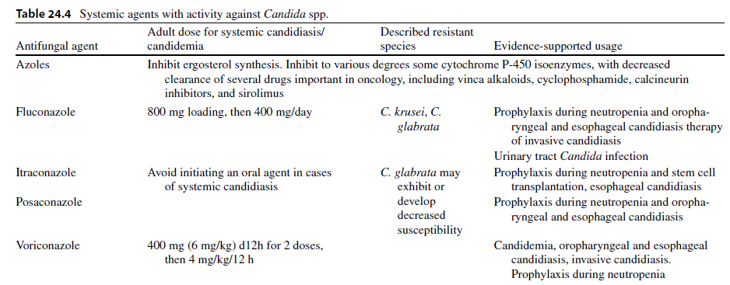
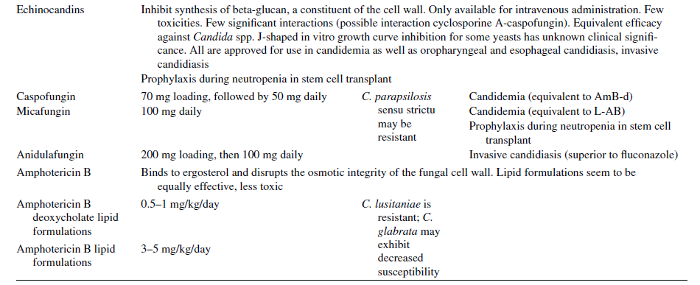

Slide 56
ANTIFUNGAL PROPHYLAXIS

Slide 57
For patients with chemotherapy-induced neutropenia, fluconazole at a dosage of 400 mg (6 mg/kg) daily (A-I), posaconazole at a dosage of 200 mg 3 times per day (A-I), or caspofungin at a dosage of 50 mg daily (B-II) is recommended during induction chemotherapy for the duration of neutropenia.
Oral itraconazole at a dosage of 200 mg daily is an effective alternative (A-I) but offers little advantage and is less well tolerated than these agents.

Slide 58
For stem cell transplant recipients with neutropenia, fluconazole at a dosage of 400 mg (6 mg/kg) daily, posaconazole at a dosage of 200 mg 3 times daily, or micafungin at a dosage of 50 mg daily is recommended during the period of risk of neutropenia (A-I).

Slide 60
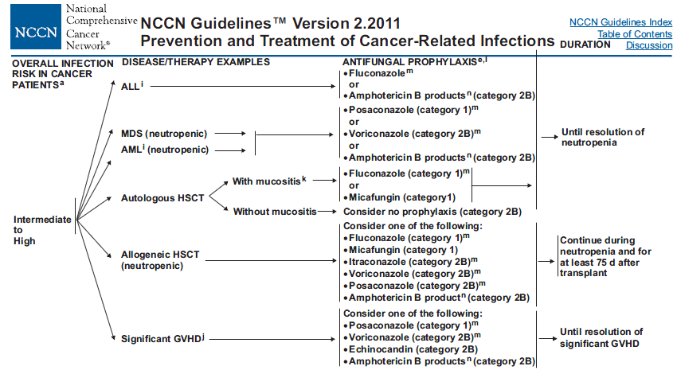

Slide 61
Aspergillosis

Slide 62
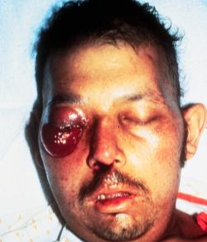
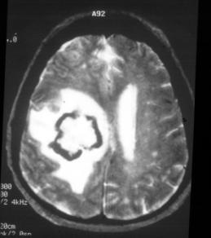
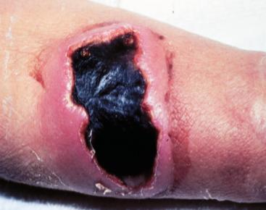
Invasive Aspergillosis
Other Clinical Presentations
A. Sino-orbital disease
B. Cerebritis
C. Cutaneous infection
Images courtesy of Kenneth V. Rolston, MD.
Stevens et al. Clin Infect Dis. 2000;36:696-709;
Walsh et al. Infect Dis Clin North Am. 1996;10:365-400.
Notes:
Sinonasal aspergillosis has a high mortality rate in immunocompromised patients; mortality can approach 100% in some subgroups. Computed tomography findings with sinusitis include mucosal thickening and bone erosion. Full sinus eschar may be observed on the nasal turbinate(s) during physical exam.
Aspergillosis of the CNS can manifest as a cerebral abscess, an epidural abscess, meningitis, or a subarachnoid hemorrhage. Mortality rates exceed 90%.
Figures A and B depict a man with refractory AML who was neutropenic for more than 45 days and developed disseminated aspergillosis, including sino-orbital disease and cerebritis.
Cutaneous infections are usually secondary to hematogenous dissemination from a lung infection in highly immunocompromised patients. Lesions begin as erythematous papules, become pustular, and eventually develop a central escalation covered with a black eschar surrounded by an elevated border. Cutaneous lesions can also develop as a manifestation of primary cutaneous infection where organisms enter at sites where the skin is broken.
Figure C depicts a patient with multiple myeloma who developed pain and black eschar at the site of intravascular catheter insertion as a manifestation of primary cutaneous infection. Biopsy of the site revealed the presence of primary aspergillosis.
Stevens DA, Kan VL, Judson MA, et al. Practice guidelines for diseases caused by Aspergillus. Clin Infect Dis. 2000;30:696-709.
Walsh TJ, Hiemenz JW, Anaissie E. Recent progress and current problems in treatment of invasive fungal infections in neutropenic patients. Infect Dis Clin North Am. 1996;10:365-400.
Slide 56

Slide 65
INVASIVE PULMONARY ASPERGILLOSIS
Early initiation of antifungal therapy in patients with strongly suspected invasive aspergillosis is warranted while a diagnostic evaluation is conducted (A-I)
IDSA Guideline of Aspergillosis 2008

Slide 66
Because of better survival and improved responses of initial therapy with voriconazole, primary therapy with D-AMB is not recommended (A-I).

Slide 67
For primary treatment of invasive pulmonary aspergillosis, IV or oral voriconazole is recom-mended for most patients . Oral therapy can be maximized by using a dose of 4 mg/kg rounded up to convenient pill sizes (B-III) . For seriously ill patients, the parenteral formulation is recommended . (A-III)
IDSA Guideline of Aspergillosis 2008

Slide 68
L-AMB may be considered as alternative primary therapy in some patients . (A-I) For salvage therapy, agents include LFABs (A-II) , posaconazole (B-II) , itraconazole (B-II), caspofungin (B-II), or micafungin (B-II).
IDSA Guideline of Aspergillosis 2008

Slide 69
Therapeutic options include a change of class
using an AMB formulation or an echinocandin (B-II)
IDSA Guideline of Aspergillosis 2008

Slide 70
In the absence of a well-controlled, prospective clinical trial, routine administration of combination therapy for primary therapy is not routinely recommended (B-II)
IDSA Guideline of Aspergillosis 2008

Slide 71
The committee recognizes, however, that in the context of salvage therapy, an additional antifungal agent might be added to current therapy, or combination antifungal drugs from different classes other than those in the initial regimen may be used (B-II)
IDSA Guideline of Aspergillosis 2008

Slide 72
In addition, management of breakthrough invasive aspergillosis in the context of mould active azole prophylaxis or suppressive therapy is not defined by clinical trial data but would suggest a switch to another drug class (B-III)
IDSA Guideline of Aspergillosis 2008

Slide 73
Surgical resection of Aspergillus infected tissue may be useful in patients with lesions that are contiguous with the great vessels or pericardium, lesions causing hemoptysis from a single focus, and lesions causing erosion into the pleural space or ribs (B-III)
IDSA Guideline of Aspergillosis 2008

Slide 74
Duration of antifungal therapy for invasive pulmonary aspergillosis is not well defined. We generally recommend that treatment of invasive pulmonary aspergillosis be continued for a minimum of 6–12 weeks; in immunosuppressed patients, therapy should be continued throughout the period of immunosuppression and until lesions have resolved. Long-term therapy of invasive aspergillosis is facilitated by the availability of oral voriconazole in stable patients.
IDSA Guideline of Aspergillosis 2008

Slide 75
For patients with successfully treated invasive aspergillosis who will require subsequent immunosuppression, resumption of antifungal therapy can prevent recurrent infection (A-III)
IDSA Guideline of Aspergillosis 2008

Slide 76
The volume of pulmonary infiltrates may increase for the first 7– 10 days of therapy especially in the context of granulocyte recovery
IDSA Guideline of Aspergillosis 2008

Slide 77
Progressive increase in Aspergillus antigen levels over time signifies a poor prognosis. However, resolution of galactomannan antigenemia to a normal level is not sufficient as a sole criterion for discontinuation of antifungal therapy (B-III)
IDSA Guideline of Aspergillosis 2008

Slide 78
Salvage therapy of itraconazole for treatment of invasive pulmonary aspergillosis that is refractory to primary therapy with voriconazole is not recommended because of the same mechanism of action or possible resistance and because of the erratic bioavailability and toxicity (B-II)
IDSA Guideline of Aspergillosis 2008

Slide 79
The aggregate body of data thus far warrants
that an antifungal triazole should be used instead of AMB in the primary treatment of infection due to A. terreus (A-II)
IDSA Guideline of Aspergillosis 2008

Slide 80
Although high-risk neutropenic patients with invasive aspergillosis may already be receiving granulocyte colony-stimulating factor or granulocyte-macrophage colony-stimulating factor as a component of their cancer chemotherapy, those neutropenic patients who are not receiving a colony-stimulating factor may benefit from the addition of granulocyte colony-stimulating factor or granulocyte-macrophage colony-stimulating factor (B-III)
IDSA Guideline of Aspergillosis 2008

Slide 81
Individual case reports suggest a role for IFN-g as adjunctive antifungal therapy for invasive aspergillosis in immunocompromised nonneutropenic patients, particularly those with CGD (B-III)
IDSA Guideline of Aspergillosis 2008

Slide 82
Management of immunosuppressive therapies. Withdrawal of corticosteroids or reduction of dosage is often critical for successful outcome in invasive aspergillosis (A-III)
IDSA Guideline of Aspergillosis 2008

Slide 83
For patients with chronic immunosuppression, continuation of antifungal therapy throughout the duration of immunosuppression seems to be associated with a more favorable outcome (A-III)
IDSA Guideline of Aspergillosis 2008

Slide 84
Surgical therapy may be useful in patients with lesions that are contiguous with the great vessels or the pericardium, hemoptysis from a single cavitary lesion, or invasion of the chest wall (B-II). Another relative indication for surgery is the resection of a single pulmonary lesion prior to intensive chemotherapy or HSCT (B-II)
IDSA Guideline of Aspergillosis 2008

Slide 85
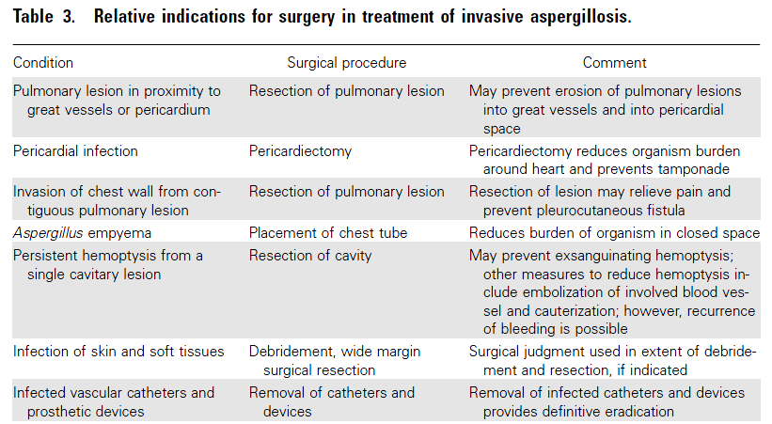
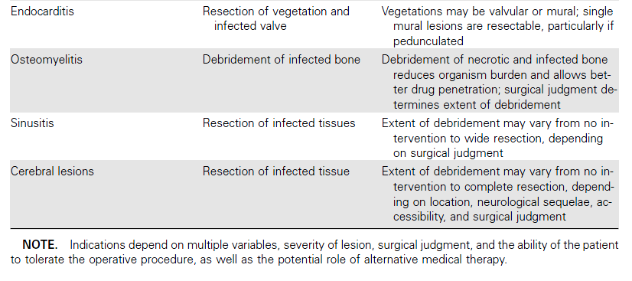

Slide 86
TRACHEOBRONCHIAL ASPERGILLOSIS
Voriconazole is recommended as initial therapy in the treatment of tracheobronchial aspergillosis (B-II)
IDSA Guideline of Aspergillosis 2008

Slide 87
Because the use of D-AMB may result in increased nephrotoxicity in association with calcineurin inhibitors, an LFAB is recommended if a polyene is considered in the patient (e.g., lung transplant recipient) (B-III)
IDSA Guideline of Aspergillosis 2008

Slide 88
Aerosolized D-AMB or LFAB may have some benefit for delivering high concentrations of polyene therapy to the infected (often anastomotic) site; however, this approach has not been standardized and remains investigational (C-III)
IDSA Guideline of Aspergillosis 2008

Slide 89
CHRONIC NECROTIZING PULMONARY ASPERGILLOSIS (CNPA; SUBACUTE INVASIVE PULMONARY ASPERGILLOSIS)
The greatest body of evidence regarding effective therapy supports the use of orally administered itraconazole (B-III). Although voriconazole (and pre-sumably posaconazole) is also likely to be effective, there is less published information available for its use in CNPA (B-III)
IDSA Guideline of Aspergillosis 2008

Slide 90
SINGLE-ORGAN, EXTRAPULMONARY FORMS OF INVASIVE ASPERGILLOSIS
However, based on the strength of the randomized study comparing voriconazole to D-AMB , the panel recommends voriconazole for primary treatment of these uncommon manifestations of invasive aspergillosis (B-III)
IDSA Guideline of Aspergillosis 2008

Slide 91
ASPERGILLOSIS OF THE CNS
The weight of evidence supports voriconazole as the primary recommendation for systemic antifungal therapy of CNS aspergillosis (A-II). Itraconazole, posaconazole, or LFAB are recommended for patients who are intolerant or refractory to voriconazole (B-III)
IDSA Guideline of Aspergillosis 2008

Slide 92
INVASIVE SINONASAL ASPERGILLOSIS
If the infection is known to be due to Aspergillus species, voriconazole should be initiated(B-III) .Thus, if the etiological organism is not known or histopathologic examination is still pending, an AMB formulation should be initiated in anticipation of possible sinus zygomycosis (A-III) . Posaconazole demonstrates salvage activity in extrapulmonary aspergillosis and offers the theoretical advantage of activity against Zygomyetes in this context, although published clinical experience is limited (B-III).
There are limited data supporting echinocandin use in Aspergillus sinusitis
IDSA Guideline of Aspergillosis 2008

Slide 93
EMPIRICAL ANTIFUNGAL THERAPY OF NEUTROPENIC PATIENTS WITH PROLONGED FEVER DESPITE ANTIBACTERIAL THERAPY AND PRESUMPTIVE THERAPY FOR INVASIVE ASPERGILLOSIS
IDSA Guideline of Aspergillosis 2008

Slide 94
Empirical antifungal therapy with AMB, an LFAB, itraconazole, voriconazole, or caspofungin is recommended for high-risk patients with prolonged neutropenia who remain persistently febrile despite broad-spectrum antibiotic therapy (A-I)
IDSA Guideline of Aspergillosis 2008

Slide 95
Empirical antifungal therapy is not recommended for patients who are anticipated to have short durations of neutropenia (duration of neutropenia, 10 days), unless other findings indicate the presence of an invasive fungal infection (B-III)
IDSA Guideline of Aspergillosis 2008

Slide 96
PROPHYLAXIS AGAINST INVASIVE ASPERGILLOSIS
Antifungal prophylaxis with posaconazole can be recommended in HSCT recipients with GVHD who are at high risk for invasive aspergillosis and in patients with acute myelogenous leukemia or myelodysplastic syndrome who are at high risk for invasive aspergillosis (A-I). Itraconazole may be effective, but tolerability limits its use (B-I)
IDSA Guideline of Aspergillosis 2008

Slide 97
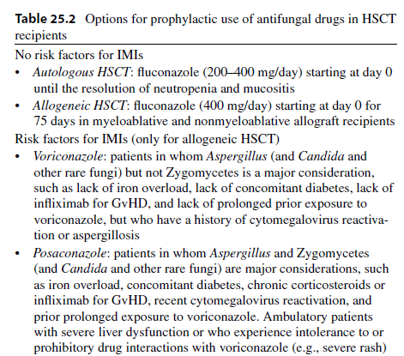
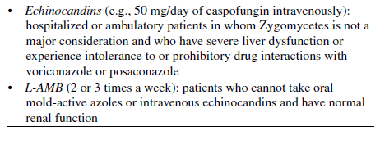

Slide 98
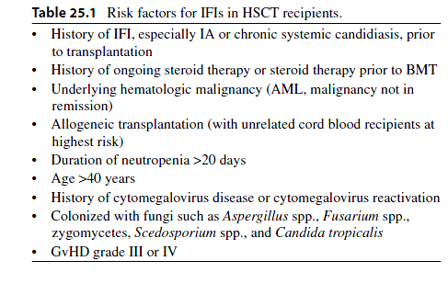

Slide 99
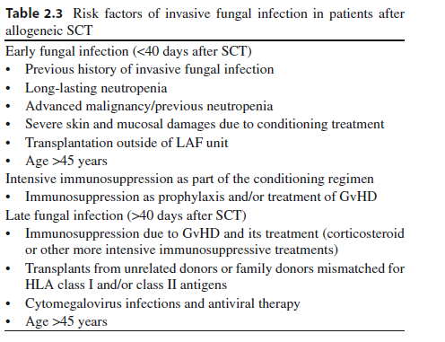

Slide 100
When should Antifungal prophylaxis given?
Prophylaxis against Candida infection is recommended in patient groups in whom the risk of invasive candidal infection is substantial, such as allogeneic hematopoietic stem cell transplant (HSCT) recipients or those undergoing intensive remission-induction or salvage-induction chemotherapy for acute leukemia
Clinical Infec tious Disease s 2011;52(4) :e56–e93

Slide 101
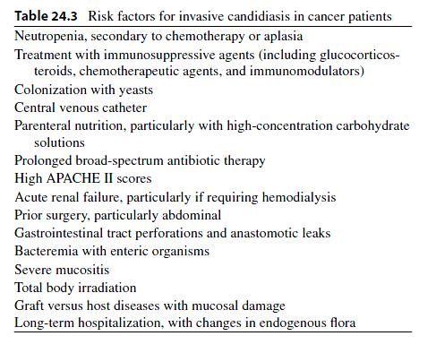

Slide 102
High risk
Prophylaxis against Candida infection is recommended in patient groups in whom the risk of invasive candidal infection is substantial, such as allogeneic hematopoietic stem cell transplant (HSCT) recipients or those undergoing intensive remission-induction or salvage-induction chemotherapy for acute leukemia (A-I).
Fluconazole, itraconazole, voriconazole, posaconazole, micafungin, and caspofungin are all acceptable alternatives.

Slide 103
With what agent
Fluconazole,
Itraconazole
Voriconazole
Posaconazole
Micafungin
Caspofungin
Clinical Infec tious Disease s 2011;52(4) :e56–e93

Slide 104
When should Antifungal prophylaxis given?
Prophylaxis against Aspergillus infection in pre- engraftment allogeneic or autologous transplant recipients has not been shown to be efﬁcacious.
Clinical Infec tious Disease s 2011;52(4) :e56–e93

Slide 105
Prophylaxis against invasive Aspergillus infections with posaconazole should be considered for selected patients >13 years of age who are undergoing intensive chemotherapy for acute myeloid leukemia (AML) or myelodysplastic syndrome (MDS) in whom the risk of invasive aspergillosis without prophylaxis is substantial (B-I).

Slide 106
Prophylaxis against Aspergillus infection in preengraftment allogeneic or autologous transplant recipients has not been shown to be efficacious. However, a mold-active agent is recommended in patients with prior invasive aspergillosis (A-III), anticipated prolonged neutropenic periods of at least 2 weeks (C-III), or a prolonged period of neutropenia immediately prior to HSCT (C-III).

Slide 107
1)Prior invasive aspergillosis
2) Anticipated prolonged neutropenic periods of at least 2 weeks
3) prolonged period of neutropenia immediately prior to HSCT
Clinical Infec tious Disease s 2011;52(4) :e56–e93

Slide 108
4) Induction for acute leukemia
5) Induction for Myelodysplastic syndrome
6) pre -engraftment allogeneic HSCT
Clinical Infec tious Disease s 2011;52(4) :e56–e93

Slide 109
Regimens
Itraconazol
Voriconazol
Posaconazol
Fluconazol?
Clinical Infec tious Disease s 2011;52(4) :e56–e93

Slide 110
Duration
For acute leukemia: Till myeloid reconstitution
In HSCT Allograft: for at least 7 5 days after transplant or until cessation of immunosuppressive therapy
Clinical Infec tious Disease s 2011;52(4) :e56–e93

Slide 111
Co-administration o f mold-active triazole-based prophylaxis with vinca alkaloids or high dose s of cyclophosphamide and anthracyclines should be avoided until these interactions have been better studied.
Clinical Infec tious Disease s 2011;52(4) :e56–e93

Slide 112
Low Risk
Antifungal prophylaxis is not recommended for patients in whom the anticipated duration of neutropenia is ,7 days (A-III).

Slide 115
What Is the Role of Empirical or Preemptive Antifungal Therapy and Which Antifungal Should be Used?
Clinical Infec tious Disease s 2011;52(4) :e56–e93

Slide 116
Clinical Infec tious Disease s 2011;52(4) :e56–e93

Slide 117
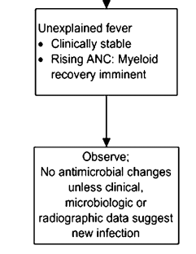
Clinical Infec tious Disease s 2011;52(4) :e56–e93

Slide 118
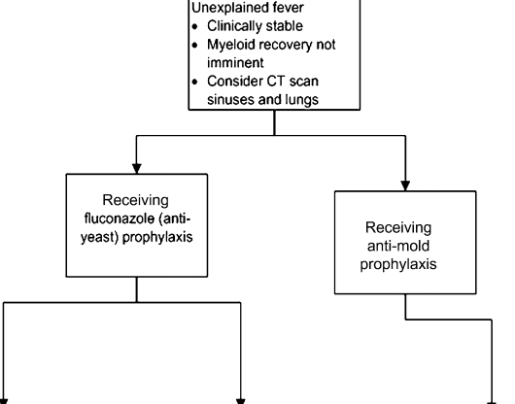
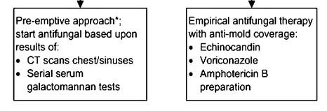
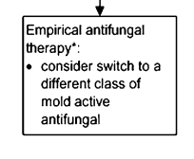
Clinical Infec tious Disease s 2011;52(4) :e56–e93

Slide 119
Clinical Infec tious Disease s 2011;52(4) :e56–e93

Slide 120
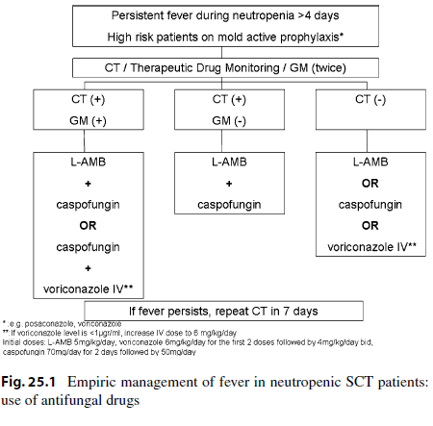

Slide 121
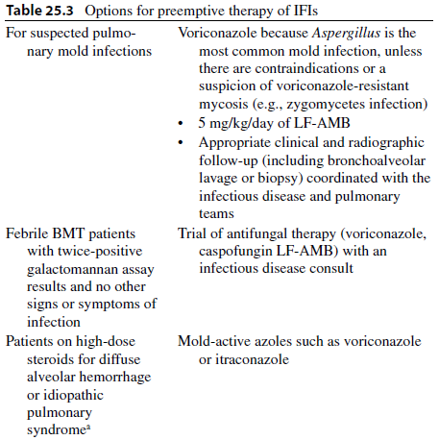

Slide 122
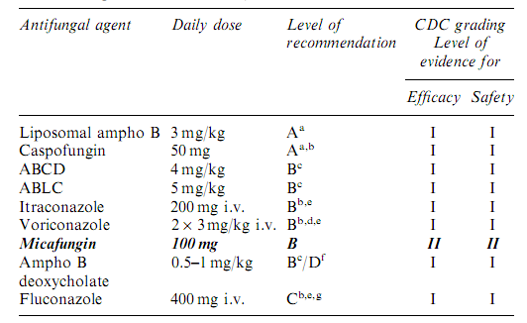
Clinical Infec tious Disease s 2011;52(4) :e56–e93

