Slide 1
Diagnosis of Invasive Fungal Disease

Slide 2
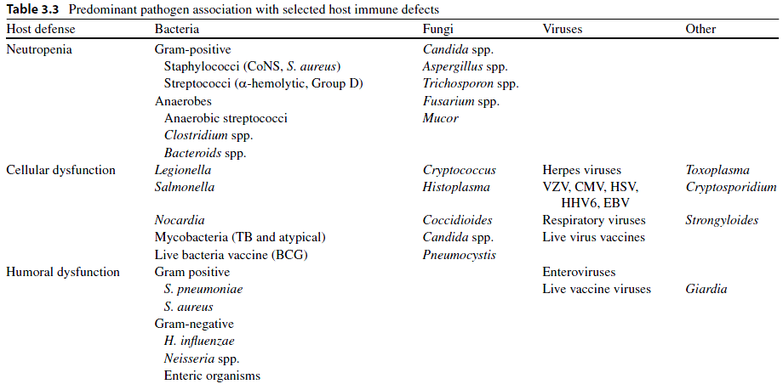

Slide 3
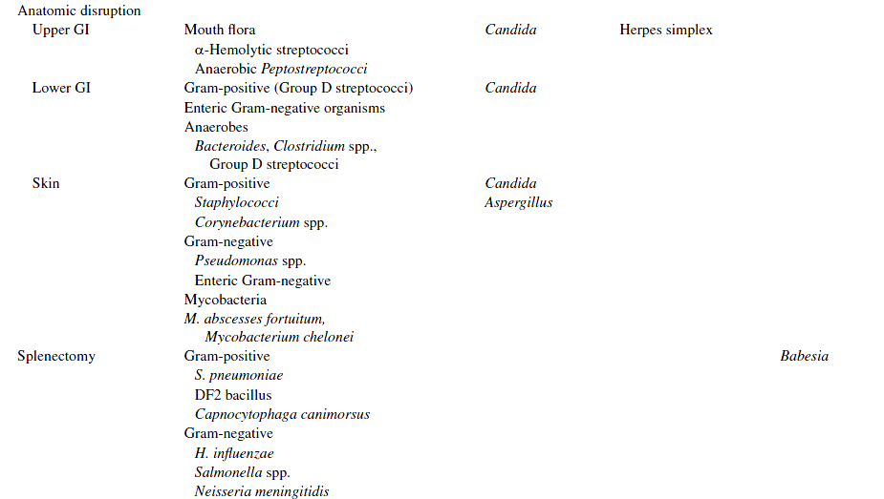

Slide 4
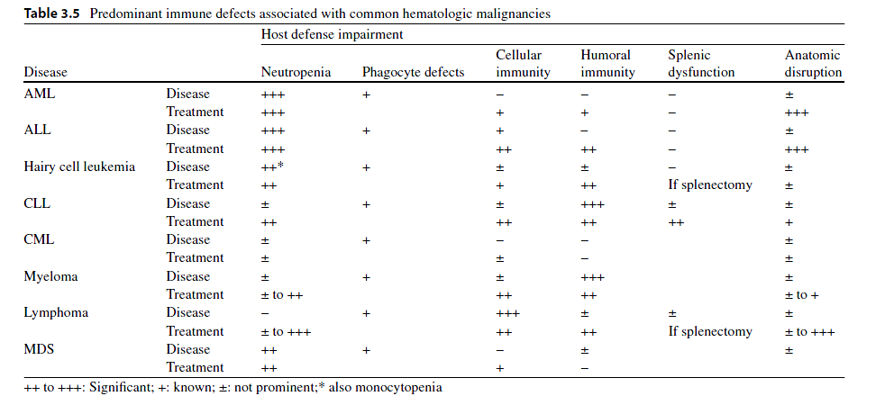

Slide 5
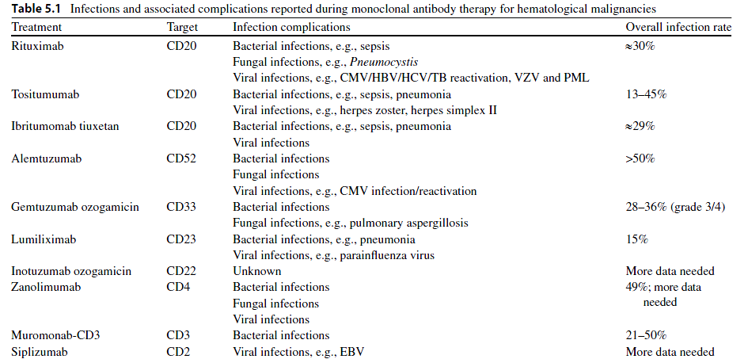

Slide 7
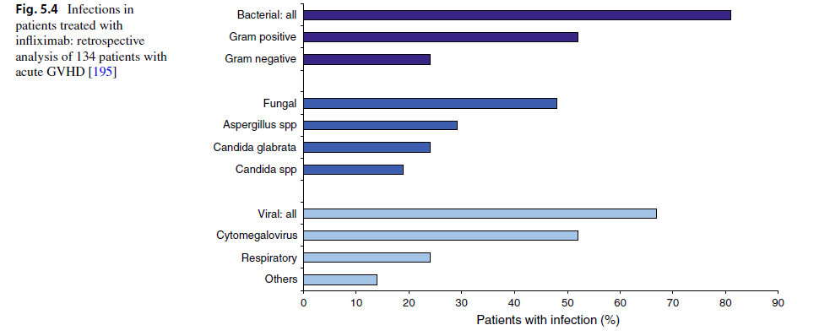

Slide 10
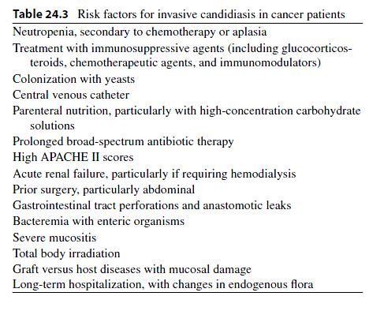

Slide 11
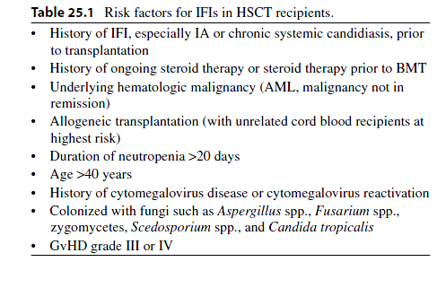

Slide 12
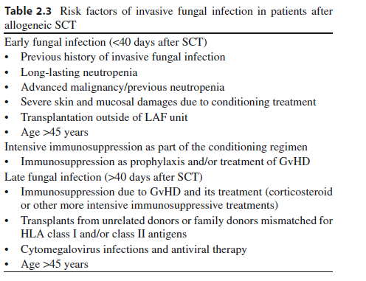

Slide 13
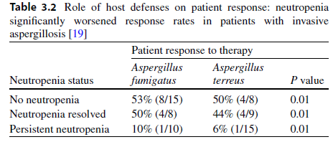

Slide 14
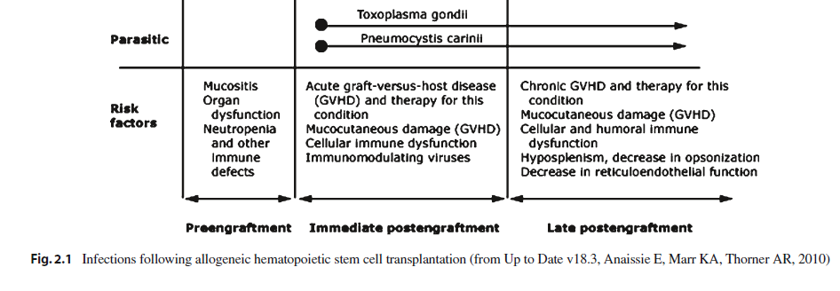

Slide 15
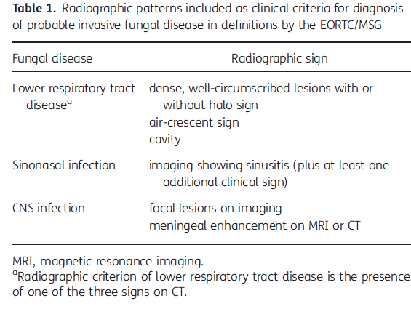

Slide 16
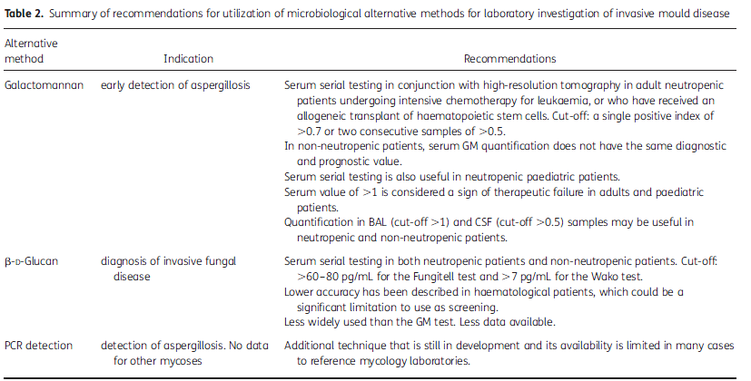

Slide 17
“Gold standard,” blood cultures for the diagnosis of candidemia have been associated with a sensitivity historically ranging from 21.3 to 54% .
The advent of lysis centrifugation has increased the diagnostic yield of blood cultures for the diagnosis of candidemia, albeit with limitations including higher rates of contamination and additional cost and required personnel

Slide 18
The Peptide Nucleic Acid Fluorescent In Situ Hybridization (PNA-FISH) test has been studied and recently introduced in clinical practice for the rapid identification of Candida species. The PNA-FISH for C. albicans has had a sensitivity, specificity, positive, and negative predictive value of 99, 100, 100, and 99.3%, respectively

Slide 19
More recently, a multicenter study evaluated the performance of a rapid two-color PNA-FISH assay for detection of C. albicans and C. glabrata directly from positive blood culture bottles

Slide 20
Considering the relatively low sensitivity of blood cultures, PCR may prove to be a significant adjunct for the diagnosis of candidemia particularly in high risk patients, such as cancer patients. However, a major limitation of most PCR assays is their relative lack of specificity, mostly due to high rates of contamination.

Slide 21
Diagnosis of Hepatosplenic Candidiasis
Definitive diagnosis requires biopsy of hepatic lesions that may reveal hyphal forms consistent with Candida species.
The diagnosis is suggested by the presence of multiple lesions of the liver and spleen, occasionally described as “bull’s eye” appearing on abdominal CT scan or magnetic resonance imaging (MRI)

Slide 22
Invasive mold infections affecting the lungs may present with different patterns on a chest CT, including small or large nodules, patchy, segmental, or wedge-shaped consolidations, peribronchial infiltrates with a tree-in-bud distribution, and cavitation .
Two CT patterns have been associated with early and late pulmonary IA: the “halo” and the “crescent” sign, respectively

Slide 23
Histopathologic confirmation of sterile tissue invasion remains the “gold standard” to establish a proven diagnosis of an invasive mold infection

Slide 24
Severe mucositis and gastrointestinal GHVD following HSCT can occasionally lead to false positive results, likely due to translocation of GM across the intestinal mucosa during periods of reduced mucosal integrity. Younger age has been associated with lower specificity rates, predominately attributed to the high concentration of GM in children’s food (e.g., cereals)

Slide 25
The revised definitions retain the original classifications of “proven,” “probable,” and “possible” IMIs. For most conditions, proven infections require proof of hyphal elements in diseased tissue. To characterize a case as probable, a host factor, clinical features, and a mycologic or nonculture-based surrogate marker (e.g., galactomannan, beta-glucan, or as determined by polymerase chain reaction [PCR]) must be present. Possible invasive fungal disease is more strictly defined to include patients with the appropriate host factors and sufficient clinical evidence of invasive fungal disease, but no mycologic evidence.

Slide 26
For rare molds, the isolation of fungus in respiratory secretions, skin, and blood is not synonymous with invasive disease. Most such cases represent contamination or colonization, even among high-risk patients

Slide 27
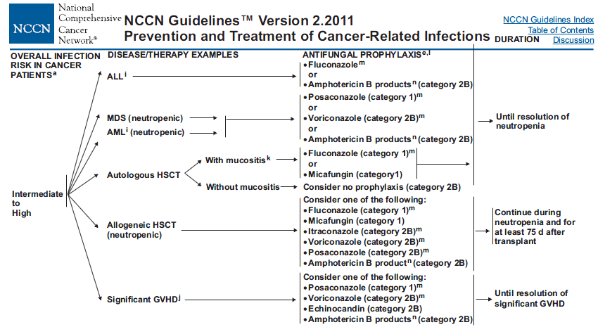

Slide 32
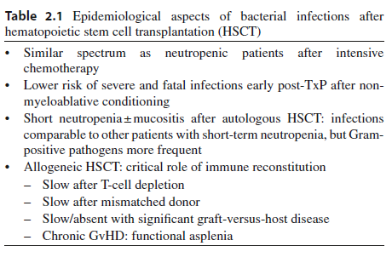

Slide 33
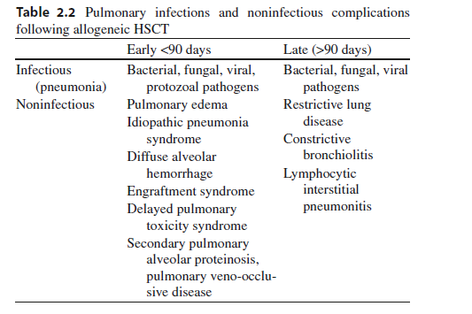

Slide 34
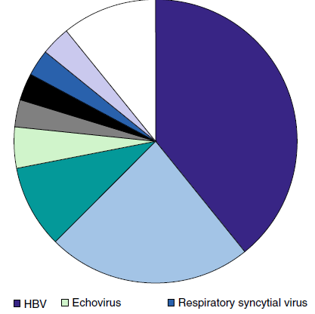

Slide 35
Diagnostic Procedures
Afebrile patient.
−− Daily clinical exam + body temperature at least three times daily.
Note: antipyretic medication (steroids; analgesics such as metamizole)
−− Serum C-reactive protein (CRP) twice weekly.
−− Aspergillus antigen (GM) ³twice weekly..

Slide 36
First fever.
−− Update physical exam, blood cultures, clinical chemistry, CRP, interleukin-6 (IL-6), and thoracic computed tomography (CT) scan; other measures according to clinical findings

Slide 37
Persistent fever.
−− Update physical exam, blood cultures, clinical chemistry, CRP, IL-6, and thoracic CT scan; consider abdominal ultrasound or magnetic resonance imaging (MRI).
−− Check results of antigen testings.

Slide 38
Fever + pulmonary infiltrates.
−− Bronchoscopy + bronchoalveolar lavage (BAL) =>microscopy + culture for bacteria;
test for Mycobacterium tuberculous (MTB)
Pneumocystis,
cytomegalovirus (CMV), respiratory viruses, adenovirus,
Aspergillus + other fungi; check for Aspergillus GM;
optional: Aspergillus-PCR and MTB/Pneumocystis-PCR.

Slide 39
Fever + signs of inflammation at CVC.
−− Blood cultures from peripheral vein and from CVC.
−− Follow-up cultures in case of cultures positive for Staphylococcus aureus and Candida spp.

Slide 40
• Fever accompanied by skin lesions.
−− Blood cultures.
−− Biopsy (=>histopathology and nonfixated =>microbiology).

Slide 41
Neurological symptoms ± fever.
−− Cerebrospinal fluid (CSF) =>human herpes virus-6 (HHV-6); Aspergillus GM; CMV; HSV, VZV.
−− Fundoscopy.
−− Cranial MRI.

Slide 42
Fever + abdominal symptoms.
−− Clostridium difficile toxins; noro-/rotaviruses; CMV; adenovirus; Epstein–Barr virus (EBV).

Slide 43
Perianal infiltrate/abscess.
−− Beware of results from inappropriate microbiological diagnostics suggesting monomicrobial etiology.

Slide 44
Fever + increasing “liver function tests” =>viral (hepatitis B virus (HBV), varicella zoster virus (VZV); CMV, etc.), Candida?
−− Liver ultrasound or CT or MRI (preferred)
NB: Pneumocystis jiroveci typically accompanied by lactate dehydrogenase rise

Slide 45
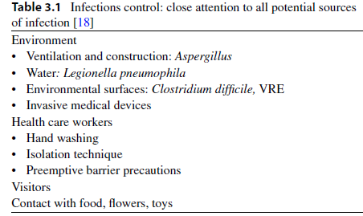

Slide 46
. They
are based on the idea that the strains that have an MIC for an
antifungal above a certain value respond significantly less well
to treatment with that drug, since it is impossible to achieve
therapeutic concentrations in vivo.

Slide 47
To date, breakpoints
have been established for infections by Candida spp. only, and
for some of the antifungal compounds available. For infections
with other species of yeasts and filamentous fungi, no breakpoints
have yet been established, although it is advisable not
to treat with drugs that are inactive in vitro, or with those that
have a high MIC for the species causing the mycosis; this is
known as an epidemiological cut-off.

Slide 48
In the case of Aspergillus
spp., some experts have proposed epidemiological cut-offs
and even tentative breakpoints to interpret the results of susceptibility
testing of those species to azole agents. An MIC value for
itraconazole and voriconazole of ≥2 mg/L, and ≥0.5 mg/L for
posaconazole, should be taken as resistant in vitro.

Slide 50
differential diagnosis
including appendicitis, ischemic colitis, pseudomembranous
colitis, or antineoplastic drug or radiation toxicity

Slide 51
NEC has been described in association with chemotherapy,
typically 10–14 days after cytotoxic chemotherapy, although
cases have been described 30 days after chemotherapy [3, 5].
Patients with leukemia, aplastic anemia, and solid tumor
undergoing high-dose chemotherapy are at an increased risk
[3, 5]. Leukemia and other hematologic malignancies, as
well as recipient of allogeneic stem cell transplantation with
delayed engraftment or acute graft vs. host disease, account
for approximately 75% of reported cases of NEC

Slide 52
Traditionally, cytotoxic drugs such as Ara-C and idarubicin
are implicated [5]; whereas, recently a variety of other
agents have been linked with NEC, including monoclonal
antibody therapy with alemtuzumab [7], taxane-containingregimens [3, 8], cisplatin, and paclitaxel [3]. NEC may also
be seen in noncancer population, recently a case was reported
following unanticipated Chinese herbal drugs-induced
neutropenia

Slide 53
A retrospective study in pediatric cancer patients showed
prolonged
neutropenia and age >16 at cancer diagnosis were
associated with a higher risk for typhlitis [2]. In a prospective
study in adults, no specific risk factor for typhlitis was
seen, and diagnosis was confirmed in 3.5% of cases [11]. An
association with the presence of oropharyngeal mucositis
and risk of NEC has been well described

Slide 54
NEC is a polymicrobial infection and organisms often
associated with this disease entity include enteric Gramnegative
bacteria (GNB) such as Escherichia coli, Proteus
species, and nonfermentative gram-negatives in neutropenic
patients like Pseudomonas aeruginosa and Stenotrophomonas
maltophilia are of concern; among the Gram-positive bacteria,
streptococci, enterococci including vancomycin-resistant
Enterococcus (VRE), and coagulase negative staphylococcus
species may be accompanied with Candida species

Slide 55
13, 14]. Cytomegalovirus or adenovirus enterocolitis may
act as a trigger for a secondary NEC in some cases

Slide 56
Antimicrobial prophylaxis may influence the time of
onset, etiology, and possibly incidence of NEC in patients
undergoing cancer therapy.

Slide 57
. We suspect that NEC is a clinical
syndrome of various primary causes, in most patients
multiple factors appear to be responsible for this entity
including severe neutropenia, young or advanced age, enteric
insult due to cancer, drugs or bacterial toxins such as
Clostridium difficile, subclinical viral disease, or unknown
genetic polymorphisms that predispose some individuals to
develop this disorder.

Slide 58
Patients with concomitant
bacteremia due to enteric organism(s) such as Escherichia coli, enterococci, and streptococci give a partial
spectrum of this polymicrobial disease, although sterile
blood cultures do not exclude a low-grade, intermittent
bacteremia
and/or fungemia in the profoundly neutropenic
susceptible patients

Slide 59
Other common causes that may be
mistaken for NEC include ischemic bowel injury, C. difficile
colitis, appendicitis, or Ogilvie’s syndrome [3]. To further
complicate the diagnosis, there is a suggestion that the latter
entities can coexist, with one small pediatric study suggesting
that the combination of appendiceal thickening and
enterocolitis may more likely to result in surgical intervention
[21]. It was interesting to note that higher mortality was
seen in children with NEC without evidence of appendicitis
[21]. The frequency of NEC cases with concurrent or
preceding
C. difficile toxin-induced intestinal epithelia cell
damage remains uncertain

Slide 60
A comprehensive review of adult neutropenic patients
with enterocolitis, appropriate diagnosis can be established
by (1) >4 mm of bowel wall thickening on CT or ultrasonic
abdominal scan combined with (2) clinical features such as
fever, abdominal pain, and diarrhea (Fig. 16.1a) [3]. Several
studies in pediatric and adults showed that a substantial
proportion of neutropenic patients may not exhibit fever or
abdominal pain during the early phase of the disease [2, 5,
11]. Therefore, a high level of suspicion in febrile neutropenic
patients even in the absence of abdominal pain and/or
distention with diarrhea or clinical or radiographic features
of paralytic ileus should raise concerns for possible
enterocolitis.

Slide 61
we recommend that bedside
abdominal ultrasounds should be reserved for unstable
patients in whom transport to the CT scan units is deferred,
similarly, patients with other serious limitations for CT scan
should than be evaluated with an abdominal X-rays and
ultrasounds

Slide 62
We suggest a combination of clinical symptoms
such as abdominal pain, fever, or diarrhea in the setting of
neutropenia and possibly cytotoxic chemotherapy combined
with imaging studies (CT abdomen) that demonstrate bowel
wall thickening (3–5 mm) and in severe case pneumatosis
intestinalis may be used (Fig. 16.1b) [3, 11]. It is important
to assess other potential treatable causes that may mimic
these features such as ischemic colitis and C. difficile colitis.

Slide 63
Cases of
prolonged
neutropenia may benefit from recombinant myeloid
growth factors such as G-CSF or GM-CSF and in select
patients with refractory neutropenia, healthy donor-derived
granulocyte transfusions may be considered

Slide 64
In neutropenic patients who are undergoing treatment for
hematologic malignancies, the frequency of CDI was 7%
among 875 courses of myelosuppressive chemotherapy

Slide 65
CDI should be suspected in all hospitalized cancer patients
with neutropenia who develop diarrheal illness, despite the
fact that chemotherapy-induced oro-intestinal tract mucosal
disruption may have indistinguishable clinical and radiologic
features.

Slide 66
Furthermore, in patients with leukemia, CDI has
been associated with secondary systemic bacterial infections,
such as vancomycin-resistant enterococcal intestinal colonization,
and is at a significantly higher risk for VRE bacteremia
following CDI

Slide 67
factors that increase the risk for acquiring CDI include being
elderly, immunosuppressed or with multiple comorbidities,
receiving tube feedings, parenteral feedings, or undergoing
gastrointestinal surgery, and cancer chemotherapy.

Slide 68
Certain
host-related factors like infection by human immunodeficiency
virus, solid organ transplantation, or bone marrow transplantation
render them particularly susceptible to CDI.

Slide 69
This absence of the
classic risk factors seen in adults indicates that toxigenic
strains of C. diff may in fact be part of the normal flora in
young children

Slide 70
In
patients with multiple myeloma or lymphoma, the risk of CDI
is low although this risk increases following autologous stem
cell transplantation to 15%

Slide 71
The risk factors
associated with CDI in these patients were prior therapy with
cephalosporins and intravenous vancomycin, On the other
hand, patients treated with paclitaxel had a lower incidence of
CDI when compared to those who were treated with hematopoietic
growth factor as part of mobilization regimen

Slide 72
Acute leukemia patients are exposed to higher risk of CDI
while on chemotherapy due to probable intestinal track colonization
and diarrheal disease [41–44]. 5-fluorouracil has been
implicated in increasing the risk of CDI in patients with solidorgan
cancer

Slide 73
Treatment with mitoxantrone and
etoposide has also been associated with CDI in patients with no
antibiotic exposure for over 6 months

Slide 74
Low serum and/or intestinal antibody
response to C. diff toxin A is associated with severe, prolonged,
and recurrent C. difficile diarrhea

Slide 75
This was
not due to widespread humoral immune deficiency or of
IgG subclass deficiency but due to selective reduction in
IgG2 and IgG3 subclass responses

Slide 76
In patients with acute leukemia and
in whom symptoms persist despite appropriate CDAD
therapy, diagnostic assays for CMV reactivation, such as
CMV antigenemia, serum fungal antigen like galactomannan,
and if possible histological evaluation of tissue samples
for special viral and fungal stains, may provide
life-saving information.

