Slide 2
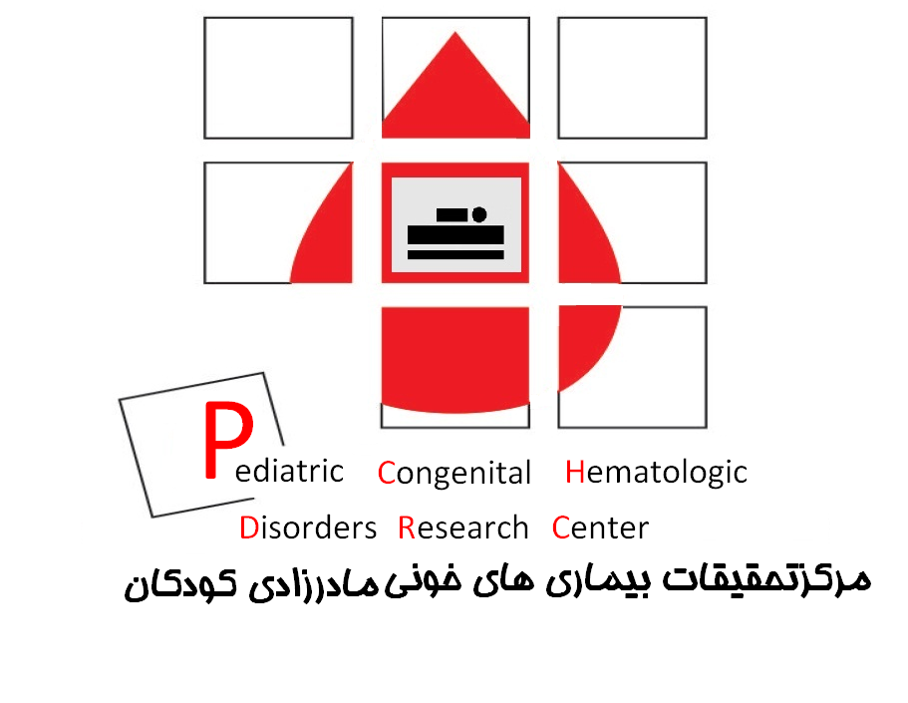
Hematological & Hemostatic manifestations of SARS-CoV-2 in children
Peyman Eshghi
Prof. of Pediatric Hematology &Oncology
Mofid Children`s Hospital
Pediatric Congenital Hematologic Disorders Research Center
SBMU
11-1399

Slide 3
COVID-19 in pediatrics
Less frequent:
  Pediatrics AAO : up to September 2020, children comprised 10% of cases and 0.3% - 3.6% of all hospitalizations in US
  Chinese CDC :2% of the cases were aged younger than 19 years
It is less severe than adult
  6% of children have severe disease versus 26% of adults
  CDC in US :73% of pediatrics present with fever and cough versus 93% in adults
Rarely skin lesion seen including :
  vasculitis, fibrin thrombus, erythema multiform and Kawasaki disease
Thrombosis can occur in children although it seems less severe than adults
Multisystem inflammatory Syndrome (MIS)
1.Singh T et al. Clin Infec Dis. 2020
2. Wang Y et al. Pediatr Inf Dis.J 2020
3. Services aap org/en/pages/2019-novel-coronavirus-covid-19-infections/children-and-covid-19-state-level-data-report. 2020.

Slide 4
Raised leukocyte and neutrophil counts have been associated with unfavorable progression in adults.
Lymphopenia was detected in 80% of critically ill adults, but in only 25% of adults with mild disease
  The SARS-CoV-2 may directly infect lymphocytes via ACE2 receptor receptor expressed on lymphocytes
  systemic increase in cytokines and inflammatory mediators may result in marked lymphocytic apoptosis
A greater number of lymphocytes was associated with faster virus clearance
At a younger age, ACE2 receptors is less developed,

Slide 5
Hematological findings and complications of COVID-19 in children
Original studies published up to July 27, 2020
Kosmeri C, et.al.Pediatr Blood Cancer. 2020;67:e28745. https://doi.org/10.1002/pbc.28745
  15 studies
  71 children Hospitals
  723 children hospitalized with COVID-19
Systematic review & Meta-analysis
  Henry BM, et al. Clin Chem Lab Med.2020;58:1135-1138
  PatelNA. PediatricCOVID-19: systematic review of the literature. Am J Otolaryngol. 2020;41:102573.
  Meena J, et.al. Indian Pediatr. 2020;S097475591600203.
  Ma X, et.al .JMedVirol. 2020. https://doi.org/10.1002/jmv.26208
  Raba AA, et.al.Acta Paediatr.2020;109(10):1948-1955.

Slide 6
WBC count :
  the majority of children with COVID-19 had a normal WBC count
  lymphopenia was rarer in children than in adults.
  The absence of significant lymphopenia in children may be explained by the milder disease in this population.
  The most common WBC abnormality in children with COVID-19 was leukopenia, while in infants and neonates, lymphocytosis was more common.
  Discrepancy among the available studies regarding the correlation of hematological manifestations with the severity of the disease in children.

Slide 7
Hb levels :
  were normal not only in asymptomatic children with COVID-19 but also in severe disease, and did not differ between children admitted to the ICU or to a medical unit.
  Anemia was a common feature in the children with a Kawasaki-like disease associated with SARS-CoV-2 infection, called multisystem inflammatory syndrome
Platelet count :
  were normal in most of the children with COVID-19
  Thrombocytopenia has been associated with respiratory deterioration in children more often encountered in critically ill patients and those admitted to the pediatric ICU.

Slide 8
Convalescent plasma for pediatric patients with
SARS-CoV-2-associated acute respiratory distress syndrome
Diorio C, Anderson EM. Convalescent plasma for pediatric patients with SARS-CoV-2-associated acute respiratory distress syndrome. Pediatr Blood Cancer. 2020;67(11):e28693
four pediatric patients with severe COVID-19.
CP was safe:
  No CP-related TEAE
  No risks of ADE or elimination of endogenous antibody response
CP may be of greatest benefit for:
  patients who are early in their illness and have not yet generated endogenous antibodies, and
  when the infused plasma has a high antibody titer.
  The small sample size of our study precludes definitive conclusions about efficacy, however, the excellent clinical response in this patient is encouraging
  There are also other few case reports

Slide 9
COVID-19 infection in pediatric oncology patients
Pediatric patients with cancer are at a higher risk of life threatening complications from respiratory viral infections and higher incidence of coinfection
adult oncology patients are at higher risk of complications from COVID-19 than those without cancer
From current evidence, pediatric patients with cancer do not appear to have a higher mortality rate from SARS-CoV-2 infection, although these patients may have a worse outcome in low- and middle-income countries
Balduzzi A, et.al.Bone Marrow Transplant.2020;1-6.
Amicucci M, et.al. Pediatr Blood Cancer. 2020; e28505.
Gampel B, et.al. Pediatr Blood Cancer. 2020; e28420.
Montoya J, et.al. Pediatr Blood Cancer. 2020; e28610.

Slide 10
thrombotic complications in children with COVID-19
Extracellular RNA has been identified to be both a natural factor VII-activating protease cofactor, and a natural procoagulant cofactor for FXII and XI
Overactivation of the complement system
Antiphospholipid antibodies
Neutrophil extracellular traps (NETs), which are extracellular networks of chromatin and nuclear and antimicrobial proteins, activate extrinsic and intrinsic pathways and also act by trapping and activating platelets
Endothelitis due to ACE2 receptors expressed in vascular endothelium

Slide 11
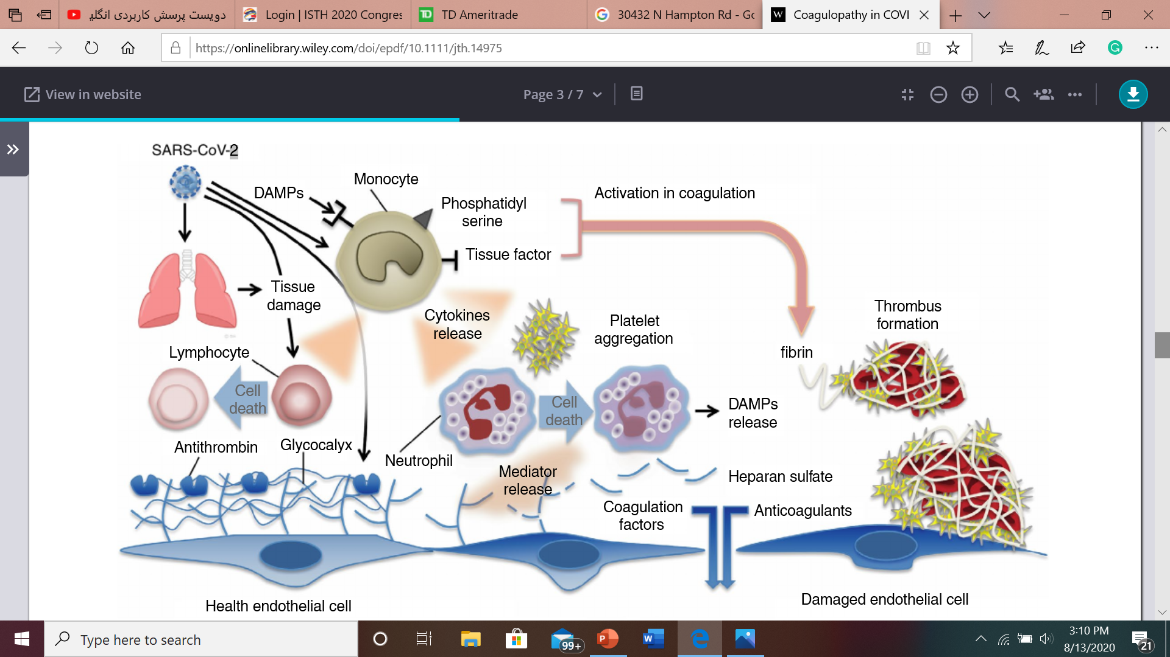
Mechanisms of coagulation activation in Covid-19
Both virus and damage-associated molecular patterns (DAMPs) from injured host tissue can activate monocytes.
Activated monocytes release inflammatory cytokines and chemokines that stimulate neutrophils, lymphocytes, platelets, and vascular endothelial cells.
Monocytes and other cells express tissue factor and phosphatidylserine on their surfaces and initiate coagulation.
Healthy endothelial cells maintain their anti-thrombogenicity by expressing glycocalyx and its binding protein antithrombin.
Damaged endothelial cells change their properties to procoagulant following disruption of the glycocalyx and loss of anticoagulant proteins
Iba T.Et al. J Thromb Haemost. 2020;00:1–7

Slide 12
Hematologic and Inflammatory parameters in COVID-19 associated with coagulopathy
Raised D-dimer
  Elevated level of D-dimers at admission is an independent prognostic factor for severe disease and mortality
Elevated Fibrinogen, vWF and FVIII due to endothelial activation by COVID-19
Prolonged PT but rarely prolonged PTT
Rarely Thrombocytopenia (5% on admission)
  Thrombocytopenia and prolonged PT correlate with severity
Viscoelastic testing : increased evidence of clot strength in ROTEM parameters of EXTEM MCF and FIBTEM MCF (increased clot firmness with contribution from fibrinogen) in children with SARS-CoV-2 infection
Elevated IL6
  Correlated with increased Fibrinogen and worse outcomes
1.Fei Zhou et al. Lancet 2020; 395: 1054–62
2. Klok F.A. et al. Thrombosis Research. July 2020, Pages 145-147

Slide 13
Coagulation outcome in children with SARS-COV 2
DIC, uncommon and is seen in patients with prolonged hospitalization, sepsis and ICU admission
  Coagulopathy can progress to DIC 7-10 days after hospitalization in critically ill ICU patients due to ARDS, secondary infection, prolonged mechanical ventilation and multiple organ failure
  Progression to DIC is correlated with disease progression
Hypercoagulability and microvascular thrombosis is usually seen in severe and ill hospitalized and ICU patients
ICU versus non-ICU patients:
  increased thrombin generation ;higher tissue plasminogen activator (tPA); plasminogen activator inhibitor-1 (PAI-1); and thrombin activatable fibrinolysis inhibitor (TAFI) levels
Venous thrombosis is significantly more common than arterial thrombosis

Slide 14
COVID-19 coagulopathy approach ≤ 18 years old
On admission
  Check CBC, PT/PTT, Fibrinogen, D-dimer, ATIII. Bun, Cr every other day
  Start anticoagulation for everybody who is COVID-19 positive
    Target: Anti-Xa: 0.2-0.4 units/ml
  If D-dimer is> 500 ng/ml (5ug/ml) or respiratory deterioration (O2>5 L nasal canula or need High-Flow oxygen therapy through Nasal Cannula or non-rebreather mask or intubation)
    Increase therapeutic dose with target Anti-Xa: 0.6-1.1 units/ml
    Perform four extremities doppler sonography
    Perform CT scan to R/O pulmonary emboli if respiratory comprise
  If D-dimer is <500 ng/ml or O2 < 5 L Nasal canula or age<7 years old
    Continue thromboprophylaxis
On discharge:
  Two weeks prophylactic or therapeutic anticoagulation
  Obtain radiologic imaging to rule out DVT
Montefiore Children’s Hospital, Colombia University, New York, USA,2020

Slide 15
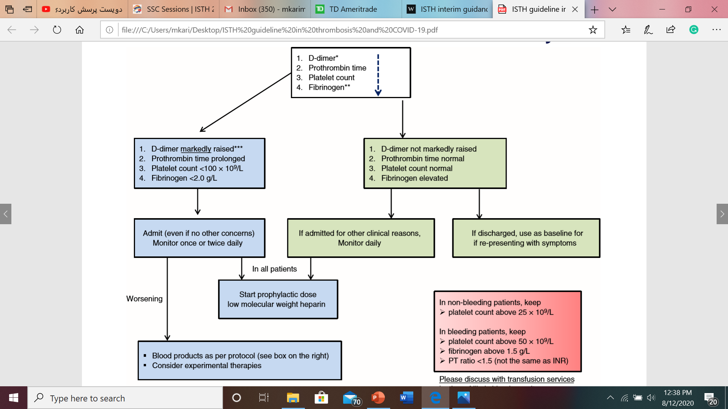
Suggested ISTH algorithm for management of coagulopathy in COVID-19
Give prophylactic heparin to everybody with hospitalized COVID-19 in the absence of contraindications
1.Thachil J. et al. J Thromb Haemost. 2020;18:1023–1026
2. Ian LEONARD-LORANT et al. Radioligy, 2020. In press
*** Although a specific cut-off cannot be defined, a three- to four-fold increase in D-dimer values maybe considered significant

Slide 16
Review Contraindications to Chemoprophylaxis
Absolute contraindications to anticoagulation
  Intracranial hemorrhage
  Acute hemorrhagic stroke/brain ischemia
  Ongoing and uncontrolled bleeding
  Uncorrected coagulopathy
  Incomplete spinal cord injury with suspected or known paraspinal hematoma
  Allergy to UFH or enoxaparin
  Platelet count < 50,000/mcl
  The patient requires an invasive procedure within the next 24 hours (LMWH)
  Puncture/epidural/spinal anesthesia within the previous 4 hours
  Congenital bleeding disorder
  Uncontrolled severe hypertension
  Intracranial mass

Slide 17
Suggested intensified anticoagulation management algorithm for patients ≤ 18 years old affected by COVID-19

Slide 18
  In Moderate to sever Hospitalized patients:
    Start standard thromboprophylaxis by monitoring CBC, Bun, Cr, PT/PTT, D-dimer, fibrinogen, AT3, and Anti-Xa (target: 0.2-0.4 units/ml) every other day.
    Switch to double dose thromboprophylaxis if D-dimer is >500 (5ug/ml) and Ferritin> 500 ng/ml and those with worsening clinical situation. Target Anti-Xa: 0.4-0.8 units/ml
    Consider therapeutic dose anticoagulation if D-Dimer > 2500 ng/ml, Platelet count> 450 x10⁹/L and CRP elevation>100 mg/dL. Target Anti-Xa: 0.6-1.1 units/ml
  In critically ill Patients meet one of three criteria: (a) respiratory failure, (b) septic shock, and (c) multiple organ failure:
    Start double dose thromboprophylaxis (Target Anti-Xa: 0.4-0.8 units/ml)
    Start therapeutic dose anticoagulation if D-Dimer > 2500 ng/ml, Platelet count> 450 x10⁹/L and CRP elevation>100 mg/dL. Target Anti-Xa: 0.6-1.1 units/ml
    Consider Heparin resistance if:
    >25 IU/kg/Hr heparine is infused and no prolongation of PTT seen

Slide 19
Anticoagulation recommendations for patients
critically ill COVID-19 phenotype admitted to the pediatric intensive care unit (PICU)
moderate to severe COVID-19 phenotype need hospitalization
Long chain (unfractionated) heparin would theoretically be preferable among anticoagulants because of their anti-inflammatory effects while LMWH has less of an anti-inflammatory effect and DOACs have little.
IV unfractionated heparin also has an advantage in that it can be stopped quickly if bleeding occurs
UFH :
  loading dose: 75 Units/kg IV over 10 minutes (Max 5000 Units)
  Initial maintenance infusion dose: (Max initial rate 1300 Units/hour)
  - Age <12 months: 28 Units/kg/hour
  - Age 1-15 years and <70 kg: 20 Units/kg/hour
  - Age ≥16 years and ≥70 kg: 18 Units/kg/hour
Anticoagulation with therapeutic dose (Consider Enoxaparin):
  <2 mo: 1.5 mg/kg/dose SC q12 h
  ≥2 mo: 1 mg/kg/dose SC q 12h
Titrate to Anti-Xa 0.6-1.1 units/mL
* If renal impairment (CrCl < 30 mL/min) OR invasive procedure is expected consider unfractionated heparin (UFH)†
Chemoprophylaxis (Enoxaparin)
  <2 mo:
  0.75 mg/kg/dose SC q12 h
≥ 2 mo:
  Wt <40 kg:
    0.5 mg/kg/dose SC q12 h
  ‎Wt ≥40 kg:
    40 mg SC qd
Titrate to Anti-Xa 0.2-0.4 units/mL
* If renal impairment (CrCl < 30mL/min) consider unfractionated heparin (UFH) †

