Slide 2

Immune Tolerance Induction for FVIII inhibitors:
Importance,Questions and Guidelines
PEYMAN ESHGHI
Prof. of Pediatric Hematology & Oncology
Mofid Comprehensive Care Center for Children with Hemophilia(MCCCH)
S.B.M.U
Tehran-26-1-1400

Slide 3
Introduction
WHY: Importance
WHAT : Definition
HOW: Mechanism
WHO: ITI outcome:Risk groups ,Predictors
WHICH Methods & protocols
Iranian experience:
  Cost-Effectiveness : HTA study in Iran
  Clinical observation and pilot reports
Main Questions & Challenges

Slide 4
Why ITI in Inhibitor patients:
More Cost of Treatment:
  Limitted access to product
  No prophylaxis in low and middle income countries
  More morbidity
No lab. monitoring for treatment
Less than 100% responsiveness to both BPAs
Less QOL

Slide 5
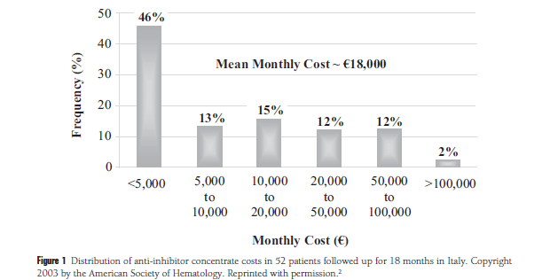
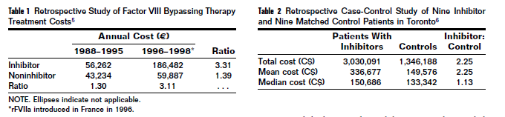
Semin Hematol 42(suppl 4):S14-S17 © 2006
It is estimated that the cost of hemostatic therapy for patients
with inhibitors can be 2.5 times higher than the cost for patients without inhibitors.

Slide 6
Incidence of Inhibitor development in haemophilia A
Global report of 15-35% (especialy in developed countries)
in Iran:
184 /1280 HA (14%) from IKH:22%, 9.4%and 3.5% of severe, moderate and mild HA respectively
41 cases (3.5%)were high responders
Sharifian R, Hosseini M. Prevalence of inhibitor in 1280 cases with Hemophilia. Acta Medica Iranica 2003; 41: 66-8.
100 /355 HA (28.1%) from six HTC in the east and south of Iran
14 cases (4%) were high responders
Eshghi P, Jazebi M, Hoorfar H, et al. Multicentric screening of factor VIII inhibitor in 355 Hemophilia a patients in IRAN 2005. Haemophilia 2006; 12: 60.

Slide 7
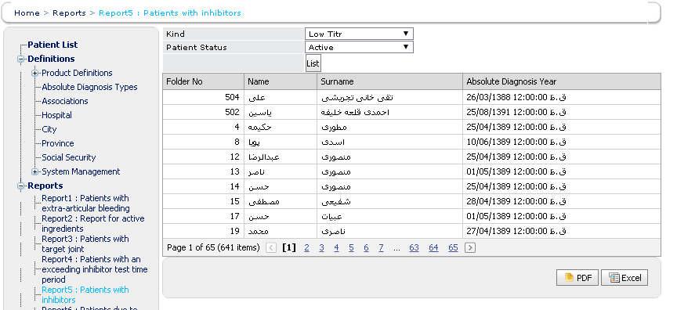
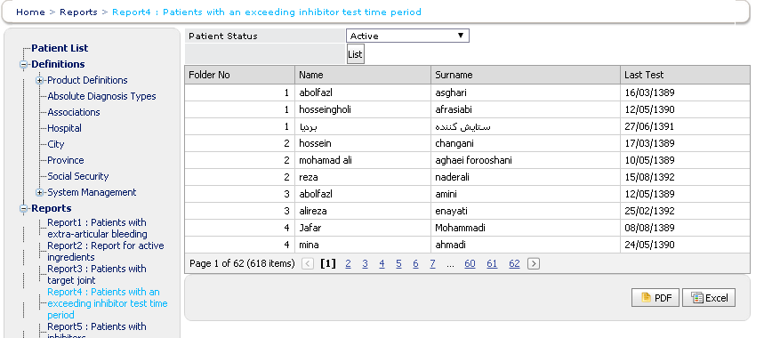
641 registered HA patients with INH (~16%)
HR ?
LR ?
618/641 of registered patients with inhibitor have not been tested again or their results have not been entered

Slide 8
SIPPET STUDY
Risk of Inhibitor Development in PUP
ALL:35.4%
  rFVIII: 44.5% (CI95 34.7-54.3)
  pdFVIII: 26.8% (CI95 18.3-35.2)
High titer: 23.3%
  rFVIII: 28.4% (CI95 19.6-37.2)
  pdFVIII: 18.6% (CI95 11.1-26.9)

Slide 9
imported coagulating factors
 | 1387 | 1389
subsidization budget | 60,000,000 $ | 70,000,000 $
All patients | 8 500 $/capita | 10,000 $/capita
Non-inhibitor patients | 6800 $/capita | 6400 $/capita
Patients who use Bypassing agents | 55000 $/capita | 77500 $/capita

Slide 10
Defenition:
Immune Tolerance Induction is a method of treatment in hemophiliacs with inhibitor to eradicate neutralizing Abs against coagulation factors :
  Immune suppression +/- high volume plasmapheresis
  With continuous chronic high dose exposure to targeted coagulation factor
the first report of use of immune tolerance induction (ITI) in a hemophilic patient.
Brackmann HH, Gormsen J. Massive factor-VIII infusion in haemophiliac with factor-VIII inhibitor, high-responder. Lancet. 2(8044), 933 (1977).

Slide 11
Immune Tolerance Registries
 | Haemophilia A | Haemophilia B
International *(Mariani) IITR | 249 | –
German (Lenk) GITR | 106 | 2
N. American (DiMichele) NAITR | 130 | 11
Total | 485 | 13
*The first and unique randomized-controlled trial on ITI in hemophilia.
**Three other independent groups have developed consensus recommendations for the current practise of ITI in patients with severe hemophilia A and high titer (>5 BU) inhibitors:
ECP ;ICP ; the United Kingdom Haemophilia Centre Doctors Organization(UKHCDO)

Slide 12
Success
To achieve ALL OF THE BELOW :
undetectable inhibitor titer (≤ 0.6 Bethesda Units (BU)by Bethesda or Nijmegen assays)
a plasma FVIII recovery ≥ 66% of expected
half-life of 7 h , determined following a 72-h FVIII exposure free period
OR Alternatively,
when the alternate day dose has been tapered to 50 iu/kg or less and the 48-h trough is measurable (>1%)
Collins PW, Chalmers E, Hart DP et al. Diagnosis and treatment of factor VIII and IX inhibitors in congenital haemophilia: 4th edition. Br. J. Haematol. 160(2), 153–170 (2013).

Slide 13
Partial success:
ALL of the below:
  Reduction in inhibitor titer to ≤ 5BU,
    undetectable inhibitor titer (by International ITI Study (I-ITI Study) )
  unaccompanied by both normalization of FVIII PK
  Clinical response to FVIII
    They don`t need BPAs to stop bleedings
  No increase in the inhibitor titre >5 BU over a 6-month period of on-demand therapy or a 12-month period of prophylaxis
  *Under a clinical point of view, partial responses are generally considered as successes considering that FVIII replacement is restored, although impaired PK usually leads to use FVIII concentrates at higher dose repeated at shorter intervals as compared with replacement therapy in non-inhibitor patients.

Slide 15
Failure:
Failure to attain the definition of success within 33 months of uninterrupted ITI
OR
failure to demonstrate a progressive 20% reduction in inhibitor titer over each successive 6-month period of uninterrupted ITI, beginning 3 months after initiation to allow for expected anamnesis
*This definition implies a minimum ITI duration of 9 months before failure is declared.
**33 months is the maximum duration of ITI,

Slide 16
Relapse
Inhibitor recurrence during the 12 month follow-up period on prophylaxis after success as evidenced by recurrent positive inhibitor titer or impaired FVIII pharmacokinetics (PK)
(by International ITI Study (I-ITI Study) )
*approximately 4–8% cases relapse after successful ITI reveals

Slide 17
ITT protocols – dose
Bonn
300–400 FVIII U/kg
daily, divided in 2-4 doses
North America
50–100 FVIII U/kg
daily
The Netherlands
25 FVIII U/kg
every other day
Kasper CK. Treatment of Haemophilia 2004;34
Collins PW. Haemophilia 2006; 12: 7-18
Tolerance to the deficient clotting factor can be achieved by giving frequent doses of FVIII over a prolonged time period
Typical dosing schemes are:
Some treatment centres also add short courses of corticosteroids (e.g. prednisone) – efficacy unproven
Addition of rituximab to ITI may improve response in patients difficult to tolerize

Slide 19
Mechanism
chronic exposure of patients with haemophilia A to FVIII under ‘non-dangerous’ conditions could be speculated to induce FVIII-specific T cells that are able to suppress the activity of FVIII-specific effector T cells.
There is a threshold dose of FVIII for the optimal stimulation of memory responses both in vitro and in vivo. FVIII doses above this threshold inhibit rather than stimulate FVIII-specific memory B-cell responses:
  selective inhibition and eradication of memory B-cells
  Defect in re-stimulation of FVIII-specific effector T cells
  induction of Treg.
Apostolou & von Boehmer, 2004; Chen et al, 2004

Slide 20
Patient-related predictors of success
Age:
  Age at ITI start, Age at inhibitor development
Race/ethnicity
FVIII genotype :Approximately 15% of the known FVIII mutations*
  Specific alleles associated with two immune response modifier genes, IL-10 and TNF-a
Hemophilia severity & type
Family history

Slide 21
Age
Age at start of ITI:
  < vs > 7 years
the time elapsing between inhibitor development and ITI start rather than age per se influences most ITI outcome considering that the longer inhibitors persist the more difficult is to revert the immune response abolishing antibodies production
Oldenburg J, et al. Haemophilia 20(1), 83–91 (2014).

Slide 22
Failure:
Significant correlation between titre at start of ITI (<10 BU) and successful outcome of ITI
Role of age at start of ITI not clearly confirmed by registries
No significant correlation between interval dx of inhibitor and start of ITI and outcome of ITI in large registries (ITSG p 0.002; NAITS p 0.10) ??

Slide 23
Race/ethnicity
No difference in success rates was found between Africans, Hispanic/Latinos and patients of other races
DiMichele DM, et al.. NAITR, Thromb. Haemost. 87(1), 52–57 (2002).
Hay CRM, et al.IITR Blood 119(6), 1335–1344 (2012).
lower ITI success rate among African Americans (58 vs 92% in Caucasians) in other studies
Callaghan MU,et al. Haemophilia 17(3), 483–489 (2011).

Slide 24
FVIII genotype
PROFIT Registry :
  higher success rate of a low inhibitor risk as compared with those with high-risk mutations (81 vs 47%; adjusted odds ratio 6.2, 95% CI 1.1–36.0) [12]
Coppola A,et al.J. Thromb. Haemost. 7(11), 1809–1815 (2009).
large deletions of FVIII gene was associated with ITI failure [40,41].
Salviato R, et al. Haemophilia 13(4), 361–372 (2007).
Peyvandi F, et al. Haemophilia 12(Suppl. 3), 82–89 (2006)

Slide 25
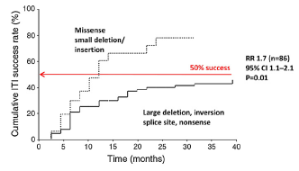
J. Astermark / Thrombosis Research 127 (2011) S6–S9
Mutations & Genetic Factors and
success rate

Slide 27
Treatment-related predictors of success
1-Inhibitor titre at start of ITI:
  >10BU
2-Maximum historical inhibitor titre:
  Different cut offs most of them >100BU or > 200BU
  I-ITIR* : By univariate analysis the higher was the peak titer the higher was the risk of failure, but this was not confirmed in the multivariate model indicating that in good risk patients this variable has less impact on ITI outcome
*The first and unique randomized-controlled trial on ITI in hemophilia. Hay CRM, DiMichele DM. Blood 119(6), 1335–1344 (2012).
3-Inhibitor peak on ITI :
  Italian PROFIT Registry :below 100 BU/ml was associated with higher chance of achieving tolerance
  I-ITIR: in the good risk population ,this variable resulted the only independent predictor of success in the multivariate model Time elapsing between inhibitor development and ITI start Hay CRM, DiMichele DM. Blood 119(6), 1335–1344 (2012).

Slide 28
•Poor risk if > 250 BU
•The best indicator of success or failure of ITI on multivariate analysis of the I-ITI study

Slide 29
Treatment-related predictors of success
4-FVIII dose and treatment schedule.
  a very wide dose regimens (25U/kg QOD to 150U/kg BID)
  Main challenge : 200U/Kg/day vs <200U/Kg/day
  the most common dose used in the field practice is 100 IU/kg every day or every other day as reported in the NAITR (52% of cases), in the IITR (48% of cases) , in the Italian PROFIT registry and in many other observational studies
  I-ITI study (50U/kg QOD vs 100U/kg BID):
    the success rate was rather high and similar in the two arms (70% for both);
    the high dose arm reached the major endpoints in a significant shorter time period than the low-dose arm
    the low-dose arm bled significantly more than high dose arm during ITI
  NAITR reported a more significant impact of doses on time to achieve tolerance than on success rate per se
  A meta-analysis of data coming from both registries ultimately demonstrated that in patients with a good risk profile FVIII dose did not impact on success rates
5-The role of infusions frequency during ITI

Slide 30
Success 69,7%; partial response 4,4%; failure 25,8% ; ITI success rates did not differ between treatment arms (24/58 LD vs 22/57 HD; p=0.909)
Significantly shorter time to negative inhibitor titer (p=0.017) and to normal recovery (p=0.001) with HD
Peak titre on ITI predicted outcome
Neither bleeding nor infections influenced outcome
LD subjects bled more often (OR 2.2; p 0.019). Early bleed rate per months 0.62 LD and 0.28 HD (p 0.00024)

Slide 31
Treatment-related predictors of success
6-Time to ITI since inhibitor development Inhibitor :
  IITR and NAITR: <5Y
  OTHER ( Orsini et al.Haematologica 90(9), 1288–1290 (2005) /Oldenburg J, et al. Haemophilia 20(1), 83–91 (2014). ): <2y
  Prompt ITI at Inhibitor Diagnosis Regardless of Titer: [Nakar et al, Haemophilia 2015]
    ITI start within 1 month of detection: Success rate 91% (21/23 pts)
    ITI start >6 month of detection: Success rate 64% (7/11 pts)
7-ITI interruptions:
  >2 weeks are associated with lower success rates
8-FVIII product type:
  pdFVIII vs rFVIII vs VWF contained FVIII : no robust evidence support the superiority/inferiority of certain types of FVIII concentrates to be used for ITI
  In I-ITIR and NAITIR most patients are tolerized with the same product in use at time of INH detection
  No evidence to support switching to another FVIII product for de novo ITI [DiMichele et al. Haemophilia 2007; 13 (Suppl. 1): 1–22]

Slide 32

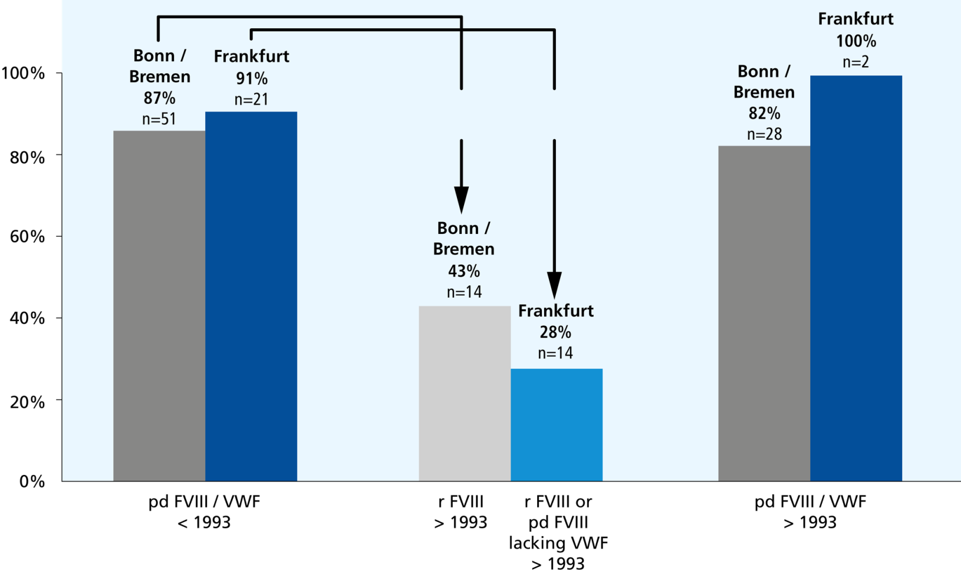
Treatment options and regimens in ITI
FVIII/VWF - concentrate in ITI
The German Experience
Frankfurt
86%
n=21
 | <1990 n=51 | ≥1990 – 7/2001 n=42
Success rate | pd F VIII | r F VIII | pd F VIII
High responders | 86% | 54% | 78%
Low responders | 93% | 72% | 91%
  Decrease in ITI success rate with rFVIII was highly pronounced in the high responders and less in low responders
Kreuz et al. Haematologica 2001; 89(s4): 16-22
Auerswald et al. Haematologica 2003; 88(s9): 21-25

Slide 33
Treatment options and regimens in ITI
Reversal of ITI-Failure
With change of high purity FVIII concentrates without VWF
to FVIII with high content of VWF* (1993-2001)
High responders (>5 BU) n=13 | median | range
Age at first ED (years) | 1.0 | 0.1-50
Number of EDs until inhibitor (n) | 13 | 4-100
Maximum inhibitor titre (BU) | 97 | 8-287
Time until change of concentrate (months) | 3.3 | 1.4-20
Time until complete success (months) | 17 | 5-36
Complete success in 10/13 patients (77%)
Haemate P® (CSL Behring), Immunate® (Baxter), Haemoctin® (Biotest), Octanate® (Octapharma), Fanhdi® (Grifols), FVIII Intersero® (Intersero)
Kreuz et al, Haematologica 2001

Slide 34
The role for FVIII product type as predictor of ITI outcome is currently prospectively investigated in:
  The ongoing Italian registry ;
  A multinational observational ITI Study (i.e., the ObsITI study) ;
  A randomized controlled trial comparing the use of VWF-containing products versus recombinant FVIII for high-dose (i.e., 200 IU/kg/day) ITI treatment in naïve poor risk; patients (i.e., the RESIST study) .

Slide 35
Bleeds/surgery and infections / inflammatory processes
Good prognosis patients
Poor prognosis patients
Monthly bleeding rate correlated with ITI outcome (p=0.0009)
Bleeds during ITI had no influence on outcome
Hay/DiMichele Blood, 2012
ObsITI-Study

Slide 36
Potential outcome predictors in immune tolerance (ITT)
 | IITR | GITR | NAITR
Success Rate* | 66% | 83% | 63%
Pre-Induction Titer < 10 BU | Yes | Yes | Yes
Historical Peak Titre | Yes | Yes | Yes
Age at ITT Initiation | Yes | NO | NO
Interval (Diagnosis to ITT) | Yes | NO | NO
Daily Dose: Overall success Time to Success | Yes N/A | NO Yes | NO Yes

Slide 37
Success factors for ITT
North American (NAITR) and International (IITR) registries:
    Success
Historical titre (BU/mL) | Pre ITT titre (BU/mL) | Dose (U/kg/day) | n | %
<50 | <10 | <50 | 81/93 | 87
 |  | >199 | 23/24 | 96
 | 10-20 | <50 | 2/3 | 67
 |  | 50-199 | 11/14 | 89
 |  | >199 | 1/3 | 33
50-200 | <10 | <50 | 8/12 | 67
 |  | 50-199 | 14/17 | 82
 |  | >199 | 3/4 | 75
 | 10-20 | 50-199 | 2/6 | 33
 |  | >199 | 3/4 | 75
 | >20 | 50-199 | 8/12 | 67
 |  | >199 | 5/7 | 71
>200 | <10 | 50-199 | 5/11 | 45
 |  | >199 | 7/7 | 100
 | 10-20 | 50-199 | 1/3 | 33
 |  | >199 | 3/4 | 75
 | >20 | 50-199 | 1/23 | 4
 |  | >199 | 12/18 | 67
Modified from Kroner Vox Sang 1999;77:33-37

Slide 38
Good risk patients
Age <8 years at time of study entry*
Historical peak titer ≤ 200 BU/ml;
Decrease of the inhibitor titer to ≤10 BU/ml in <24 months*
Pre-ITI titer ≤10 BU/ml;
Patients naïve to previous ITI courses*
sufficient to have at least one negative predictor to label patients as ‘bad risk’
Maria Elisa Mancuso Clin. Invest. (Lond.) (2015) 5(3)
*just for inclusion into the I-ITI Study

Slide 39
The management of patients who failed ITI
Increasing FVIII dose up to 200 IU/kg/day;
Changing FVIII product type by switching from recombinant to plasma-derived concentrates (or vice versa) since up to now no superiority of one class over the other has been demonstrated and the role for VWF is only suggested;
Adding immunosuppressive drugs.

Slide 40
international consensus: an international panel of haemophilia opinion leaders gathered in New York, NY, on 9– 11 June 2006, and again in London, England, on 14– 16 September 2006,
to accomplish two goals:
to critically evaluate the quality of the published literature on ITI
To formulate consensus on a set of recommendations for ITI:
  When and how to start
  Dose and protocols
  Defining complete and partial success and failure
  Defining ITI outcome
  Supporting care during ITI

Slide 41
International consensus: an international panel of haemophilia opinion leaders gathered in New York, NY, on 9– 11 June 2006, and again in London, England, on 14– 16 September 2006,
When to start ITI
Wait until INH titre <10 BU/mL
Wait is usually fairly short*
Most children will be very young at start of ITI
Close surveillance of INH titer during waiting period is essential
Avoid FVIII exposure during waiting period
10 BU may be absolute cut-off
Start ITI regardless of INH titre if
Waiting period is >1–2 years
A severe/life-threatening bleeding occurs
*NOW : ASAP regardless of INH titer ?
DiMichele et al. Haemophilia 2007; 13 (Suppl. 1): 1–22

Slide 42
International Consensus
Dose
Good-risk patient
Peak historical titre <200 BU/mL
Pre-ITI titre <10 BU/mL
<5 years since INH diagnosis
Poor risk patient
Peak historical titre >200 BU/mL
Pre-ITI titre >10 BU/mL
>5 years since INH diagnosis
Evidence sugessts higher success rates with the use of high-dose regimens (≥200 IU/kg/day)
Patient may be eligible for RESIST trial
No dosing regimen demonstrated superior to another
Patient may be eligible for I-ITI-study
DiMichele et al. Haemophilia 2007; 13 (Suppl. 1): 1–22

Slide 43
International Consensus
FVIII product
In first attempt:
ITI successful with and without VWF
No definite data support superiority of any FVIII product
Most patients are tolerized with the same product in use at time of INH detection
  This approach works
  No evidence to support switching to another FVIII product for de novo ITI
Immunoadsorption
No role for IA as a first-line ITI component
DiMichele et al. Haemophilia 2007; 13 (Suppl. 1): 1–22

Slide 44
International Consensus
Incomplete/No response to first-line ITI regimens
Continue initial ITI regimen
Maximise dose
Switch to VWF-containing FVIII product if ITI was initiated with a monoclonal or recombinant product
Consider adding rituximab or another immune-modulating drug to the current regimen
RESIST study, an I-ITI companion trial, plans to study this
question directly by randomizing ITI-naı¨ve poor-risk hemophilia
inhibitor patients to receive 200 u kg)/ day of either
recombinant or IP-vWf containing FVIII
DiMichele et al. Haemophilia 2007; 13 (Suppl. 1): 1–22

Slide 45
International Consensus
Prophylaxis during ITI
Pre-ITI
rFVIIa (90-270 µg/kg/day)
During ITI
Early joint bleeding or ICH*
  FEIBA (50–200 U/kg OD to BIW)
  rFVIIa (90–270 µg/kg/day)
Monitor FVIII recovery when INH titre=10 BU
DC bypassing therapy at any level of FVIII recovery
* Higher doses used for ICH
DiMichele et al. Haemophilia 2007; 13 (Suppl. 1): 1–22

Slide 46
ITI barriers
Cost
CV Line access & their complications

Slide 47
Supportive care during ITI: impact on ITI outcome
1-central venous catheter device (CVAD)
In a recent European survey, 72% of centers preferred a central venous catheter device (CVAD) for ITI
Infection rates are particularly high (50–83%) during ITI
NAITR:CVAD infection was not a significant ITI outcome predictor but there is controversy in other studies
2-Arteriovenous Fistulae (AVF)
Other complications noted in 3-19% of procedures included thrombosis, transient distal ischemia, failure to mature and mild forearm hematoma.
Accessible after a median of 45 days

Slide 48
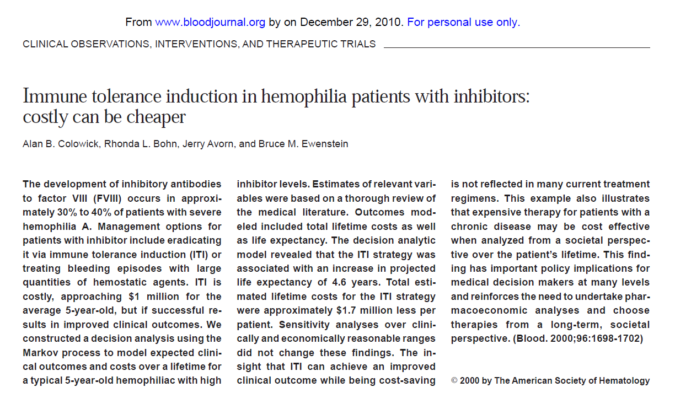

Slide 49
the hypothetical patient is a 5-year-old boy with severe hemophilia A and a high responding inhibitor of 25 BU.
The regimen used in the model is consistent with practice in North America and a recently completed multicenter, prospective trial in the United States
DiMichele DM, Kroner BL, and the ISTH Factor VIII/IX Subcommittee Members. Analysis of the North American Immune Tolerance Registry (NAITR) (1993-1997): current practice implications. Vox Sang. 1999;77(suppl 1):31-32.
DiMichele DM, Goldberg I, Kroner B, et al. Results of the first multicenter prospective trial of immune tolerance therapy (IT) in hemophilia A. Thromb Haemost. 1999; Suppl 130.
The ITI regimen in this model was defined as 100 U/kg/d of FVIII for 420 days

Slide 50
patients with inhibitors have the same annual number of bleeding episodes as do patients with severe hemophilia without inhibitors, albeit with a higher likelihood of complications:
Annual number bleeding episodes
Minor Low = 3
Average = 15
High = 27
Moderate = 3
Major = 0.2
Annual number of minor bleeding episodes in ITI arm:
Low = 0.1
Average = 0.8
High = 0.1
Excess risk annual hazard rate for mortality:
With inhibitor= × 4
Without inhibitor = × 2.5

Slide 51
The study by Harvard health economists using Markov decision analysis predicted:
immune tolerance in a 5-year-old child approached $1 million
ITI is the preferred strategy for managing patients with hemophilia A with high titer inhibitors, resulting in both $1.7 million lower costs and 4.6 years increased life expectancy when compared with the use of alternative hemostatic agents
cost savings of $1.6 million with the use of ITT rather than lifelong APCC therapy

Slide 52
Cost effectiveness analysis for Octanate® in ITI in comparison to NovoSeven ® in the treatment of haemophilia patients with inhibitors: Russian experience
N. ZOZULYA and O. PLYUSHCH, Haemophilia (2010), 16 (Suppl. 4) , 08P42
inhibitors increase 3 to 5-fold in overall HA treatment costs
12 poor prognosis patients were selected for ITI high-dose Bonn protocol (ObsITI study)
Complete ITI success rate of 78.3%
Treatment duration untill complete success: 9.5(5-18)
Decreased Median NO. of bleeding per year from 25 to 1.5

Slide 53
Mean cost of treatment (high dose ITI+prophylaxis after successful ITI) :
2.6M €/10Y
Pre ITI phase ,On Demand Treatment:
4.5 M€/10Y
Estimated saving:
1.9M €/10Y
Break-even point(BEP)[the number of years the cost of on-demand treatment with bypassing agent vs ITT& post-success prophylaxis become equal] :
3.5 Y

Slide 54
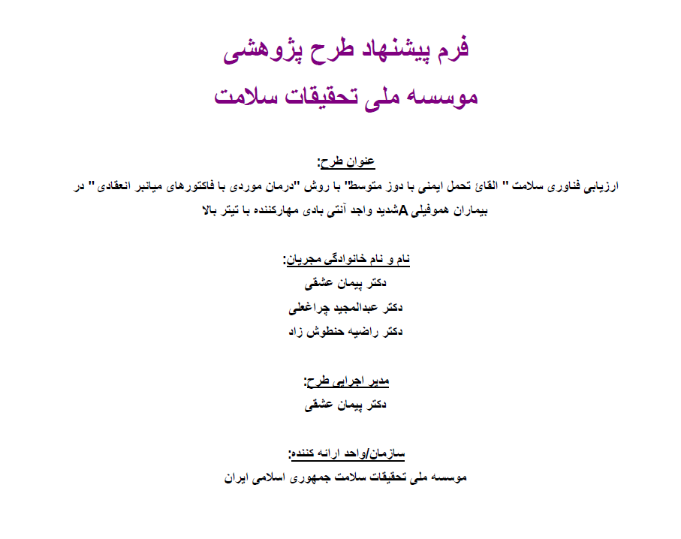

Slide 55
Efficacy, Safety and Cost of Immune Tolerance Induction in good risk children with Hemophilia A and high titer inhibitor in IRAN
Same Good risk group as IITR
Same success definition as IITR
100 U/Kg/day
Pd FVIII
Same assessment method as suggested in RESIST

Slide 57
بیمارستان مفید:
بیمارانیکه دوره درمان تکمیل شده

Slide 58
بیمارستان مفید:
بیمارانیکه دوره درمان تکمیل شده
Time to start>5Y

Slide 59
بیمارستان مفید:
بیمارانیکه دوره درمان تکمیل شده
Pre-ITI titer= 68
Time to start>5Y

Slide 60
بیمارستان مفید:
بیمارانیکه دوره درمان تکمیل شده

Slide 61
بیماران جدید
نام و نام خانوادگی Name & Family Name | وزن Weight | وضعیت مهارکنندگی قبل از درمان Inhibitory Titer Before Treatment |  |  |  | پروتکل Protocol | ABR | AJBR | مدت شروع | FVIII U/Kg Vial | FEIBA U/Kg Vial | FVII a M/Kg Vial
 |  | اولین مهادکننده | بیشترین مهارکننده |  | تیتر شروع
امیر محمد کیخسروی | 30 | 70 | 70 | 1.5 |  | A | 0 | 0 | 8 month | 24000 U/Kg 1440 Vial | 0 | 0
ماهان ریسمانچیان | 15 | 5 | 5.5 | 1.6 |  | A | 0 | 0 | 8 Month | 21800 U/Kg 654 Vial | 0 | 0
امیر علی خنیابی | 15 | 134 | 730 | 45 |  | B | 7.2(Y) در 5 ماه 3 نوبت | 2.4(Y) در 5 ماه یک نوبت | 5 Month | 37000 U/Kg 1110 Vial | 1067 U/Kg 32 Vial | 960 M/Kg 12 Vial

Slide 62
بیماران جدید

Slide 66
Q&A

