Slide 1
In The Name of GoD conditioning regimeni in peditaric
Hematopoietic Stem Cell transplantation
BIBI SHAHIN SHAMSIAN. MD

Slide 2
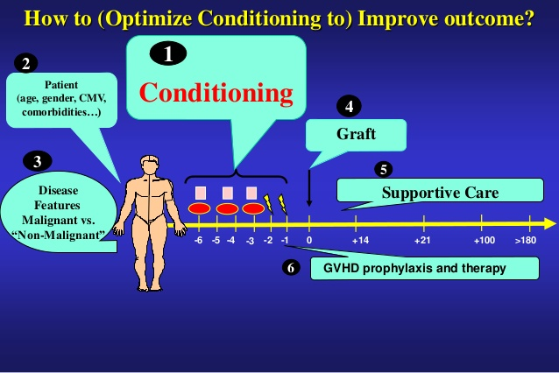
Conditioning regimens For hematopoietic cell transplantation
Boglarka Gyurkocza. BLOOD, 17 JULY 2014 x VOLUME 124,Nu3. USA
one size does not
ﬁt
all

Slide 3
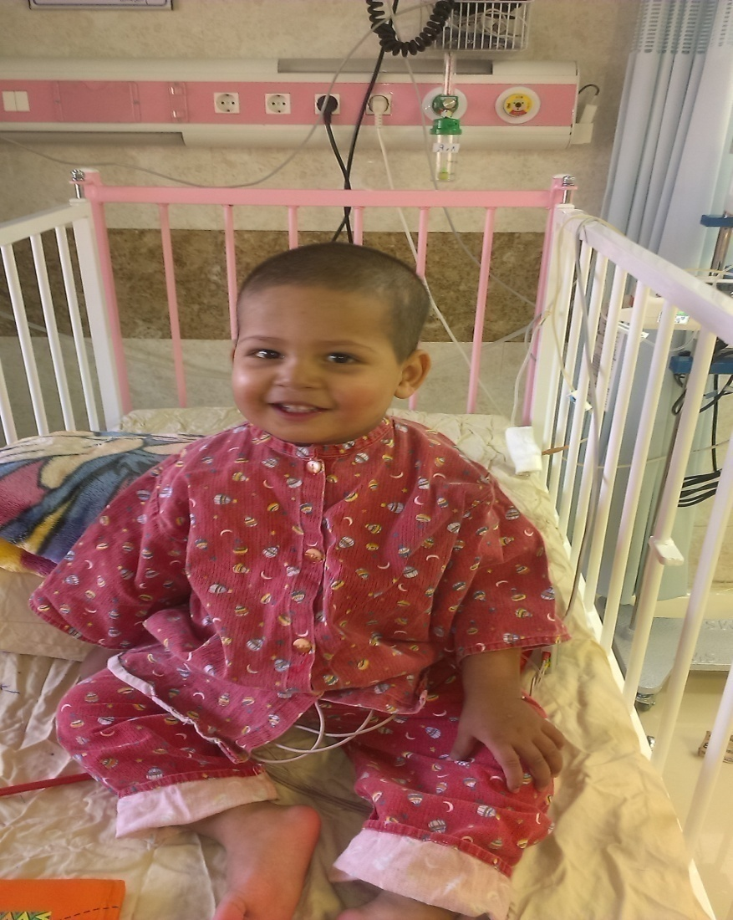
معرفی بیمار
پسر 20 ماهه
تشخیص ۶ ماهگی
تزریق خون + دسفرال
فریتین : 760
اسپلنومگالی خفیف
تقسیم بندی pesaro کلاس ۱-۲
پیوند سلولهای بنیادی الوژنیک
اهداکننده : برادر سازگار بافتی -۱۹ ساله
منبع پیوند:خون محیطی PB/
رژیم اماده سازی:بوسولفان+ سیکلوفسفامید
اولین کیمریسم 95%
آخرین کیمریسم 65٪
فریتین : 800
هموگلوبین الکتروفوز- بتا تالاسمی مینور
هموگلوبین 11
2.5 سال پس از پیوند

Slide 4

معرفی بیمار
دختر 16 ساله
تالاسمی ماژور - تزریق خون مکرر
فریتین : 4000-5000
آهن زدا : دسفراال- اسورال و L1
اسپلنومگالی+ هپاتومگالی
کلاس۳
زمان پیوند فریتین : حدود ۳۰۰۰
پیوند : خواهر سازگار بافتی- 12ساله
منبع پیوند : مغز استخوان,BM
پروتکل ۲۶: برای بیماران کمتر از ۱۷ سال پر خطر
کیمریسم: 95%
۵ماه پس از پیوند
هموگلوبین الکتروفورز: بتا تالاسمی مینور
هموگلوبین 10-11
کیمریسم: ۸۵٪

Slide 5
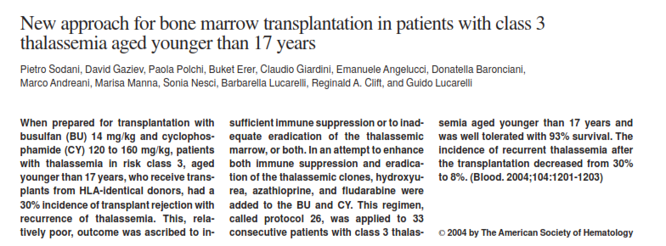
BLOOD, 15 AUGUST 2004 VOLUME 104, NUMBER 4

Slide 6
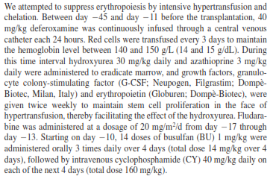
Protocol 26 Thalassemia <17y

Slide 7
HSCT
HSCT is a potentially curative therapeutic approach for a variety of Malignant and NonMalignant diseases
Malignant Disorders; Conditioning regimens as part of the procedure- to achieve 2 goals;
Sufﬁcient Immunoablation to prevent Graft Rejection & Reduce the Tumor burden.
Immunologic Reactions of donor cells against malignant host cells (ie, graft-versus-tumor [GVT] effects) : RIC Conditiong
Applicable to Older and Medically inﬁrm patients)

Slide 8
Classification of Conditiong regimen
(CIBMTR): Meeting 2006
High-dose (myeloablative); Alkylating agents (single or multiple) with or without TBI, ablate marrow hematopoiesis,not allowing autologous hematologic recovery
Reduced-intensity regimens ;Do not ﬁt the deﬁnition for Mac or non MAC,prolonged Cytopenias, and they require HSC support
Differentiation RIC regimens from MAC :Dose of alkylating agents or TBI is generally reduced by 30%
Nonmyeloablative ; Minimal Cytopenias, do not require stem cell support.

Slide 9
optimal conditioning regimen
selecting the optimal conditioning regimen for any given patient need to be considered:
Disease-related factors such as :Diagnosis and remission status
patient-related factors including Age, donor availability, and presence of comorbid conditions

Slide 10
USA.Cori M. Abikoff.2014
MAC HSCT has provided a lifesaving cure for children
MAC :lifelong morbidity associated with the use of highly toxic conditioning agents in a very young population
Risk of such complications limited the use of HSCT.
SCD and Thalassemia; Medical management ;improve survival, the risk of toxicity associated with HSCT was seen by many as a contraindication to its use
HSCT: Combined immunodeﬁciency, 80-%-90% cure rate

Slide 11
HSCT in Pediatrics USA.2012
Tolerate more intensive MAC :
children usually do not have the comorbidities typical of adults (eg, chronic hypertension, diabetes mellitus, chronic coronary ischemic disease, smoking-related illnesses)
Pedaitric centers have preferred:
Bone marrow (BM), Umbilical cord blood (CB) to PBSCs
Lack a survival advantage with PBSCs in pediatric recipients
However, Heavily pretreated children are at risk for early TRM and long-term morbidities

Slide 12
Satwani et al. / Biol Blood Marrow Transplant 19 (2013).USA
Mortality rate in Children
According to recent CIBMTR analyses:
Day + 100 Mortality rate :
5%-20% for patients with malignant and nonmalignant diseases after MAC HLA-matched sibling donor (MSD) Allo-HSCT
10%-40% after unrelated donor AllP.

Slide 13
Reduced Intensity Conditioning and Hematopoietic Stem Cell
Transplantation in Pediatric Nonmalignant Disease:
Cori M. Abikoff M.2014. .A New Therapeutic Paradigm
RIC:The ability to minimize toxicity and a bright outlook for the future of HSCT in Children with chronic NMDs
RIC
less reversible myelosuppression
Reduced regimen-related toxicity
2.6-fold decrease in GVHD
Greater incidence of mixed chimerism

Slide 14
Conditioning

Slide 15
Conditioning Regimen
High-dose conditioning regimens:
TBI-based regimens(12- to 16-Gy TBI)
High-dose chemotherapy-based regimens
Reduced intensity conditioning regimens
Radioimmunotherapy-based regimens
Anti-T cell antibody-containing regimens

Slide 16
High-dose conditioning regimens
TBI-based regimens
TBI-based regimens(12- to 16-Gy TBI):
Effectiveness against most leukemias and lymphomas
Ability to penetrate to sanctuary sites
Children : Fatal- GI ,Hepatic, Pulmonary toxicities, Secondary malignancies, & impaired Growth &Development in children.
Fractionation resulted ;
Decreased organ toxicity but also sustained antineoplastic effects
Hyperfractionation – with lung shielding, decrease interstitial pneumonitis of 4%
TBI Combination: + CPM, Vp16 ,Melphalan ,Cytozar,
Superiority:???

Slide 17
MAC regimen European practice in Pediatric
Bone Marrow Transplantation .2008.K Vettenranta,
MAC : continues to be employed in HSCT in pediatric HSCT
Fractionated TBI (fTBI) remains, with its considerable anti-leukemic potential; cornerstone of conditioning in the most ALL in its ﬁrst, second or subsequent remission , despite its well-established long term sequelae
Feasibility of Chemotherapy-only regimens :
Established & widely employed in other pediatric indications(in ALL < the age of 2 years, AML, MDS or severe Aplastic anemia)
Conditioning regimens are being modiﬁed :
pre-transplant residual disease
Aadvanced HLA typing
Haploidentical transplantations in the pediatric setting.

Slide 18
BMT.2008.TBI
All: MRD, MUD, Mismatch; 10–14 Gy, fTBI > age of 2 years.
TBI+ VP16 60mg/kg>2-3 yearsY old,TBI+ CPM
Chemotherapy-only regimens (BU/CY/ Mel)
Clinical efﬁcacy only chemo > fTBI-containing TBI in ALL and over the age of 2 years :??
< 18 mo: BU + CY backbone in combination with, for example, Mel, Thiotepa, Etoposide
AML: BU + CY backbone are mostly used and supplemented in most cases with Mel.
MDS and JMML : BU + CY +Mel & fTBI-contaning regimens
Severe Aplastic Anemia: No fTBI-containing regimens
CY with or without ATG in the Sibling donor setting
Fludarabine plus cyclo plus ATG in the unrelated setting

Slide 19
Transplantation Conditioning Regimens and Outcomes after Allo HSCT in Children and Adolescents with Acute Lymphoblastic Leukemia
.USA.2012.james Tracey
SCT outcomes in patients age <18 years with ALL ( 765 patients)
Second remmision or more
Most in remmision,HLA-matched sibling or unrelated donor.
4 group
Cy + TBI <1200cGy
Cy+Vp16+ TBI<1200
Cy + TBI > 1300cGy
Cy+Vp16+ TBI >1300
Neither TBI > 1200 cGy nor the addition of Etoposide resulted in fewer relapses.
No improves survival :by TBI > 1200 cGy nor the addition of etoposide

Slide 20
High-dose chemotherapy-based regimens
Alkylating agents remain the Mainstay of such regimens:
Favorable toxicity proﬁle (Marrow toxicity as dose-limiting toxicity)
Effect on Nondividing tumor cells
Busulfan; ( Po/IV- less liver toxicity in Iv)
profound toxic effect on nondividing marrow cells including early myeloid precursors

Slide 21
Busulphan
Questions; Busulphan - Po Vs IV, Pharmacokinetic BU ?
TBI -CY VS BU- CY???
CIBMTR: Busulfan resulted in superior survival with no increased risk of relapse or treatment-related mortality in patients with Myeloid malignancies, supporting the use of High-dose IV busulfan vs TBI

Slide 22
Impact of Conditioning Regimen on Outcomes for Children with Acute Myeloid Leukemia Undergoing Transplantation in First Complete Remission. An Analysis on Behalf of the Pediatric Disease Working Party of the European Group for Blood and Marrow Transplantation. Lucchini G. Send to
Biol Blood Marrow Transplant. 2017.
pediatric patients with AML, 3 different conditioning regimens:
Total body irradiation (TBI) and cyclophosphamide (Cy)
Busulfan (Bu) and Cy;
Bu, Cy, and melphalan (Mel)
patients > 2 and <18 years age undergoing matched all- HSCT for AML in first complete remission (CR1) in 204 European Group for Blood and Marrow Transplantation centers between 2000 - 2010
source; BM-440 MSD:458
Patients receiving Bu CyMel ; lower incidence of relapse at 5 years and higher overall survival (OS) and leukemia-free survival with a comparable non relapse mortality (NRM)
Among pediatric patients receiving HSCT for AML in CR1, the use of Bu CyMel conditioning proved superior to TBI- Cy and Bu-Cy in reducing relapse and improving LFS.

Slide 23
Allo-SCT using BU, CY and melphalan for children with AML in second CR. R Beier. Bone Marrow Transplantation (2013)
Children with AML in second CR
BU-CY, and Melphalan (Bu- Cy, Mel) /AML in second remission (CR2) between 1998 -2009.
Children Data:109/152
60 / 109 children (55%) received Bu Cy Mel.
Median age: 12.2 years
OS after 5 years was 62%

Slide 24
Radioimmuno therapy-based regimens
Duo to toxicity TBI:
Targeted Radiotherapy using radiolabeled monoclonal antibodies would be superior to external beam TBI
Successfully developed in the Auot -HSCT& Allo- HCT setting
CD20 –NHL
CD33, and CD45 leukmia & MDS

Slide 25
Anti-T cell antibody-containing regimens
In Vivo T cell Depletion : ATG & Alemtuzumab
Tcell depletion Donor & Host
Modulation of cell surface molecules mediating interactions of lymphocytes and the endothelium,
Modulation & depletion of Ag-presenting cells
Induction of regulatory T lymphocytes.
Efficasy: Several factors including the dose
its source & formulation (rabbit vs horse; thymoglobulin, ATG-Fresenius vs Atgam),
Timing of administration
Degree of HLA disparity between host and donor
Graft source (marrow vs PB )
Intensity of the conditioning regimen use
Alemtuzumab: concern infection &Relapse

Slide 26
ATG in paediatric haemopoietic stem cell transplantation
Spain.The lancet hematology.2015.Diaz, M. A
Below or above 6 mg/kg total dose timing of administration (closer to the infusion day)
cell counts present in the graft or in the recipient before conditioning.
The present study does not make firm conclusions regarding the use of ATG conditioning for allogeneic transplantation in children.
However, a useful message has emerged; individualised use of ATG
More prospective studies should be done, especially in allogeneic transplantation using donors other than HLA-identical family donors.

Slide 27
Reduced intensity & Nonmyeloablative conditioning regimens
1970s -Early1980:
ALLO HSCT: Immunologic GVT effects GVHD
& lower Relapse rates
compared with
Autologous , Syngenic
& T cell-depleted grafts
RIC:Less toxic but immunosuppressive
RIC;Older and medically inﬁrm patients

Slide 28
RIC,2014
Mixed chimerism
T Cells , CD14, NK cells , Cd34: donor T cell kimerism & Graft Rejection
MC: may be sufﬁcient to correct the phenotype of certain congenital nonmalignant disorders( HLH, Thalassemia)
Full Donor Chimerism may be necessary to exert GVT effects to control malignant diseases
Sensitivity of different Hematologic malignancies to GVT effects can vary substantially, a phenomenon not entirely understood

Slide 29
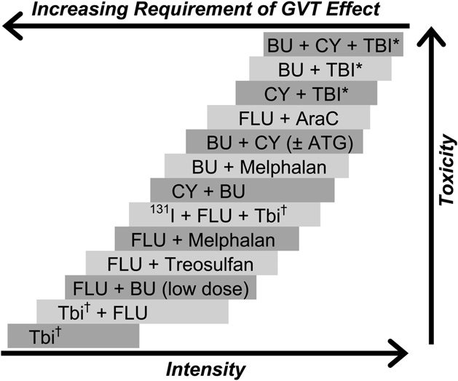
Immunosuppressive and myelosuppressive potency.

Slide 30
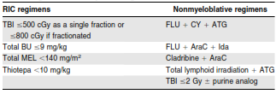
Examples of RIC and nonmyeloablative regimens .according to commonly used agents and combination.
Blood , 17 JULY 2014 x VOLUME 124, NUMBER 3

Slide 31
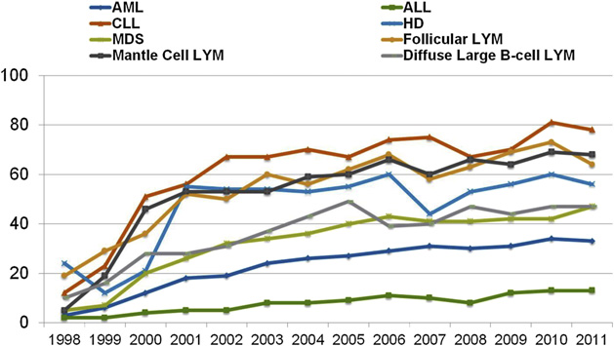
Percentage of RIC allo-HCTs, registered with CIBMTR, 1998 to 2011by year of transplant and disease,

Slide 32
purine analogs/ In RIC
MD Anderson group:
Purine analogs (Fludarabine or Cladribine) were combined with different doses of Melphalan (180, 140, and eventually 100 mg/m2
, a nucleoside analog ,immunosuppressive properties & synergizing effect with alkylators by inhibiting DNA repair.
Clofarabine Second generation a,Antileukemic activity
Purine nucleoside + Alkylating agent ; Busulfan or with TBI

Slide 33
Comparison of Transplantation with RIC & MAC for children
Japan : Blood 2105. ALL
(RIC) :pretransplant morbidity or are unable to tolerate a MAC regimen
1334 children /ALL allo SCT ,First Tansplant. 2000 -2010
1201 /MAC vs 133/RIC regimen
5-year overall survival (OS):RIC and MAC 75.2% and 73.4% at CR1
Five-year relapse-free survival rates ; 43.0% and 52.4% in RIC and MAC
Relapse ; 434 patients (54 with RIC and 380 with MAC)
TRM at 5 years were 15.7% and 15.3% with RIC and MAC, respectively
Age at diagnosis, gender of patient, disease status at SCT, stem cell source, RIC/ MAC, HLA compatibility, TBI, and cytogenetics, transplant outcomes
with RIC and MAC regimens were not signiﬁcantly different in OS
Conclusion:The results should be interpreted with caution( Low Patients in Ric and retrospective study)

Slide 34
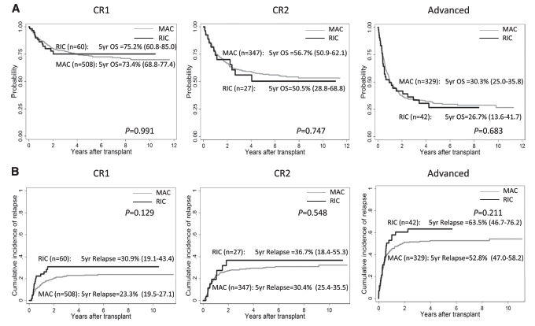
Japan . Blood .2015
OS and cumulative incidence of Relapse of children who underwent . transplantation at CR1, CR2, and advanced stages with RIC&MAC

Slide 35
Fludarabine and Exposure-Targeted Busulfan Compares Favorably with Bu-Cy in Pediatric HSCT. Maintaining Efﬁcacy with Less Toxicity.
Bartelink. 2014 .American Society for Blood and Marrow Transplantation
Bu dose toxicity : Concern
wide variability among children’s responses to Bu-based conditioning before allo-HCT
Further optimizing the pediatric conditioning regimen may be to replace the alkylating agent Cy with the nucleoside analog ﬂudarabine (Flu)
Bu and Cy use glutathione S-transferase (GST) in drug metabolism, a combination of these drugs results in GST depletion, thereby increasing the risk of toxicity
Flu does not cause GST depletion
FluBu combination may act synergistically on apoptosis of target cells
Data on the use of Flu Bu in children are limited
Horn et al. studied high-dose FluBu, but closed the study prematurely owing to a high incidence of Graft failure.

Slide 36
Fludarabine and Exposure-Targeted Busulfan Compares Favorably with Bu-Cy in Pediatric HSCT. Maintaining Efﬁcacy with Less Toxicity. I.H. Bartelink. 2014 American Society for Blood and Marrow Transplantation
2 consecutive cohorts of HCT recipients
HCT :Nonmalignant , myeloid malignancy, or lymphoid malignancy with a contraindication for TBI
2009 -2012, 64 children Protocol: Flu + Bu
50 pediatric : Bu Cy +[Mel] in myeloid malignancies ,2005 - 2008
Conclusion:Flu (160 mg/m 2)with targeted Myeloablative Bu (90 mg. h/L) is less toxic than and equally effective as Bu Cy (Mel) in patients with similar indications for Allo-HCT.

Slide 37
Results
2-y OS & EFS ; 82% and 78%, respectively, for the Flu-Bu cohort & 78% and 72%, for the Bu Cy(Mel) cohort (P = not signiﬁcant)
Relapses in patients with malignant disease was not signiﬁcantly different between the 2 cohorts (P = .361)
NRM : not differ between the 2 cohorts (P =.57)
Pattern of toxicity (lung, hepatic, and cGVHD) and more rapid Thrombocyte engraftment with Flu-Bu suggests a reduction in endothelial damage
Flu : Less VOD not dependent on hepatic glutathione stores for detoxiﬁcation.

Slide 38
Results
Future strategies may focus on the use of Flu-Bu as a conditioning platform for HCT in all diseases and for providing better disease control in malignant diseases.
Dose targeting of Bu is critical to improve outcomes of HCT
Lee et al. showed that combining Flu with untargeted Bu may result in low donor chimerism.
More recent studies suggest that optimal dosing of Flu may be essential as well, in children, 250 mg/m2 with an AUC day 0-4 of 72.5-80 mg.h/L; high incidence of toxicity

Slide 39
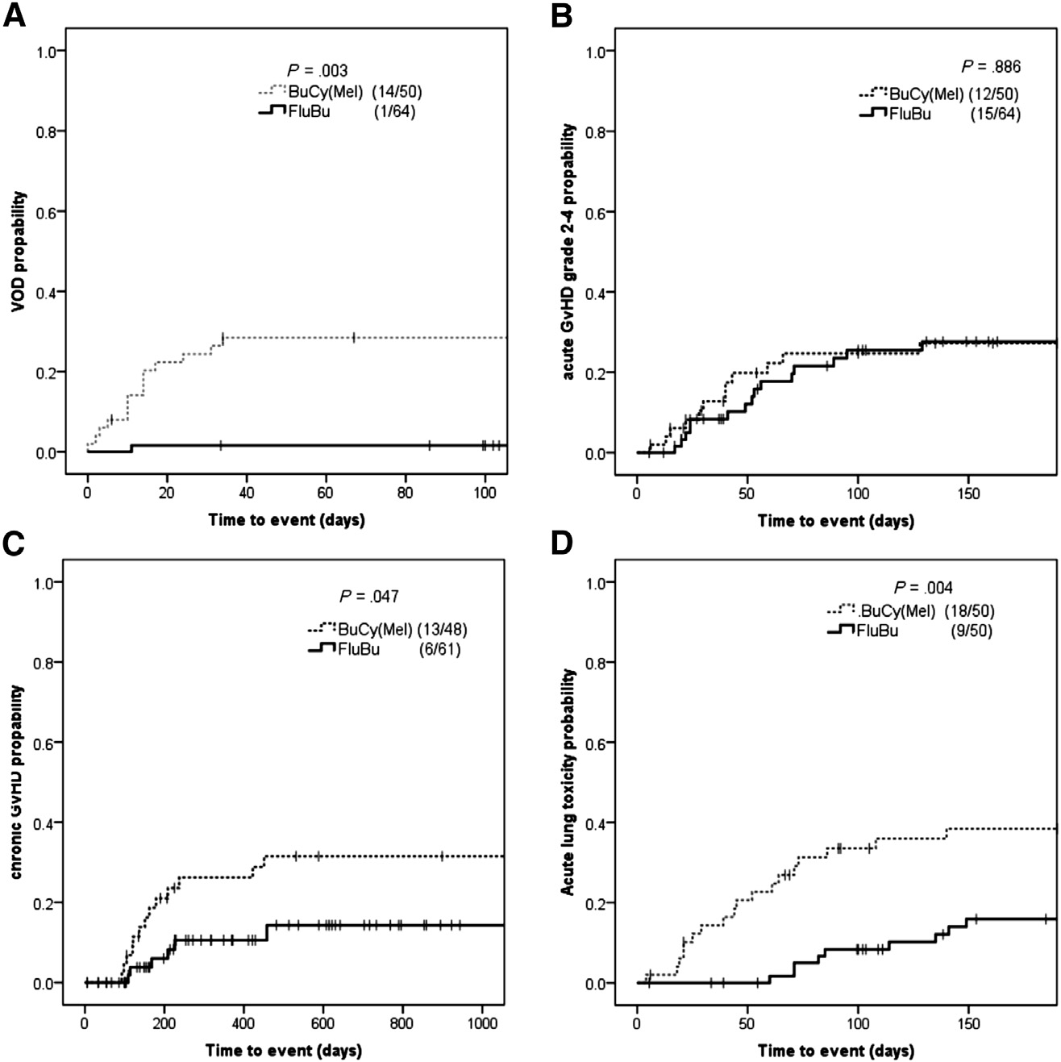
VOD (A), aGVHD (B), cGVHD (C), and IPS (D) by treatment cohort in 50 patients treated with BuCy(Mel) & and in 64 patients treated with FluBu

Slide 40
Transplantation-Related Mortality, Graft Failure, and Survival after Reduced-Toxicity Conditioning and ALLo HSCT in 100 Consecutive Pediatric Recipient.
Prakash Satwani.Usa.2012
Reduced-toxicity conditioning and allo-HSCT in 100 consecutive children and adolescent recipients (mean age, 9.2 +- 6.8 years).
50: Malignancy
Median donor Chimerism in engrafted patients was 98% on day + 100 and 98% on day +365

Slide 41
Transplantation-Related Mortality, Graft Failure, and Survival after Reduced-Toxicity Conditioning and ALLo HSCT in 100 Consecutive Pediatric Recipient. Prakash Satwani.Usa.2012
Acute (GVHD) was 20%
Chronic GVHD was 13.5%
TRM was 3% by day +100
Incidence of primary (graft failure PGF) was 16% overall,31.4% after umbilical cord blood transplantation (UCBT)
5 -year EFS : 59.5% +- 5%, and 5-year OS : 72.9%+-5%.
RIC allo-HSCT in pediatric recipients is associated with low TRM
However, chemotherapy naive UCBT recipients have a signiﬁcantly higher incidence of PGF

Slide 42
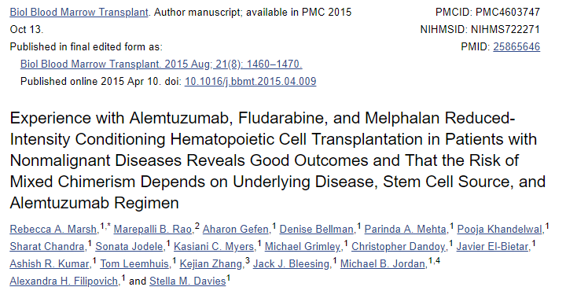
Anti Cd 52 , Alemtuzumab

Slide 43
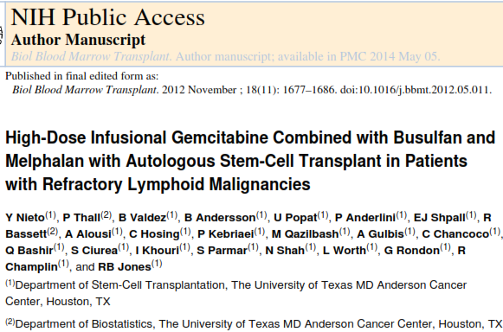
Lymphoid malignancy

Slide 44
Neuroblastoma COG protocol
CEM protocol +
Local Radiation( Day 42) +
13 Cis Retinoeic Acid( day 66) 160 mg / m2 /day every 2 weeks x 6 month
Carboplatin 425mg/M2 x 4 days+
Melphalan 70/M2 x 3days +
Etoposide 338mg/M2x4 days

Slide 45
Treosulfan for Conditioning in Children and Adolescents Before Hematopoietic Stem Cell Transplantation (HSCT) .Christina Peters.2013
Treosulfan, a water-soluble prodrug of a bifunctional alkylating agent (mucositis, diarrhea,dermatitis)
616 patients (pts) < 18 years
For Auto &Allo HSCT;2005 -2010
Malignant & Non malignant disease
Results : low toxicity proﬁle of Treosulfan, even in heavily pre-treated children and adolescents & in patients undergoing a second HSCT.
Treosulfan is highly efﬁcient to enable engraftment without increasing the risk for severe acute or chronic GVHD.

Slide 46
Conclusion
In evaluating a patient for allo- HCT, all inﬂuence the choice of conditioning regimen.
Clinical practice varies substantially among institutions.
Most regimens have been evaluated in phase 1 or 2 trials only, and randomized phase 3 trials are lacking in the ﬁeld.
Patient selection and local patterns of supportive care have a great impact on outcomes
Age alone should not be considered a contraindication to allogeneic HCT.
Diagnosis and remission status of patients
Cytoreductive therapy or post-transplant maintenance therapy

Slide 47
Conclusion
Standard regimens have not been established for the various forms of HCT

Slide 48

Thank You

