Slide 1
In the name of GOD Temozolomide
NAME:Peyman Eshghi
AFF:Prof of Pediatric Hem& Onc
SBMU
Mofid Children Hospital
DATE& PLACE: 8-7-91
………..

Slide 2
The Complete Drug Reference Martindale 36th edt
Drugs.com
Cure4kids.org
Principle &practice of pediatric 6th edition Oncology; P.Pizzo 6th edt. 2011
DRUG INTERACTIONS IN THE THERAPY OF Malignant tumors 5th updates .Baxter
MONOGRAPH

Slide 3
Temozolomide
Temozolomide is used in children primarily for the brain tumors but is also undergoing study as part of combination
Absorption of temozolomide from the GI tract is rapid and complete.

Slide 4
Chemical characteristics
A methylating agent
it is a prodrug,: its active metabolite is MTIC (same as dacarbazine)
but temozolomide does not require enzymatic activation in the liver
at physiological pH spontaneously decomposes to MTIC(Unlike dacarbazine)
insoluble in aqueous solution and is available in capsules for oral administration only

Slide 5
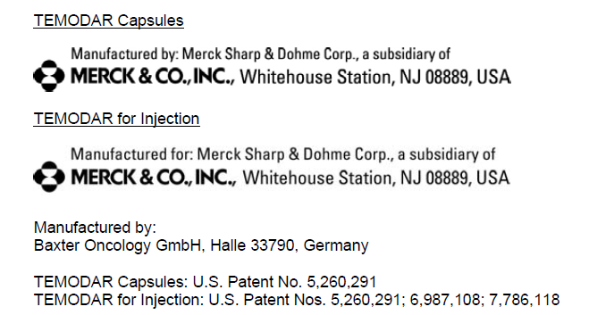
Copyright © 1999, 2008 Merck Sharp & Dohme Corp., a subsidiary of Merck & Co., Inc. All rights reserved. Revised: 05/2012

Slide 6
Mechanism of Action
Imidazotetrazine derivative prodrug;
active metabolite MTIC methylates guanine-rich areas of DNA that initiate transcription, which lead to DNA double strand breaks and apoptosis

Slide 7
Pharmacokinetics
Half-Life elimination: 1.8 hr
Peak Plasma Time: 1 hr (empty stomach); 2.25 hr (high-fat meal)
Bioavailability: 100%
LESS CLEARANCE RATE IN CHILDREN
WIDE DISTRIBUTION
PENETRATE BBB

Slide 8
Absorption of temozolomide from the gastrointestinal tract is rapid and complete
When administered with food-especially fatty ones- the bioavailability is slightly lower but remains 90% or more.
take it on empty stomach
at the same time every day in relation to a meal.

Slide 9
DOSAGE AND ADMINISTRATION
divided dosing schedules had greater antitumor effect
a single daily dose for 5 consecutive days. The recommended dose for children is 200 mg/mvday (1,000 mg/m2/course) when administered as a single agent,
A continuous daily dosing schedule is also being investigated, and a dose of 75 mg/m2/day appears to be tolerable for 6 to 7 weeks in adults.V"

Slide 10
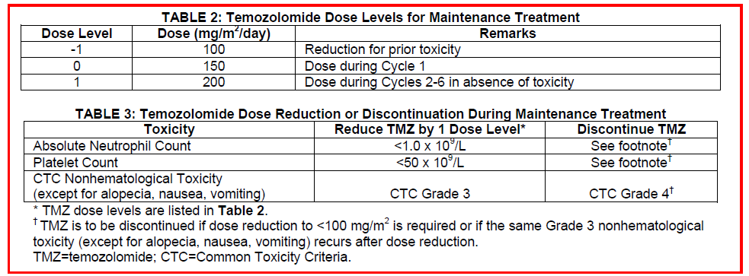

Slide 12
ADR
The most common adverse reactions (≥10% incidence) are:
alopecia, fatigue, nausea, vomiting, headache, constipation, anorexia, convulsions, rash, hemiparesis, diarrhea, asthenia, fever, dizziness, coordination abnormal, viral infection, amnesia, and insomnia.
The most common Grade 3 to 4 hematologic laboratory abnormalities (≥10% incidence) are:
lymphopenia, thrombocytopenia, neutropenia, and leukopenia.
Allergic reactions have also been reported.
Convulsions may be severe or life-threatening in people who take

Slide 13
Myelosuppression :
is the dose-limiting toxicity of ternozolomide.
delayed myelosuppression :Nadir neutrophil and platelet counts typically occur 21 days after the start of therapy, and recovery of blood counts may take 7 to 10 days
This necessitates administering temozolomide on a 28-day schedule.
Does not appear to be cumulative.

Slide 14
Nausea& Vomiting
There are no dietary restrictions
To reduce nausea and vomiting,it should be taken on an empty stomach. Bedtime administration may be advised.
Antiemetic therapy may be administered prior to and/or following administration of temozolomide
In case of vomiting, do not take any more capsules. Wait and take your next planned dose.

Slide 15
Side Effects
A case of diffuse erythematous skin rash that progressed to an extensive full body desquamative skin rash has been reported. Even though temozolomide was permanently discontinued, the patient continued to experience the rash on a long-term basis with periodic exacerbations

Slide 16
WARNINGS AND PRECAUTIONS
The TEMODAR toxicity profile in pediatric patients is similar to adults in 122 children in the COG study.
Hypersensitivity
Cases of myelodysplastic syndrome and secondary malignancies, including myeloid leukemia, have been observed.
Caution in Sever Hepatic/Renal Impairment
Pneumocystis carinii Pneumonia
Prophylaxis :
all patients receiving concomitant TEMODAR and radiotherapy for the 42-day regimen.
a longer dosing regimen.
However, all patients particularly patients receiving steroids, should be observed closely for the development of PCP regardless of the regimen.

Slide 17
If TEMODAR capsules are accidentally opened or damaged, be careful not to breathe in (inhale) the powder from the capsules or get the powder on your skin or mucous membranes (for example, in your nose or mouth

Slide 18
TEMODAR (temozolomide) Capsules should not be opened or chewed.
They should be swallowed whole with a glass of water.
If capsules are accidentally opened or damaged, precautions should be taken to avoid inhalation or contact with the skin or mucous membranes
If contact with any of these areas happens, flush the area with water
The use of gloves and safety glasses is recommended to avoid exposure in case of breakage of the vial or capsules

Slide 19
FOOD& DRUG INTERACTIONS
Valproic Acid
Administration of valproic acid decreases oral clearance of temozolomide by about 5%. The clinical implication of this effect is not known
Time to Max. level of Temozolomide increased when was given with high-fat foods

Slide 20
HOW SUPPLIED/STORAGE AND HANDLING
Store TEMODAR Capsules at 25°C (77°F); excursions permitted to 15°-30°C (59°-86°F)
Store TEMODAR for Injection refrigerated at 2°-8°C (36°-46°F).
After reconstitution, store reconstituted product at room temperature
(25°C [77°F]).
Reconstituted product must be used within 14 hours, including infusion time.

